Slide 1

Introduction to Security
Chapter 1
The Evolution of Private Security

Slide 2
Introduction - Growth of Private Security
The field of private security is a large, multi-faceted business that continues to grow every year.
It has grown well past the days of a solitary guard standing post in a guardhouse.

Slide 3
Introduction - Growth of Private Security
Other evidence of growth is the development and proliferation of college degree programs in security and related areas.
Advances in security technology and procedures offer great promise for increased growth of the security field.

Slide 4
Introduction - Growth of Private Security
All businesses, regardless of size, have security concerns:
  Fraud
  Theft
  Computer hacking
  Workplace violence

Slide 5
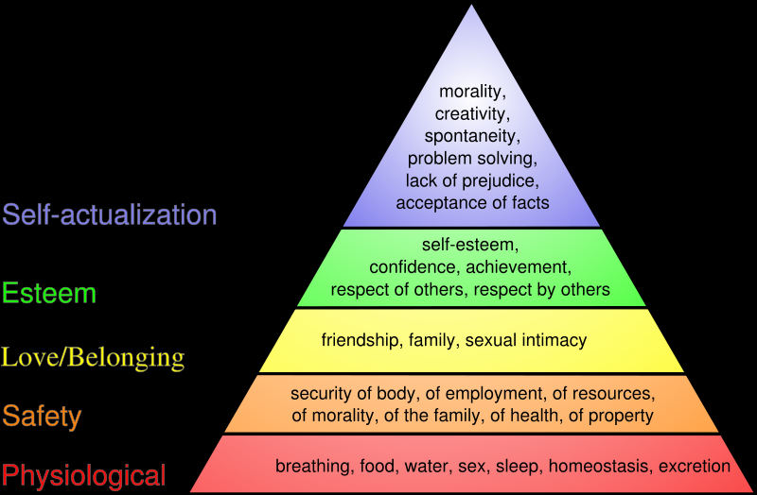
Security Defined:
One of the classic definitions of security is Maslow’s Hierarchy of Needs:

Slide 6
Influences on the Evolution of Security:
Reith’s 4 phases of security evolution:
  Individuals or small groups come together to seek collective security
  The discovery by these groups of the need for laws or rules
  The inevitable discovery that some members would not obey the rules
  The means to compel observance of the rules were found and established

Slide 7
Influences on the Evolution of Security:
Reith maintained that early civilizations failed because their quest for security had no policing mechanism to it.
Use of the army to solve these problems only made them worse.
This example highlights the need for a security enforcement group.

Slide 8
Influences on the Evolution of Security:
Physical Barriers
  Ancient barriers
    Lakes
    Caves
    The Great Wall of China
  Contemporary barriers
    U.S.- Mexico border fence

Slide 9
English Influences on Security:
Community efforts:
  Watch and Ward: town watchmen to patrol the city at night and man the gates to walled cities
  Hue & Cry: When a watchman encountered resistance from someone he was trying to arrest, he would cry out, and the citizens would come and assist him in the capture
  Assize of arms – all males 15-60 were required to keep a weapon at home as a peacekeeping measure.

Slide 10
English Influences on Security:
Issues with Community efforts:
  Merchants were dissatisfied with the service they received with this practice.
  The middle class was resisting the idea of being pressed into service.
  The idea of hiring people for security was brought into practice.

Slide 11
English Influences on Security:
Henry Fielding (1707-1754)
  Chief Magistrate of Bow Street
  One of the earliest advocates of crime prevention
  Favored reprimands instead of death
  Exercised leniency
  Advocated magistrates be paid for their work so that they did not rely on fines/fees for their income
  Created Bow Street Runners – the first detective agency in England

Slide 12
English Influences on Security:
Sir Robert Peel (1788-1850)
  His Metropolitan Police Act created the London Metropolitan Police.
  His main theme was crime prevention.
  This theme did not persist in public law enforcement, which became more concerned with reacting to crime.
  This kept alive the need for private security to prevent crime.

Slide 13
Evolution of Private Security in the U.S.
Express companies
  Formed to safely transport goods in the crime-ridden, post-Civil War U.S. West
  1853 – Wells Fargo created; operates East of the Mississippi

Slide 14
Evolution of Private Security in the U.S.
Railroad Police Acts
  Railroads typically operated beyond the reach of law enforcement officers.
  In the 1800s, states passed these acts which allowed private railroads to establish their own security forces.
  Railroad police were typically given a club and revolver and told to protect the railroad – nothing more.

Slide 15
Evolution of Private Security in the U.S.
Allan Pinkerton (1819-1884)
  Born in Scotland, he immigrated to the Chicago, Illinois area where he became a barrel maker.
  After turning in some counterfeiters he found, he became the first deputy sheriff of Cook County, Illinois.
  Formed the Pinkerton National Detective Agency and adopted the slogan “We Never Sleep.”
  Also performed intelligence work for the Union army during the Civil War.
  Became a public company in 1965 and became Pinkertons, Inc.

Slide 16
Evolution of Private Security in the U.S.
1853 – August Pope patents the first electric burglar alarm system
1858 – Edwin Holmes establishes the first central burglar alarm system in the country
1858 – Washington Perry Brinks founds Brinks, Inc. in Chicago as a freight service. It has transformed into an armored car and courier service.

Slide 17
World Wars I & II and Private Security
Both wars had very powerful effects on the growth of private security.
Although private security tapered off after WWI, it was renewed with WWII and has grown ever since.
Security forces concerned with:
  Espionage
  Sabotage
  General factory security as the country was at war
  http://www.asisonline.org

Slide 18
ASIS
American Society for Industrial Security
Incorporated in January 1955
257 original charter members, there are currently about 35,000 worldwide members.
Drafted the ASIS Code of Ethics, which provides baseline ethical standards for the industry to follow.

Slide 19
Types of Private Security
Corporate security
Cyber security
Executive protection
Healthcare security
Loss prevention
Private security management
Risk assessment
Strategic intelligence
Terrorism
Workplace violence

Slide 20
Security Positions
Entry Level Positions
  Private security guards
  Private patrol officers

Slide 21
Security Positions
Mid-Level Positions
  Private investigators and detectives
  Armed couriers
  Central alarm respondents
  Consultants

Slide 22
Security Positions
Top-Level Positions
  Loss prevention specialists
  Security directors
  Risk managers
  Chief security officers

Slide 23
Proprietary vs. Contract
Proprietary
  In-house
  Hired, paid and controlled by the company
Contract
  Outside firms or individuals providing services for a fee

Slide 24
Proprietary vs. Contract
Proprietary
  More knowledgeable about the company
  More accepting of training the company wants
  More courteous to, and better able to recognize, VIPs
  Status symbol
  May be more expensive
Contract
  May be more cost effective
  Lowered liability
  More flexibility to cover staffing needs
  No hiring/firing issues
  Less control over employees
  Service disruption
  Brand or reputation damage
  Less continuity among staff

Slide 25
Hybrid Services
  Hybrids are simply a combination of proprietary and contract.
  Generally, proprietary employees act as management and use contract employees as line officers.

Slide 26
Security Compensation
Average compensation for security professionals rose to $117,000 in 2007.
Median increase for all security professionals rose 6%

Slide 27
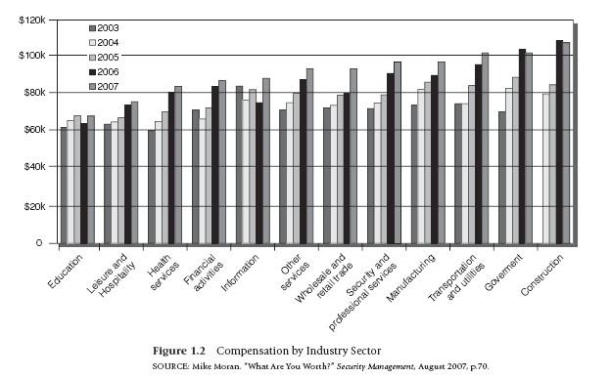

Slide 29
Regulation of Private Security
Many cities and most states have some degree of government regulation for private investigation agencies.
However, there is little regulation of individual employees in those agencies.

Slide 30
Minnesota private investigator requirements:
A $5000 surety bond
Verified certificates from no less than five citizens who have known the applicant for more than five years, and who can attest to the applicant’s good character.
2 photographs and a full set of fingerprints.

Slide 31
General private investigator requirements:
State residency
U.S. Citizenship
Training/work experience as a police officer or investigator
Clean arrest records
Pass a background investigation
Oral/written exams

