Slide 1
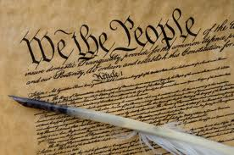
Constitutional Law in Schools

Slide 2
Terminal Objective
Upon completion of this module, the participant will be able to identify and understand the sections of the United States Constitution that would be most applicable in a school environment.

Slide 3
Enabling Objectives
Explain the federal government’s role in Texas schools.
Understand the Supreme Court’s decision in Tinker v. Des Moines Ind. Comm. Sch. Dist.
Explain the meaning of in loco parentis
Explain the Constitutional restrictions on corporal punishment
Understand and explain procedural due process as it relates to expulsion and suspension of a student
Understand and explain the rights and restrictions placed on a student’s rights of free speech
Understand and explain the rights and restrictions applied to religion in schools

Slide 4
The United States Constitution
The US Constitution does not specifically mention education.
The Tenth Amendment says that the federal government is limited by the powers specifically granted in the Constitution.
Each State, County, City, School District can make it’s own rules, laws as long as they are restrictive and not in conflict with the Federal Law.
So, who has control over education?
Notes:
10th Amendment:
The powers not delegated to the United States by the Constitution, nor prohibited by it to the States, are reserved to the States respectively, or to the people.

Slide 5
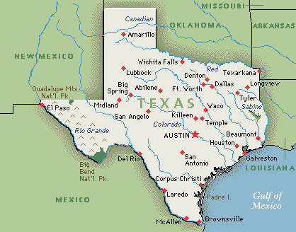
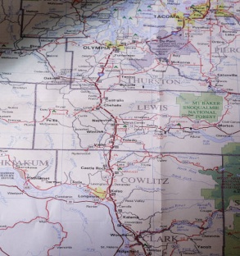

County
CITY
Federal Government makes its laws, state can make their own, counties can make their own, cities can make their own, and school districts can make their own, REMEMBER, each level down the ladder MUST make the laws, rules, MORE Restrictive than the level above them.
(Example – US says you can burn the flag, Texas has laws that say no. Cities have laws on dogs running loose, State of Texas does not govern that……etc. on down the line – eventually you get to school uniforms etc.)
School District

Slide 6
The Commerce Clause
Article I, Sec. 8, Clause 3 of U.S.C.
The Commerce Clause is the method by which the federal government retains some control over areas not specifically granted to it in the Constitution. Article I, Section 8, Clause 3 of the United States Constitution.
It states that the US Congress has the power “to regulate Commerce with foreign Nations, and among the several States, and with the Indian Tribes.”
Notes:
The Commerce Clause is found in Article I, Section 8, Clause 3 of the US Constitution.
This clause is bolstered by the Necessary and Proper Clause, which states that this power may be implemented by Congress’ power “to make all laws which shall be necessary and proper for carrying into Execution the foregoing Powers, and all other Powers vested by this Constitution in the Government of the United States, or in any Department or Officer thereof."

Slide 7

Commerce Clause Example
Congress often ties federal education funding to the implementation of certain federal programs.
For example, a state cannot receive funding under programs administered by the U.S. Department of Education unless they comply with FERPA. 20 U.S.C. Section 1232g
AND other parts of Federal Law
Notes:
A few laws affecting public education:
FERPA – 20 U.S.C. Sect. 1232g
Age Discrimination in Employment Act – 29 U.S.C. Sect. 621
Equal Access Act – 20 U.S.C. Sect. 4071
Individuals with Disabilities Education Act (IDEA) – 20 U.S.C. Sect. 1400
Sect. 504 of the Rehabilitation Act of 1973 – 29 U.S.C. Sect. 794
Title VII of the Civil Rights Act of 1964 – 42 U.S.C. Sect 2000
Title IX of the Educational Amendments of 1972 – 42 U.S.C. Sect 1681

Slide 8
US Constitution in Schools
For the most part, the individual states have power over their education system.
However, schools still must operate within the Constitution with regards to specifically enumerated civil rights and liberties.
Bill of Rights
Notes:
Life – not to be killed, injured, or abused.
Liberty – to move freely, assemble peaceably, keep and bear arms, assemble a militia, communicate with the world, express opinions, practice one’s religion, secure in person/house/papers/vehicles against unreasonable search & seizure, privacy
Private Property
Equal protection
To petition an official for redress of grievances
To petition a court for redress of greivances
To not have one’s rights disabled without due process of law

Slide 9
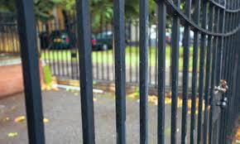
Tinker v. Des Moines Independent Community School District
In 1969, the Supreme Court held that “it can hardly be argued that either students or teachers shed their constitutional rights…at the schoolhouse gate.”

Slide 10
Restrictions on Rights of Students
The rights of students can be restricted in significant ways based on two principles:
  In loco parentis – in place of the parents
  The school’s important role to educate
The Supreme Court often uses a balancing test in which it balances the interest of the student against the interest of teachers and administrators to maintain order in schools.
Notes:
in loco parentis- When a minor student is in a school's custody, that school can and should assume a parental-type role and take on certain decision-making responsibilities for the child.
For balancing test, See New Jersey v. T.L.O.
Held that “the warrant requirement…is unsuited to the school environment.” Weighs the privacy interests of students against the “substantial need of teachers and administrators…to maintain order in schools…”

Slide 11
Corporal punishment

Slide 12
Corporal Punishment
The United States Supreme Court has recognized that a student’s liberty interests are implicated when corporal punishment is imposed by educated. However, there is not a great deal of due process to which a student is entitled before corporal punishment is used.
Notes:
The Supreme Court has held that because of the “openness of schools” and the availability of common-law safeguards, the risk that corporal punishment would violate a student’s substantive rights is minimal.

Slide 13
Corporal Punishment
In Texas, an educator entrusted with the care, supervision, or administration of a student may use force, but not deadly force, against the student for the “special purpose” of controlling, training, or educating the student.
The use of force is justified only when and to the extent that the educator reasonably believes the force is “necessary to further the special purpose or to maintain discipline in a group.”

Slide 14
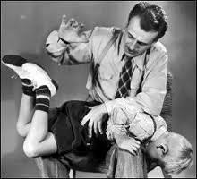
Corporal Punishment
Educators may be subject to both civil and criminal liability for the unreasonable use of corporal punishment. In addition, Texas statutes prohibiting assault and injury to a child also provide protection against excessive use of corporal punishment.
Notes:
Under the Education Code, a professional employee of a school district is not personally liable for discretionary acts incident to or within the scope of the duties of the employee’s position, “except in circumstances in which a professional employee uses excessive force in the discipline of students or [commits] negligence resulting in bodily injury to students.”

Slide 15
What is Reasonable?
In determining whether the use of corporal punishment is reasonable, courts look at the entirety of the circumstances of a particular case, including:
  The seriousness of the student’s infraction
  The attitude and past behavior of the child
  The nature and severity of punishment
  The age and strength of the child
  The availability of less severe but equally effective means of discipline
  Ingraham v. Wright, 430 U.S. 651 (1977)
Notes:
See Ingraham v. Wright, 430 U.S. 651 (1977) - holding that the constitutional due process clause does not require notice and hearing prior to imposing corporal punishment in public school

Slide 16
Procedural Due Process:
Suspension
The United States Supreme Court has held that students must be afforded procedural due process before being suspended, even if the suspension is for a short period of time. ( U.S. Constitution – 14th Amendment July 9, 1868)

Slide 17
Procedural Due Process:
Suspension
A student who is facing short-term suspension has a constitutional right to:
  Oral or written notice of the nature of the infraction and the punishment for the infraction;
  An explanation of the evidence the authorities have if the student denies the charges; and
  An opportunity to refute the charges before an objective decision maker
  Gross v. Lopez, 419 U.S. 565 (1975)
Notes:
See:
Goss v. Lopez, 419 U.S. 565 (1975) – holding that a public school must conduct a hearing before a student can be suspended

Slide 18
Procedural Due Process:
Removal to a DAEP
Notice in the Student Code of Conduct – must set out standards of student behavior and specify which violations could result in DAEP placement
Conference regarding a student’s removal – no later than the third class day after a student is removed from class
Reasonable notice of the conference is given to all parties
Length of removal to a DAEP – there is no absolute limit, but there are some guidelines
Notes:
If a student’s placement in a DAEP is to extend beyond 60 days or the end of the next grading period, whichever is earlier, the student’s parent or guardian is entitled to notice of and an opportunity to participate in a hearing before the school board. Any decision of the board is final and may not be appealed.
Before a student may be places in a DAEP that extends beyond the end of the school year, the board must determine that:
The student’s presence in the regular classroom program or at the regular campus presents danger of physical harm to the student or another individual; or
The student has engaged in serious or persistent misbehavior that violates the district’s code of conduct
The board is mandated to set a term for a student’s placement in a DAEP. If the period is inconsistent with the guidelines in the Student Code of Conduct, the order must give notice of the inconsistency. The period may not exceed one year unless, after review, the district determines that:
The student is a threat to the safety of other students or district employees; or
Extended placement is in the best interest of the student
In either case, a student placed in a DAEP must be provided with a review of his or her status at intervals of 120 days or less by the board.

Slide 19

Free Speech

Slide 20

Free Speech in Schools
In Tinker, the Supreme Court held that students could wear black armbands in a public high school in protest against the Vietnam War because administrators could not show that the symbolic speech substantially disrupted educational activities.
The Tinker children wearing their armbands, with their mother
Notes:
The court held that this symbolic speech could be prohibited only if administrators could show it would cause a substantial disruption of the school’s educational mission.

Slide 21
Exceptions to Tinker
In subsequent cases, the Supreme Court has carved out three exceptions to Tinker:
  Sexually explicit or lewd speech -
  Bethel Sch. Dist. No. 403 v. Fraser, 478 U.S.
  675 (1986)
  School-sponsored speech –
  Hazelwood v. Kuhlmeier, 484 U.S. 260 (1988)
  Speech promoting illegal drug use –
  Morse v. Frederick, 551 U.S. 393 (2007)
Notes:
Tinker and cases that followed established that students can express their opinions, so long as the student doesn’t “materially and substantially” disrupt classes or school activities. A student can also be prevented from using vulgar, indecent, inappropriate or harmful words. However, student speech may not be censored if the censorship is intended to silence a particular viewpoint with which the school disagrees.
For sexually explicit or lewd speech, see Bethel Sch. Dist. No. 403 v. Fraser, 478 U.S. 675 (1986), upholding suspension of a boy who made a speech full of sexual double entendres at a school assembly. Speech: "I know a man who is firm - he's firm in his pants, he's firm in his shirt, his character is firm - but most [of] all, his belief in you the students of Bethel, is firm. Jeff Kuhlman is a man who takes his point and pounds it in. If necessary, he'll take an issue and nail it to the wall. He doesn't attack things in spurts - he drives hard, pushing and pushing until finally - he succeeds. Jeff is a man who will go to the very end - even the climax, for each and every one of you. So please vote for Jeff Kuhlman, as he'll never come between us and the best our school can be. He is firm enough to give it everything."
For school-sponsored speech, see Hazelwood v. Kuhlmeier, 484 U.S. 260 (1988) – holding that public school officials may impose some limits on what appears in school-sponsored newspapers and publications. If the speech conflicts with a school’s “legitimate pedagogical goals,” the school can restrict it. A school sponsored paper is not a public forum. This would be different if the paper was a private student paper. Speech: Paper proof contained stories about teenage pregnancy and divorce, using some pseudonyms and some real names.
For speech promoting illegal drug use, See Morse v. Frederick, 551 U.S. 393 (2007) - holding that the First Amendment does not prevent school administrators/educators from suppressing student speech at a school-sponsored event if the speech is reasonably viewed as promoting illegal drug use. Speech: “BONG HiTS 4 JESUS” banner.

Slide 22
Free Speech & Dress Codes
The Supreme Court hasn’t touched this. However, the Fifth Circuit Court of Appeals (which has jurisdiction over Texas) has created a fourth exception:
  Student speech may be restricted through content-neutral regulations – regulations not directed at censoring the expressive content of student clothing.
  Examples: mandatory uniform policies or dress codes
  Canady v. Bossier Parish School Board, 240 F.3d 437 (5th Cir. 2001)
Notes:
See Canady v. Bossier Parish School Board, 240 F.3d 437 (5th Cir. 2001)

Slide 23
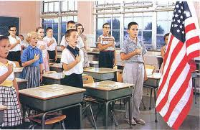
Free Speech &
Pledge of Allegiance
Texas Code Annotated 25.082
Under state law, each school in Texas requires students to recite the Pledge of Allegiance to the U.S. and state flag once a day.
Students can be excused from recitation upon written request of a parent or guardian.
Notes:
See Texas Code Ann. § 25.082
See West Virginia State Board of Education v. Barnette – holding that public school students are not required to say the pledge, saying that the “compulsory unification of opinion” violated the First Amendment.

Slide 24
The First Amendment
It’s about FREEDOM !
Religion in Schools

Slide 25
Religion in Schools
  Establishment Clause – Congress can make no law respecting the establishment of a religion.
  Free Exercise Clause – Congress can make no law prohibiting the free exercise of religion.
  Free Speech Clause – Congress can make no law abridging the freedom of speech
So what does this mean for religion in schools?

Slide 26
Religion in Schools
The Supreme Court has repeatedly held that “there is a crucial difference between government speech endorsing religion, which the Establishment Clause forbids, and private speech endorsing religion, which the Free Speech and Free Exercise Clauses protect.”
Santa Fe Ind. Sch. Dist. v. Doe, 530 U.S. 290, 302 (2000)
Notes:
See Santa Fe Ind. Sch. Dist. v. Doe, 530 U.S. 290, 302 (2000)

Slide 27
What is Prohibited?
Teachers and other school officials may not lead their class in prayer, devotional readings from the Bible, or other religious activities.
School officials may not attempt to persuade or compel students to participate in prayer or other religious activities.
School officials may not decide that prayer should be included in school-sponsored events

Slide 28
What is Allowed?
Not all religious speech that takes place in public schools is governmental speech.
  Students may pray, study religious materials, or discuss religion with other students when not engaged in school activities or instruction
  Students may organize prayer groups, religious clubs, or “see you at the pole” gatherings and must be given equal access to facilities for assembling as other groups
  Moments of silence are allowed, so long as the school does not encourage or discourage students from praying during them

Slide 29
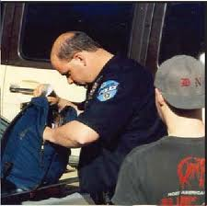
Search and seizure
Coming up next…

Slide 30
References
Constitution of the United States and Selected Amendments
Tinker v. Des Moines Independent Community School District et al., 393 U.S. 503 (1969)
New Jersey v. T.L.O, 469 U.S. 325 (1985)
Texas Education Code
Ingraham v. Wright, 430 U.S. 651 (1977)
School Crime and Discipline Handbook 2010, Office of the Attorney General of Texas
Goss v. Lopez, 419 U.S. 565 (1975)
Bethel Sch. Dist. No. 403 v. Fraser, 478 U.S. 675 (1986)
Hazelwood v. Kuhlmeier, 484 U.S. 260 (1988)
Morse v. Frederick, 551 U.S. 393 (2007)
Canady v. Bossier Parish School Board, 240 F.3d 437 (5th Cir. 2001)
Santa Fe Ind. Sch. Dist. v. Doe, 530 U.S. 290, 302 (2000)
Guidance on Constitutionally Protected Prayer in Public Elementary and Secondary Schools, U.S. Department of Education, February 7, 2003
Presentation created by: Janice Hardaway
© 2012 Institute for Criminal Justice Studies - Texas School Safety Center

