Slide 1
 | San Antonio Police February 3, 2015
(U//LES) Law Enforcement Sensitive
Thank you for being here.
Please be sure to sign in.

Slide 2
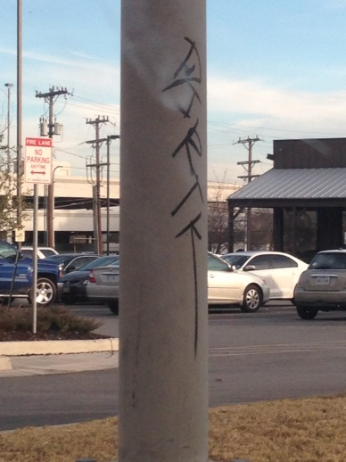
Central
Central Patrol recently reported in their area a small tagging group calling themselves DEA (Dead End Army) and a group called DIRT.
DEA is mentioned in briefly in December as possibly associating with DATK or Party Boys. DEA members appear to be a group of young teenager taggers living on dead end streets particularly around the railroad tracks. It is believed the leader is VELASCO, Luis Carlos aka/Sillboy DOB: 12/29/93, (1314 Thorain) and some of his followers: CASTILLO, Jesse DOB: 11/04/94, (615 Rosehill ) who was documented as DATK in May 2014, TALLEY, Quayshaun, DOB: 05-15-95, (1527 W Sunshine) was is inactive as RTG in 2012 and CONTRERAS, Ruben DOB: 07/21/92. Colors: Possibly black
Dirt Members: Reynosa, Gabriel Anthony 04-22-96 222 Adrian tx id#35568224 alias PYRO
Lara, Victor Agusto Jr. 09-01-96, Aka/TORE; VIC, 807 Probandt ss#632541216 vehicle LP#FBR9589 documented by Bexar County as Bloods- Los Angeles Heights and Hernandez, Richard 10-09-98 1207 W. Wildwood ss#630648933 alias RICHIE documented by Bexar County as Bloods- KILLA MOTHAFUKAS WHEREVER (KMW). All were documented by SAPD in December 2014 as DIRT members. Colors are red and black and know to shoot in 2250’s and hang out in 2260. (SAPD14279919).
**ANYONE HAVE ANY ENCOUNTERS, KNOWLEDGE, OR INSIGHT ON THESE INDIVIDUALS/GROUPS?
Photo on left taken Jan 24, 2015 by Intern Travis at EB410 before Jones Maltsburger Intersection.
Photo taken by Travis on Jan 24th from a Social Media site used by a DATK tagger. The location is unknown.

Slide 3
Offense: Shooting Date: 01/30/2015 Time: 1748
Case #: SAPD15022123 Address: IH 35 S NB / Dolorosa District: 2120
Suspect: Unknown Suspect Vehicle: Red Ford Explorer, first 2 of TXLP are DL.
Victim: CERDA, Edgar, W/M, DOB: 04/06/1989, 206 W Ansley Blvd (Dist: 6150)
Synopsis: CERDA was driving NB on the highway, when his vehicle window was shot, and shattered as a result. CERDA did not see anyone shoot at his vehicle. CERDA did see a vehicle drive by him at a high rate of speed, weaving in and out of traffic. CERDA managed to get the first 2 letters of the TXLP, which were DL. The area was searched, but no suspects or suspect vehicles were found. CERDA had been grazed by a bullet that came through the driver’s side window. CERDA was taken to UH in stable condition.
Intel Note: Records show CERDA, EDGAR ANASTICIO, DOB:04/06/88 as an Inactive Chicanos Taking Over. Research produced a possible suspect and suspect vehicle. All information was forwarded to the handling officer. POC: Assignment Pending.
Offense: Aggravated Assault-DW | Date: 01/29/2015 | Time: 1801
Case #: SAPD15021282 | Address: Santiago and Hamilton | District: 2350
Suspect: FONTENOT, Matthew B/M 03/26/1994, 7527 Parr
Victim: CHAVEZ, Juan W/M 07/14/1980 SID: 691891
Synopsis: Multiple 911 calls were received from the location for a large fight. According to witnesses, an altercation between FONTENOT and CHAVEZ started for an unknown reason. FONTENOT took a knife and stabbed CHAVEZ in the chest. CHAVEZ then took the knife from FONTENOT and stabbed him in the abdomen and arm. Both males were transported via EMS with serious injuries.
Intel Note: CHAVEZ has been documented as part of a tagging crew called “NOK”, No Other Kind, but has been inactive since 2002. FONTENOT is documented as “GRAPE ST WATTS” as of 2013.. POC: Det G Silva #2473
Offense: Firearms and Narcotics | Date: 01/29/2015 | Time:
Case #: SAPD15024181 | Address: 300 block of Huerta | District: 2340
Suspect:
Synopsis: AP was arrested after a search resulted in officers locating heroin, cocaine and a firearm at his residence.
Intel Note: AP is a documented Mexican Mafia member.

Slide 4
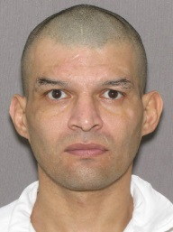
Offense: Deadly Conduct - Firearm Date: 01/24/2015 Time:
Case #: SAPD15016881 Address: 333 N Santa Rosa District: 2120
Suspects 1-3: Unknown white males, 19-26 y/o Suspect Vehicle: Black Mitsubishi 4d Other: VASQUEZ, Nathan HM 18-19 Victim1: LOZANO, Edson HM DOB: 09/17/95, 308 Rounds St Victim2: VALDEZ, Samantha HF DOB: 05/23/96 1022 Rivas St
Synopsis: Officers responded to a shooting call at the hospital at the listed address. LOZANO & VALDEZ were contacted and explained they had spent the evening with an old friend, VASQUEZ. During the evening, they noticed VASQUEZ was asking a lot of questions and mentioned he was staying with some guys who own guns. VASQUEZ asked LOZANO & VALDEZ to drop him off at the corner of Delgado and Calaveras. After dropping VASQUEZ off, the LOZANO & VALDEZ went to their home nearby. They were sitting in VALDEZ’s car when they noticed the suspect vehicle pass by slowly several times then ultimately stopped near them asking for directions to "Delgado St." At the same time, one of the suspects got out of the back of the vehicle and approached LOZANO & VALDEZ with a shotgun. When he pointed the shotgun through the passenger window., LOZANO grabbed the barrel of the gun and told VALDEZ to drive away. As she did, the barrel of the gun broke the passenger window of the car. LOZANO received cuts on his left hand and right pinky finger from the glass. The suspects fled the location in their vehicle. POC: Det R Neaves # 2173
Intell: No gang affiliation was found for VASQUEZ.
Offense: Aggravated Assault w/ Deadly Weapon Date: 01/03/2015 Time: 1721
Case #:: SAPD15001839 Address: 114 Bowdoin St District: 2360
Arrested: GARZA Fernando L/M DOB: 01/17/1972 SID: 507068
Victim: RAMOS, Lisendro L/M DOB: 09/17/1988
Synopsis: During an altercation between GARZA and RAMOS, GARZA brandished a knife and stabbed RAMOS in the arm. GARZA fled the location on a bike. A short time later Officers located GARZA and took him into custody without incident. RAMOS was transported to University Hospital with non-life threatening injuries. Investigation continues. POC: Det J. Rivera #2232
Intel Note: GARZA is documented by TDCJ as Suspected Mexican Mafia and in December completed his (Garza) probationary period. No gang affiliation was noted for RAMOS. Further researched showed that on 06/05/14, GARZA was the victim in a cutting in which he was involved in an altercation with Espinoza, Jose L/M DOB: 02/14/81 a confirmed Mexican Mafia member currently incarcerated in TDCJ. Espinoza told Officers at the time that GARZA had claimed to be EME and called out Espinoza because he used to claim EME in prison. Espinoza further stated that after he got out of prison, he no longer claimed EME, and this angered GARZA . Espinoza admitted that during the altercation, he stabbed GARZA . In that case, GARZA fled prior to the arrival of Officers and was never contacted. Officers wrote the information report and booked Espinoza for Public Intoxication. (SAPD14122317)

Slide 5
North
Offense: Shooting Date: 12/20/2014 Time: 0217
Case #: SAPD14280788 Address: 19178 Blanco Rd District: 3170
Suspect Vehicles: White Honda Civic and a black Dodge Charger Victim: RODRIGUEZ, Ricky Martin DOB: 02/11/1992 SID# 1005612, 330 Cheryl #1102 (Dist: 5220)
Synopsis: RODRIGUEZ was involved in a disturbance at Martini Night Club with 2 unknown males who ultimately shot at RODRIGUEZ striking him once in the abdomen. The suspects then fled the location in an unknown direction in the vehicles described above. RODRIGUEZ was uncooperative, refusing to give any information on the suspects. The security guards reported hearing individuals in the parking lot arguing prior to shots being fired. The suspects were not located. The investigation was closed due to lack of cooperation from RODRIGUEZ. POC: Det J Marfin #2078
Intel Note: No gang affiliation was noted on RODRIGUEZ.

Slide 6
East
East is extremely active with gang related activity from selling of narcotics to deadly conducts and homicides. The Crips and the Bloods are currently at odds, specifically the Crockett Blocc Crips and Wheatley Court Gangsters (Bloods). However, other gang members from other subsets, for example, Denver Heights, have fallen victim to the violence as well. In incidents like this, retaliation is a concern. Pop and Gang units are canvassing the area, documenting gang members and working with the homicide division to apprehend the shooter(s).
Offense: Homicide | Date: 01/19/2015 | Time: 2223
Case #: SAPD15013681 | Address: 1000 Gibbs | District: 4120
Suspect: 4 Black males possibly with “Crock blocc gang” Suspect Vehicle 1: Silver small SUV Suspect Vehicle 2: White 4 Dr sedan
Deceased 1: PRICE, Vontay B/M 11/02/92, DOA (was inactive file as Wheatley Court Gangster-Blood set) Deceased 2: WILLRICH, Royal B/M 08/08/84, Denver Heights Five other victims sustained non-life threatening injuries.
Synopsis: Several individuals were at the Zip –In car wash when three suspects approached the group and began shooting at the PRICE & WILLRICH who were standing near a vehicle. It appeared PRICE & WILLRICH were specifically targeted by the suspects. As PRICE & WILLRICH collapsed , the suspects walked over and continued to shoot them. The suspects then walked away from the location. When officers arrived , they confirmed 2 DOAs at the scene. Several other victims hit by gunfire had been transported to area hospitals by unknown means.
Intel Note: “Crocket Blocc” gang members are suspected of this shooting but the motive remains unknown. In 2010, at the age of 17, PRICE was arrested for the murder of Deante Walker, 23 at the Marigold Apartments, 2300 Goliad Rd near Pecan Valley Dr. Walker was found lying on his back in the parking lot with almost a dozen shell casings around his body. Deante was documented as an ETG Crip (PJPS). The case was dismissed. Vontay was arrested more recently in a stolen vehicle. Homicide, working closely with Gang and Pop, is actively working this case . POC: Det M Ramos #5399

Slide 7
Offense: Cutting | Date: 01/16/2015 | Time: 2017
Case #: SAPD15011394 | Address: 535 Gembler #127 | District: 4160
Suspect: B/M, 60-67 yoa, 6’04”/170, grey beard, walks with a limp, street name of “Stickman”
Victim: STRONG, Larry B/M DOB: 12/02/1951
Synopsis: STRONG stated he and “Stickman” were involved in an argument that escalated into a cutting at a Preston St and S New Braunfels. “Stickman” cut STRONG with a knife on the right hand, then fled the location. Police were called to STRONG’s home address where he made a police report but refused medical treatment. The investigation is ongoing at this time.
Intel Note: The case has been temporarily closed pending a return call from the complainant. Gang affiliation is uncertain as Stickman has not yet been identified. Does anyone has any idea who this might be? POC: Det J Marfin #2078
Offense: SHOOTING Date: 12/22/14 Time:1939 SAPD14282710 Address: 371 Dorie St District: 4230
SP1: RABB, Claude BM 033177 (Blood Stixx) SP2: GREEN, Dominque BM 071677 (Blood Stixx) SPV: TX/BZB418 Blk EVI Ford Mustang V: NORTH, William BM DOB 032577, 9502 Hanover Cove, Converse (Blood Stixx)
Officers were dispatched to the above location and located NORTH, who was parked in the yard in front of a vacant house, with several gunshot wounds. He was transported to SAMMC underwent surgery and in critical condition. RABB & GREEN gave conflicting stories as to their location at the time of the shooting and were further interviewed in NCID. No other witnesses located. POC: Det. Soto, NCID Intell: NORTH is a suspect in two shootings. Intel: On 09/10/14 @ 1857, officers were dispatched to a shooting w/hit Morningview & Wheatley. Michael A Martin, the Victim and documented Blood Stixx, dob/02-12-83 found with gunshot wound to the forehead and lower left leg. Blood trail was tracked four blocks away to 371 Dorie where more blood and shell casings were located. Martin did not provide helpful suspect(s) info and no witnesses to the incident (SAPD14201085). On 11/25/14 @ 2220, officers were dispatched to 370 Dorie for drive by where police discovered two separate vehicles had damage from gunshot. Several AK and 9mm shell casings were found on the street. The complainant, Dominique GREEN, was uncooperative with officers and would not consent to search for victims. He did, however, inform them that he sent his family members away after the shooting. He eventually agreed to let officers in and they located GREEN’s 18 year old nephew asleep on the couch in the middle bedroom (SAPD14262360). The above cases were closed due to complainants not remembering the incident or failing to cooperate with law enforcement. This is reflective of perhaps unresolved issues between Blood Stixx and another group/individual.

Slide 8
West
Offense: SHOOTING Date: 01/16/15 Time: 0203 Case #: SAPD15010744 Address: 9055 Marbach, Speedway Bar District: 5330
Suspect: H/M, Grey Hoodie, blue jeans Suspect Vehicle: Black Infinity or a Gold SUV seen by different witnesses Victim1 : FARIAS, Armando “MANDO”H/M, DOB: 01/14/89, 1903 Vera Cruz (Dist: 2330) Victim2: TREVINO, Oscar H/M DOB: 04/22/80, Bouncer at Speedway
On 01/16/15 at 0203, police were dispatched to a disturbance that began inside the bar and had moved outside to the parking lot where the suspect pulled a gun and shot both victims. FARIAS sustained a gunshot wound to the stomach and left lower back while TREVINO sustained a gunshot wound to the right shoulder. Intel: FARIAS is listed as an active PARTY BOYZ member (4/2013) On 04/02/13, FARIAS was documented as “visiting a friend”, ROGELIO “ROGER” GAMEZ at GAMEZ’ residence on El Monte Blvd (2220). GAMEZ, DOB: 05/07/84, was arrested for POM (SAPD13069802).

Slide 9
South
Offense: Deadly Conduct-Firearm Date: 02/01/15 Time:
Case: SAPD15023072 Address: 915 Sams District: 6250
Suspect: Unk Victim: Castellanos, Elda W/F/DOB 03/16/1963
Synopsis: Officers arrived on scene and located CASTELLANOS who stated that while she was asleep in her bed someone drove by shooting at her home multiple times. The scene was processed by CSI. CASTELLANOS stated she did not know why anyone would shoot at her house. POC: Det R Dart #2071
Intel Note: Eddie Albert GARZA DOB: 07/29/71 may be residing at this location. He has a previous history that includes narcotics and was documented as a Kings member back in 2005.
Offense: Shooting | Date: 01/24/2015 | Time: 1923
Case #: SAPD15017421 | Address: 1010 Milvid Ave | District: 6120
Suspect: Unknown
Victim: ROCHA, Angel Montez, L/M, 06/29/1981, SID #681356
Suspect Vehicle: small 4 dr silver or white vehicle, possibly a Mazda.
Synopsis: ROCHA drove to the location for unknown reasons. A short time later, several neighbors reported hearing shots fired. ROCHA was found on the ground in front of the listed location with a several gunshot wounds. ROCHA was transported to SAMC, where he expired.. A description of the suspect vehicle seen fleeing EB from the location was broadcast. A perimeter was established, but there were no apprehensions at this time. The investigation continues. POC: Det A Howard #2063.
Intel Note: ROCHA is documented as both , Insane Chicano Gangsters (SAPD) and Orejon (TXGANG). He was recently released from FBOP for conspiracy to transport illegal aliens. ROCHA was involved in an attempt murder with a rival gang, CA-13, 02/09/2001, SAPD01-088212. ROCHA was involved in an attempted drive-by, resulting in Joe Palafox being killed, 03/08/2004, SAPD04-158694. ROCHA was a suspect in a robbery, 08/08/2005, SAPD05-540349.

Slide 10
Prue
Offense: Aggravated Assault w/DW | Date: 02/01/2015 | Time: 2005
Case #: SAPD15023591 | Address: 7307 Cherry Brook | District: 7330
Suspect 1: Hispanic male 17 yr- 20 yr Black hoodie Suspect 2: Hispanic male 17 yr- 20 yr Suspect 3: Black male 17 yr- 20 yr Blue bandana blue hoodie Suspect 4: White male 17 yr – 20 yr
Victim: FLORES, Abel W/M DOB: 12/23/90
Synopsis: FLORES was walking home when he was approached by the four suspects in a vehicle who asked if he was with the “SR” gang, which stands for “Street Runners”. FLORES told them he was not in the gang. The suspects squared up to FLORES who began to fight with the suspects. FLORES fell to the ground and tried to curl up to protect himself then felt pain in his leg and forearm. As the suspects fled, they yelled , “Big OLK” which according to FLORES stands for Outlaw Gangsters. It was then that FLORES realized he had been stabbed. He sustained a puncture wound to his thigh and forearm and was taken to University Hospital with non-life-threatening injuries. FLORES claimed he did not know any of the suspects. Case Pending Assignment.
Intel Note: No gang affiliation was found on FLORES. Is anyone hearing any information on BIG OLK?
Offense: DRIVE BY SHOOTING Date: 01/26/2015 Time: 0053 Case #: SAPD15018325 Address: 8811 Fredericksburg Rd, Bombay Ranch Bar District: 7150
Suspect 1: REYNA, Fernando DOB: 09/06/1993, 318 Knobhill (Driver) Suspect 2: CHAPA, John DOB: 09/16/1993, 2721 Mistletoe (Passenger) Suspect 3: CASTILLO, Joe DOB: 12/27/1990, 153 Rosabell #2 (Passenger) Suspect Vehicle: Blk pickup Victim: TALLMADGE, Daniel W/M DOB: 12/09/79 gunshot to right shoulder (not in TXGANG, PJPS)
On 01/26/15 at approximately 0053, officers responded to a report of a drive by shooting at the 8800 block of Fredericksburg. Witnesses reported a black pickup travelling eastbound on Fredericksburg leaving a trail of bullet casings scatted along innermost lane of Fredericksburg Rd. TALLMADGE was struck on the right shoulder as he exited Bombay Ranch Bar. Prue Patrol Officer stopped a vehicle matching the description at Wurzbach and Brenda Lane occupied by the above three occupants. The officer located shell casings in the bed of the truck and officers also discovered 2 weapons believed to be used in the shootings as they retraced the path taken. Witnesses and suspects interviewed; suspect vehicle & evidence were processed; suspects have not been charged at this time. POC: Det A. Howard Intel: No gang affiliation documentation were found for any of the subjects listed. ANYONE HAVE ANY FURTHER INFO?

Slide 11
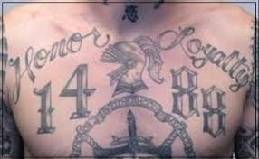
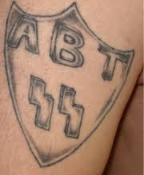
Officer Safety
An Aryan Brotherhood member has reportedly made threats to a law enforcement officer named “Scott”. It is believed the officer may be from the Houston, San Antonio or Dallas area. This unconfirmed threat was received and disseminated by ICE-Homeland Security Investigations to the law enforcement community on February 7th, 2015.
“We must secure the existence of our people and a future for white children.”

Slide 12
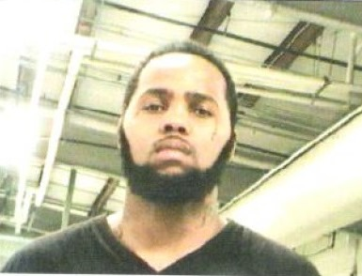
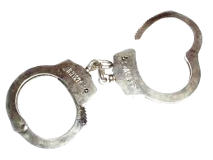
WANTED FOR MURDER
**Subject should be considered armed and dangerous**
TAYLOR, Wayne M. “Mackey” B/M DOB: 11/27/80 Taylor allegedly shot and killed Lloyd Hughes on 12/30/14 in San Antonio, TX and fled the scene. He is known to have family in San Antonio, TX, New Orleans, LA, and Nacogdoches, TX. There is also information he may have taken a bus to Atlanta, GA. Anyone with information regarding the whereabouts of this subject is encouraged to call the Bexar County Sheriff’s Office at 210-335-6000. Murder Warrant #1513845.

Slide 13
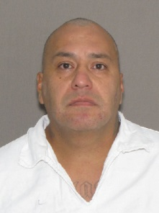
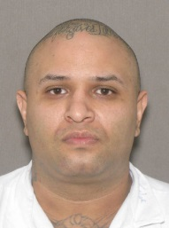
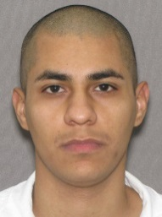
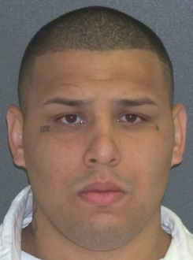
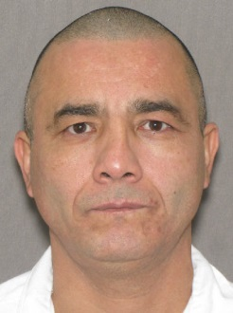
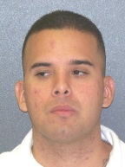
TDCJ Releases to Bexar County for January
Arturo AGUILAR
DOB: 07/04/74
155 N San Felipe,
78237 (5130)
C/Mexican Mafia
Jesse AMBRIZ
DOB: 08/04/83
1114 Milvid, 78211 (6120)
S/Tango
Thomas CANTU
DOB: 02/04/87
3735 E Commerce #M-5,
78219 (4160)
C/Tango
Ruben CARRERA
Aka/Vise
DOB: 03/04/86
313 Verelena (5240)
C/Tango
Robert ESPINO
DOB: 05/08/64
434 Abshire, 78237 (5140)
C/Mexican Mafia
David Lee ESPINOZA
DOB: 07/01/84
4543 Mascota, 78207 (5130)
S/Tango

Slide 14
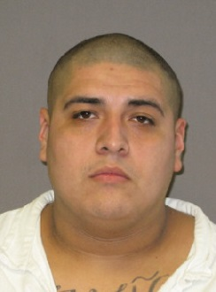
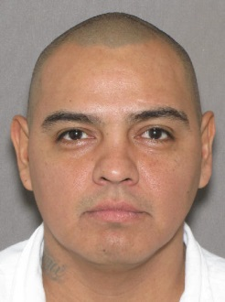
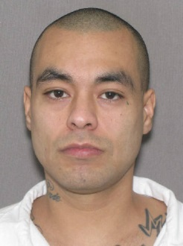
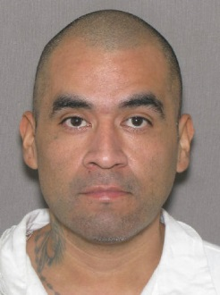
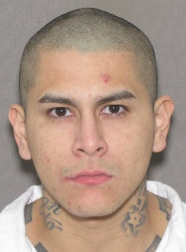
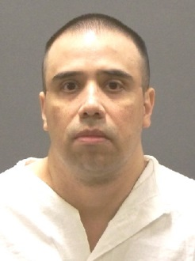
TDCJ Releases to Bexar County for January
Jesse ESTRADA
Aka/Chuy
DOB: 11/28/62
654 Aurora, 78228 (5130)
c/EX-Mexican Mafia
Ricardo FERNANDEZ
DOB: 02/07/58
2147 Texas Ave,
78228 (5220)
C/EX Mexican Mafia
Bryan Paul GAGNE
Aka/Oso
DOB: 10/06/91
318 Tedder, 78211 (6140)
S/PRM
Albert Garces
Aka/Sir Loco
DOB: 05/10/74
115 Harvard Terrace, 78201 (5210)
C/EX Mexican Mafia
Antonio GARCIA, Jr
DOB: 12/10/86
535 S Acme #9102, 78237 (5140)
C/Tango
Garcia, Manuel
Aka/Droopy
DOB: 12/16/74
1015 Clark St, 78210 (4140)
C/Mexican Mafia
Manuel GUZMAN
Aka/Lil Manz
DOB: 032388
5542 Brook Hill (5250)
C/Tango
Anthony LEDEZMA
Aka/Dirty; Tony the Tiger; ACE
DOB: 090572
1222 McKinley (4150)
C/Mexican Mafia

Slide 15
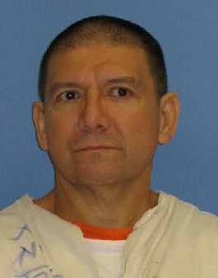
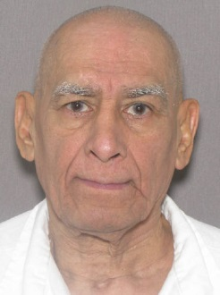
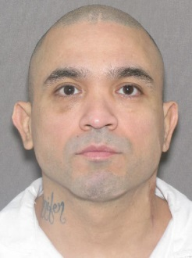
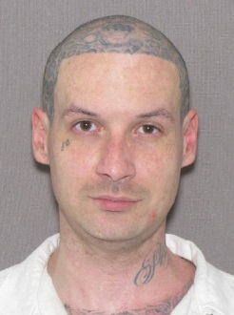
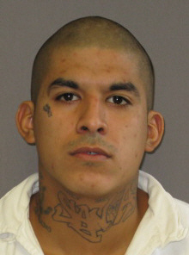
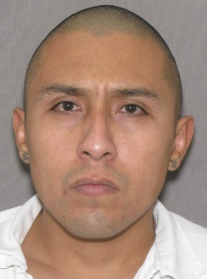
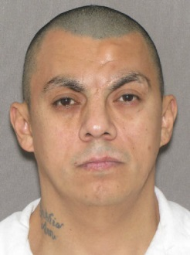
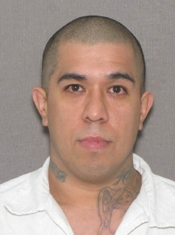
TDCJ Releases to Bexar County for January
Jose RIVAS Jr
DOB: 06/13/60
4919 Vancouver Blvd,
77469 (7210)
S/Mexican Mafia
Fred Cruz RODRIGUEZ
Aka/Pijas; Red Fred
DOB: 09/26/42
750 W Mayfield St #1, 78211 (6130)
C/EX-Texas Syndicate
Richard RODRIGUEZ
Aka/CHORE; Shorty
DOB: 08/27/71
906 Green St, 78225 (6110)
C/Mexican Mafia
Mark Thadius STOCKTON
Aka/Psycho
DOB: 10/17/84
4110 Ramsgate, 78230 (7220)
S/Aryan Brotherhood TX
Justin Lee VASQUEZ
Aka/Shorty
DOB: 11/29/92
3911 Spear, 78237 (5140)
C/Tango
Jesse VILLANUEVA
DOB: 10/07/84
523 Kayton St, 78210 (4150)
C/Tango
Jeffrey J VINCENT
Aka/Jeff
DOB: 11/18/76
521 Sims, 78225 (6110)
C/EX-Tango
Roger ZAMORA
Aka/Rabbit
DOB: 102383
1700 Jackson Keller #5115 (3310)
C/Tango

Slide 16
Federal Bureau of Prisons Release
Vincent SAENZ aka/BISKIT
DOB: 07/16/82 & 06/16/80
126 Shoreview Place (6350)
San Antonio, TX 78242
Tango (SAPD 2013)
PV-Smuggling Goods Out of U.S.

Slide 17
Thoughts for Agency Participation:
What group is the most active in your area?
Do they have ties or hang out in San Antonio?
(Elaborate)
Is there something NEW or UNUSUAL in your area?
Do you have information on Wanted Gang Members in San Antonio?
What kind of training would you find useful?

Slide 18
Contact Information
Gang Office:
Officers at SWTFC: 210-207-7680
SWTFC@sanantonio.gov
Analyst, Vicki Norris: 210-207-4854
Veronica.Norris@sanantonio.gov

