Slide 1
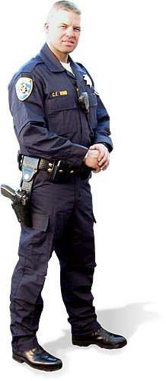
Receiving Bomb Threats
This TCLEOSE approved School-Based Law Enforcement Curriculum is the property of TxSSC-ICJS

Slide 2
Learning Objectives
Participants will learn and explain why it is important to document a bomb threat and the correct procedures for documenting a threat.
Participants will learn, recall and explain the three (3) ways of how threats are delivered.
Participants will learn, recall and explain the critical actions for responding to a bomb threat.
Participants will learn, recall, distinguish between and explain the difference between a general and specific bomb threat.
Participant will learn, recall and explain the four (4) types of bomb threats.
Participants will learn and explain why it is important to preserve evidence germane to receiving one of the four (4) types of bomb threats.

Slide 3
Purpose
The purpose of this lesson is to acquaint the participants (Call Takers and Law Enforcement Officers) with the correct procedures (actions) for receiving a “Bomb Threat”.

Slide 4
COMPLACENCY “KILLS”
Is one of the truest statements in the law enforcement careers to date. When we as law enforcement officers drop our vigilance posture (let down our guard) we are most vulnerable!
WE MUST BE PREPARED

Slide 5
Foreword
Today you will learn correct procedures from “Best Practices” lessons learned in regard to receiving a “Bomb Threats”.

Slide 6
Documenting a “Bomb Threat”
Bomb threats are the most common type of bomb incident. Every bomb threat must be carefully evaluated because a threat may launch the response plan.
Notes:
Documenting a bomb threat: Bomb threats are the most common type of bomb incident. Every bomb threat must be carefully evaluated because a threat may launch the response plan.
How the response plan will be implemented is determined by the
specifics of the threat.
Target location protocols to document and respond to a bomb threat
are dependent on the policies of the effected business, plant, government entity and/or school and emergency (First Responder) response agencies.

Slide 7
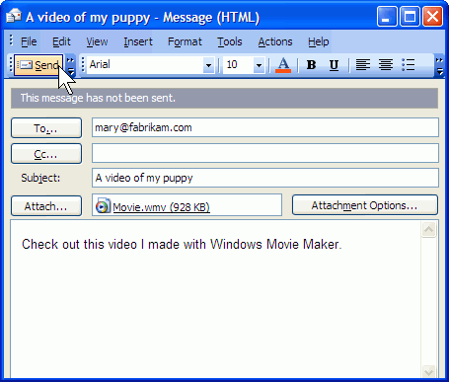
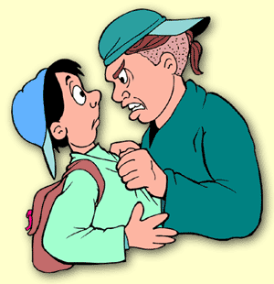
Threat Delivery
Telephone
Written—email, letters, writing on walls or mirrors
Face to face
Notes:
Threat delivery: How information about a specific threat is collected depends on how the threat is made. Threats are usually made in one of three ways:
Telephone
Written—email, letters, writing on walls or mirrors
Face to face

Slide 8
Receiving a Threat
Words
Spoken or written (letters or e-mails)
Physical item such as a suspicious package.
A threat is considered “received” when staff becomes aware of a threat.
Notes:
Receiving a threat: As previously discussed a bomb threats may be communicated through words, spoken or written (letters or e-mails), or as a physical item such as a suspicious package. A threat is considered “received” when staff becomes aware of a threat. As soon as a threat is received, the response plan begins, starting with documenting the threat.

Slide 9
4 - Critical Actions
Collecting
Assessing
Notifying
Deciding
Notes:
Critical actions: There are four critical actions for responding to a threat. However, not every response will require every step. Response involves the following:
Collecting information as the threat is received
Assessing the threat and deciding if the response plan
should be implemented
Notifying community agencies
Deciding on evacuation procedures
NOTE: Responsible officials must consider any bomb threat as a criminal offense and refer all incidents to law enforcement. Federal laws include significant penalties on those who communicate bomb threats, including juveniles.

Slide 10
2-Types of Threats
General
Specific
“I’ve placed a bomb at your
company (or school).”
“There’s a bomb in the boys
locker room in the gym
set to detonate at 1:00 p.m.”

Slide 11
Documenting Threat
The procedure for documenting a threat must:
1. Collect as much information as possible concerning the bomb
the perpetrator
all aspects of the situation.
Notes:
Documenting a threat: The procedure for documenting a threat must collect as much information as possible concerning the bomb, the perpetrator and all aspects of the situation. This information is used to assess the threat. In many cases, while the threat is being made is the only opportunity to collect information. Typically, this information is documented on a Bomb Threat Incident Form. First responders and law enforcement will request this information after dispatch to the targeted location. An example Bomb Threat Checklist will be in your student handout.

Slide 12
Four (4) Types of Bomb Threats
Telephoned threats:
Written threats:
Verbal threats:
Hoax threats:
Notes:
Four (4) Types of Bomb Threats
Telephoned threats: A Bomb Threat Checklist is used to document telephoned threats while the threat is being made. Using this form helps the person receiving the threat to keep the caller on the phone and record vital information. Background noises and characteristics of the caller’s voice are useful in evaluating a bomb threat. If background noise on the phone is similar to the school’s background, the caller
might be close to the school, which may suggest a hoax.
Written threats: Threats may also occur as written documents, emails, or writing on walls or mirrors. In light of criminal proceedings, the protocols for preserving and recording the threat follows local law enforcement policy. These protocols are defined in the building or facility bomb incident response plan. Typically, the evidence chain of custody involves as few people as possible. Staff is responsible for cordoning off the area where the threat is, notifying the police, and preserving or recording the threat.
Verbal threats: Any verbal threat, whether from a disgruntled employee, other community member, patent and/or student, must be reported to local law enforcement. This helps deter future threats and provides evidence for legal action. Verbal threats from students are considered an imminent warning sign requiring immediate attention by school staff and law enforcement. Because it is not unusual for a student planning a bomb incident or making a bomb to tell peers, reports of this nature from fellow students must be investigated thoroughly. (Complacency Kills).
Hoax threats: Most bomb threats are made over the phone and end up being hoaxes. When one hoax threat occurs, expect others to follow. They are often intended to result in evacuation of the targeted premise, building and/or structure.

Slide 13
Preserving Evidence
Help law enforcement link a suspect to other threats through particular details.
If the threat is physical, such as writing on a mirror, or a suspicious item, staff must protect the scene around the threat until police arrive.
Protects the building occupants
Chain of custody for the evidence
Notes:
Preserving evidence: Frequently, information collected on an incident form will help law enforcement link a suspect to other threats through particular details. These details may include background noises, method of delivery, or handwriting. Documenting the threat does not end with completing a form about a threat. If the threat is physical, such as writing on a mirror, or a suspicious item, staff must protect the scene around the threat until police arrive. This protects the building occupants, and the chain of custody for the evidence, which is critical in a court case.

Slide 14
SUMMARY – Cont’d:
Importance of documenting a bomb threat.
Complacency can kill.
3 -Types of Threat Delivery
1. Telephone 2. Written (Letter or E-mail) 3. Face-to-Face

Slide 15
SUMMARY – Cont’d:
4 - basic “Critical Actions” we must take. 1. Collect 2. Assess
3. Notify
4. Decision (Evacuation Procedures)
2-Types of Threats
1. General
2. Specific

Slide 16
SUMMARY – Cont’d:
4 -Types of Threats 1.Telephone 2. Written 3. Verbal 4. Hoax
Preservation of evidence.

Slide 17
QUESTIONS

Slide 18
DEFINE & PROCESS Group Activity
GROUP #1: Explain why it is important to document a bomb threat and the correct procedures for documenting a threat. And Identify and explain the three (3) ways of how threats are delivered.
GROUP #2: Identify and explain the critical actions for responding to a bomb threat.
GROUP #3: Identify and distinguish between a general and specific bomb threat.
GROUP #4: Identify and explain the four (4) types of bomb threats.
VOLUNTEER: Explain why it is important to preserve evidence germane to receiving one of the four (4) types of bomb threats.

Slide 19
REFERENCES - SOURCES
Department of Homeland Security – New Mexico Tech (EMRTC) – Understanding and Planning for Bomb Incidents Student Handout.
Cathleen Corbitt-Dipierro Interactive Designer interFIRE VR and Bomb Threat Response: An Interactive Planning Tool for Schools

Slide 20
EVALUATION
Test covering all Learning Objectives.
A passing score of 70% must be obtained.
Ensure you put you name on your test sheet.
Circle the correct answer. Each question is worth 10-points.

Slide 21
THANK YOU & HAVE A NICE DAY

Slide 22
Course Contact Information
Texas School Safety Center (TxSSC)
350 N. Guadalupe, Suite 140, PMB 164
San Marcos, Texas 78666.
877-304-2727
www.cscs.txstate.edu

