Slide 1
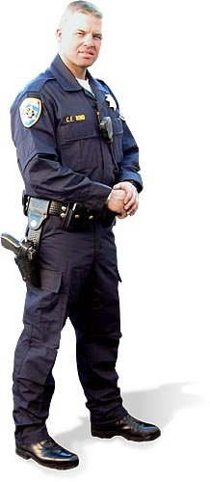
TEXAS PENAL CODE
INSTRUCTOR: OFFICER COLE LANGSTON
CARROLLTON POLICE DEPARTMENT

Slide 2
LEARNING OBJECTIVES
The student will be able to explain “public place” as it defined in this code.
The student will be able to explain when an administrator is justified in the use of force involving a student.
The student will be able to describe the classification of misdemeanors.
The student will be able to explain the offense of “Criminal Solicitation of a Minor.”
The student will be able to explain the offense of “Improper Relationship Between Educator and Student.”
The student will be able to define coercing, soliciting or inducing in regards to gang membership.
The student will be able to define “Terroristic Threat.”
The student will be able to explain the differences between “Illegal Weapons” and “Prohibited Weapons”.

Slide 3
LEARNING OBJECTIVES (cont.)
The student will be able to explain the offense of “Improper Relationship Between Educator and Student.”
The student will be able to define coercing, soliciting or inducing in regards to gang membership.
The student will be able to define “Terroristic Threat.”
The student will be able to explain the differences between “Illegal Weapons” and “Prohibited Weapons”.

Slide 4
Definition of a Public Place Penal Code 1.07
"Public place" means any place to which the public or a substantial group of the public has access and includes, but is not limited to, streets, highways, and the common areas of schools, hospitals, apartment houses, office buildings, transport facilities, and shops.
Hallways of public school?
Cafeteria?
Waiting areas?
Classroom?
Notes:
USSC said a public school hallway is a public place.
Classrooms are not. Use Disruption of Class.
Cafeteria and other public areas are

Slide 5
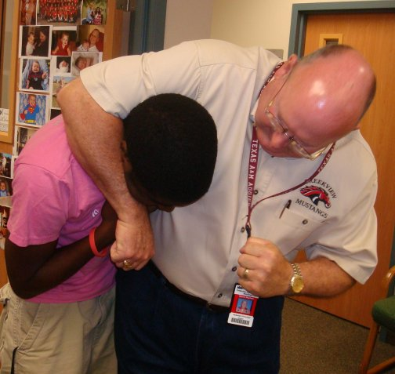
Use of Force: Educator-Student Penal Code 9.62
The use of force, but not deadly force, against a person is
justified:
If the actor is entrusted with the care, supervision, or administration of the person for a special purpose
AND
When and to the degree the actor reasonably believes the force is necessary to further the special purpose or to maintain discipline in a group
Special purpose: controlling, training,
or educating the student

Slide 6
Penalties
CLASS A MISDEMEANOR. An individual adjudged guilty of a Class A misdemeanor shall be punished by:
(1) a fine not to exceed $4,000;
(2) confinement in jail for a term not to exceed one year; or
(3) both such fine and confinement.
CLASS B MISDEMEANOR. An individual adjudged guilty of a Class B misdemeanor shall be punished by:
(1) a fine not to exceed $2,000;
(2) confinement in jail for a term not to exceed 180 days; or
(3) both such fine and confinement.
CLASS C MISDEMEANOR. An individual adjudged guilty of a Class C misdemeanor shall be punished by a fine not to exceed $500.

Slide 7
Criminal Solicitation of a Minor Penal Code 15.031
Requests, commands, or attempts to induce a minor (under 17 years old) to
engage in specific conduct that would constitute an offense or make a minor
a party to an offense listed below
Continuous Sexual Abuse of a Child
Indecency with a Child
Sexual Assault
Aggravated Sexual Assault
Sexual Performance by a Child
Murder
Capital Murder
Aggravated Kidnapping
Aggravated Robbery
Drug offenses enhanced by Drug Free Zone (HSC 481.134)
Injury to a Child, Elderly Individual, or Disabled Individual (if offense is 1st degree and victim is child)
Criminal Solicitation of any 1st degree felony
Manufacture of Delivery of Substance in PG 1
Manufacture of Delivery of Substance in PG 1-A
Manufacture of Delivery of Substance in PG 2
Manufacture of Delivery of Substance in PG 3 or 4
Delivery of Marijuana
Delivery of Controlled Substance or Marijuana to a Child

Slide 8
Improper Relationship Between Educator and Student Penal Code 21.12
An employee of a public or private primary or secondary
school commits an offense if the employee engages in:
(1) sexual contact, sexual intercourse, or deviate sexual intercourse with a person who is enrolled in a public or private primary or secondary school at which the employee works; or
(2) conduct described by Section 33.021 (Online Solicitation of a Minor), with a person described by Subdivision (1), regardless of the age of that person.
2nd Degree Felony

Slide 9
Coercing, Soliciting, or Inducing Gang Membership Penal Code 22.051
A person commits an offense if, with intent to coerce, induce,
or solicit a child (under 17) to actively participate in the
activities of a criminal street gang, the person:
Threatens the child with imminent bodily injury (or)
Causes bodily injury to the child
Threatening is a State Jail Felony
Injury is a 3rd Degree Felony

Slide 10
Soliciting Membership in a Criminal Street Gang Penal Code 71.022
(a) A person commits an offense if the person knowingly causes, enables, encourages, recruits, or solicits another person to become a member of a criminal street gang which, as a condition of initiation, admission, membership, or continued membership, requires the commission of any conduct which constitutes an offense punishable as a Class A misdemeanor or a felony.
(a-1) A person commits an offense if, with intent to coerce, induce, or solicit a child (under 17) to actively participate in the activities of a criminal street gang, the person:
(1) threatens the child or a member of the child's family with imminent bodily injury; or
(2) causes bodily injury to the child or a member of the child's family.
1st offense: 3rd Degree Felony
2nd or subsequent offenses: 2nd Degree Felony

Slide 11
Terroristic Threat Penal Code 22.07
(a) A person commits an offense if he threatens to commit any offense involving violence to any person or property with intent to:
(1) cause a reaction of any type to his threat by an official or volunteer agency organized to deal with emergencies;
(2) place any person in fear of imminent serious bodily injury;
(3) prevent or interrupt the occupation or use of a building, room, place of assembly, place to which the public has access, place of employment or occupation, aircraft, automobile, or other form of conveyance, or other public place;
(4) cause impairment or interruption of public communications, public transportation, public water, gas, or power supply or other public service;
(5) place the public or a substantial group of the public in fear of serious bodily injury; or
(6) influence the conduct or activities of a branch or agency of the federal government, the state, or a political subdivision of the state.

Slide 12
Terroristic Threat Penal Code 22.07
(a)(1) is a Class B misdemeanor.
(a)(2) is a Class B misdemeanor, except that the offense is a Class A misdemeanor if the offense:
(1) is committed against a member of the person's family or household or otherwise constitutes family violence; or
(2) is committed against a public servant.
(a)(3) is a Class A misdemeanor, unless the actor causes pecuniary loss of $1,500 or more to the owner of the building, room, place, or conveyance, in which event the offense is a state jail felony.
(a)(4), (a)(5), or (a)(6) is a felony of the third degree.

Slide 13
Harassment Penal Code 42.07
(a) A person commits an offense if, with intent to harass, annoy, alarm, abuse, torment, or embarrass another, he:
(1) initiates communication by telephone, in writing, or by electronic communication and in the course of the communication makes a comment, request, suggestion, or proposal that is obscene;
(2) threatens, by telephone, in writing, or by electronic communication, in a manner reasonably likely to alarm the person receiving the threat, to inflict bodily injury on the person or to commit a felony against the person, a member of his family or household, or his property;
(3) conveys, in a manner reasonably likely to alarm the person receiving the report, a false report, which is known by the conveyor to be false, that another person has suffered death or serious bodily injury;
(4) causes the telephone of another to ring repeatedly or makes repeated telephone communications anonymously or in a manner reasonably likely to harass, annoy, alarm, abuse, torment, embarrass, or offend another;
(5) makes a telephone call and intentionally fails to hang up or disengage the connection;
(6) knowingly permits a telephone under the person's control to be used by another to commit an offense under this section; or
(7) sends repeated electronic communications in a manner reasonably likely to harass, annoy, alarm, abuse, torment, embarrass, or offend another.
Class B Misdemeanor, but subsequent offenses are Class A Misdemeanor

Slide 14
Use of Laser Pointers Penal Code 42.13
A person commits an offense if the person knowingly directs a light from a laser pointer at a uniformed safety officer, including a peace officer, security guard, firefighter, emergency medical service worker, or other uniformed municipal, state, or federal officer.
Class C Misdemeanor

Slide 15
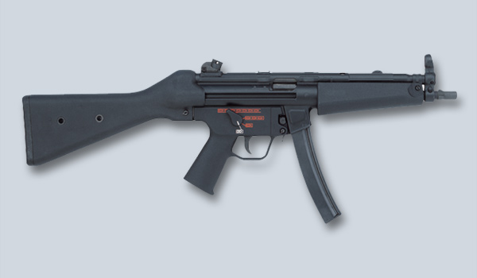
Places Weapons Prohibited Penal Code 46.03
A person commits an offense if the person intentionally, knowingly, or recklessly possesses or goes with a firearm, illegal knife, club, or prohibited weapon on the physical premises of a school or educational institution, any grounds or building on which an activity sponsored by a school or educational institution is being conducted, or a passenger transportation vehicle of a school or educational institution, whether the school or educational institution is public or private, unless pursuant to written regulations or written authorization of the institution.

Slide 16
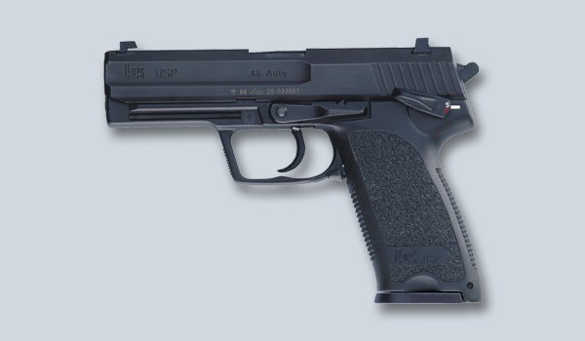
Premises
A building or portion of a building, but does not include public or private driveways, streets, sidewalks, walkways, parking lots, parking garages, or other parking areas.
Grounds or Buildings
Must be a school sponsored activity taking place
Example: stadium or athletic field
Transportation vehicles
School bus

Slide 17
Unlawfully Carrying a Weapon Penal Code 46.02
An update to the law in 2007 made it legal to carry on or about your person a firearm, illegal knife, or club in a vehicle
Made it illegal to carry on or about your person a firearm in a vehicle if:
The firearm is in plain view (OR)
The person is:
Engaged in criminal activity, other than a Class C Misdemeanor that is a violation of law or ordinance regulating traffic
Prohibited by law from possessing a firearm
A member of a criminal street gang

Slide 18
Prohibited Weapons Penal Code 46.05
A person commits an offense if he intentionally or knowingly
possesses, manufactures, transports, repairs, or sells:
(1) an explosive weapon;
(2) a machine gun;
(3) a short-barrel firearm;
(4) a firearm silencer;
(5) a switchblade knife;
(6) knuckles;
(7) armor-piercing ammunition;
(8) a chemical dispensing device; or
(9) a zip gun.

Slide 19
Assault on a Public Servant
A person commits an offense if the person:
(1) intentionally, knowingly, or recklessly causes bodily injury to another, including the person's spouse;
(b) An offense under Subsection (a)(1) is a Class A misdemeanor, except that the offense is a felony of the third degree if the offense is committed against:
(1) a person the actor knows is a public servant while the public servant is lawfully discharging an official duty, or in retaliation or on account of an exercise of official power or performance of an official duty as a public servant;

Slide 20
In the Matter of J.L.O., No. 03-01-00632-CV, 2002
Austin Court of Appeals held assault on a public servant adjudications for contact with a classroom teacher and aide
In the Matter of P.N. (06-4-01B)
Austin Court of Appeals held that a teacher was a public servant and was considered to be discharging “an official duty” when restraining a student

Slide 21
Criminal Trespass Penal Code 30.05
A person commits an offense if he enters or remains on or in
property, including an aircraft or other vehicle, of another
without effective consent, or he enters or remains in the
building of another without effective consent and he:
(1) Had notice that entry was forbidden; or
(2) Received notice to depart, but failed to do so
Class B Misdemeanor
Class A if habitation or carries a deadly weapon

Slide 22
Disorderly Conduct Penal Code 42.01
A person commits an offense if he intentionally or knowingly:
(1) uses abusive, indecent, profane, or vulgar language in a public place, and the language by its very utterance tends to incite an immediate breach of the peace;
(2) makes an offensive gesture or display in a public place, and the gesture or display tends to incite an immediate breach of the peace;
(3) creates, by chemical means, a noxious and unreasonable odor in a public place;
(4) abuses or threatens a person in a public place in an obviously offensive manner;
(6) fights with another in a public place;
(10) exposes his anus or genitals in a public place and is reckless about whether another may be present who will be offended or alarmed by his act

Slide 23
Weapon-Free School Zones Penal Code 46.11
School means a private or public elementary or secondary school
Enhances all weapons offenses in Penal Code Ch. 46 to next highest level if committed in a place the actor knew was:
Within 300 feet of the premises of a school
On premises where an official school function is taking place
On premises where an event sponsored or sanctioned by UIL is taking place
Excludes Places Weapons Prohibited

Slide 24
Gang Free Zones Penal Code 71.028
New law effective September 2009
Enhances penalties for selected offenses to next highest category if the actor is 17 years of age or older and the offense was committed:
Within 1,000 feet of school property, institutions of higher education, public or private youth center, playground
Within 300 feet of a shopping mall, movie theatre, public swimming pool, or video arcade
On a school bus

Slide 25
Included offenses:
Murder
Capital murder
Arson
Aggravated Robbery
Robbery
Aggravated Kidnapping
Kidnapping
Aggravated Assault
Aggravated Sexual Assault
Sexual assault
Forgery
Deadly conduct
Assault (Class A)
Unlawful Manufacture, Transportation, Repair, or Sale of a Firearm or Prohibited Weapon
Any offense under Penal Code Chapter 43 Subsection B (Obscenity) depicting or involving conduct by or directed toward a child younger than 18
Offenses enhanced by Engaging in Organized Crime to a 1st Degree Felony, cannot be enhanced with this section

Slide 26
Questions
A Class A Misdemeanor shall be punished by a fine not to exceed $5,000. true____ false____
A terroristic threat against a public servant is a Class A Misdemeanor. true____ false____
Directing a laser pointer at a police officer is a Class C Misdemeanor. true____ false____

Slide 27
TEXAS PENAL CODE
INSTRUCTOR: OFFICER COLE LANGSTON
CARROLLTON POLICE DEPARTMENT

