Slide 1
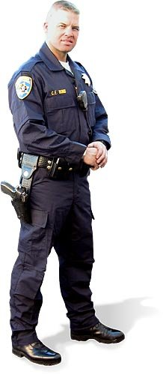



CODE OF CRIMINAL PROCEDURE
INSTRUCTOR: OFFICER COLE LANGSTON
CARROLLTON POLICE DEPARTMENT
Notes:
1

Slide 2
LEARNING OBJECTIVES
The student will be able to identify the duties and powers of a peace officer.
The student will be able to explain his/her responsibilities in response to a report of child abuse or neglect.
The student will be able to identify those violations law enforcement is required to report to school district and the time limits to do so.
The student will be able to define a “Writ of Attachment.”
The student will be able to explain the procedures to follow when a child is taken into custody, including violation of curfew.
The student will be able to identify what agencies may compile a data base pertaining to criminal street gangs.
The student will be able to explain the circumstances requiring notice to superintendent or school administrator of juvenile sex offenders attending in their district.
The student will be able to explain an officer’s duties when a report of a missing child or person is filed.
Notes:
2

Slide 3
DUTIES AND POWERS
CCP 2.13
It is the duty of every peace officer to preserve the peace within the officer's jurisdiction. To effect this purpose, the officer shall use all lawful means.
The officer shall:
    in every case authorized by the provisions of this Code, interfere without warrant to prevent or suppress crime;
    execute all lawful process issued to the officer by any magistrate or court;
    give notice to some magistrate of all offenses committed within the officer's jurisdiction, where the officer has good reason to believe there has been a violation of the penal law; and
    arrest offenders without warrant in every case where the officer is authorized by law, in order that they may be taken before the proper magistrate or court and be tried.
It is the duty of every officer to take possession of a missing child (under 18).

Slide 4
INVESTIGATION OF CERTAIN REPORTS ALLEGING ABUSE
CCP 2.27
On receipt of a report alleging serious physical or sexual abuse of a child by a person responsible for the care, custody, or welfare of the child, an investigator from the appropriate local law enforcement agency shall investigate the report jointly with the Department of Protective and Regulatory Services or with the agency responsible for conducting an investigation under Subchapter E, Chapter 261, Family Code (various agencies charged with investigation allegations of abuse in various facilities (including schools)).
Allegations of abuse or neglect of a child in public or private schools under the jurisdiction of the Texas Education Agency (TEA), will be investigated by Department of Family and Protective Services (CPS).
CPS will forward the report to TEA, the State Board of Educator Certification, school board, superintendent, principal (unless principal is subject of report)
Parent may also request a copy of the report
Report will be redacted to protect identity of reporting person

Slide 5
ARREST

Slide 6
CCP 15.22 WHEN A PERSON IS ARRESTED
  A person is arrested when he has been actually placed under restraint or taken into custody by an officer or person executing a warrant of arrest, or by an officer or person arresting without a warrant.
CCP 15.23 TIME OF ARREST
  An arrest may be made on any day or at any time of the day or night
CCP 15.24 WHAT FORCE MAY BE USED
  In making an arrest, all reasonable means are permitted to be used to effect it. No greater force, however, shall be resorted to than is necessary to secure the arrest and detention of the accused
CCP 15.25 MAY BREAK DOOR
  In case of felony, the officer may break down the door of any house for the purpose of making an arrest, if he be refused admittance after giving notice of his authority and purpose

Slide 7
CCP 15.26 AUTHORITY TO ARREST MUST BE MADE KNOWN
  If make arrest with warrant, must notify arrestee under what authority arrest is made
  Do not have to have warrant in hand
  Upon request shall show warrant to arrestee as soon as possible
  If warrant is not in officer’s possession, must notify arrestee at time of arrest of the charge and the fact that a warrant had been issued
  Arrest warrant and affidavit are public information at time of execution of warrant

Slide 8
Warrantless Arrests
CCP 14.01. OFFENSE WITHIN VIEW
  A peace officer or any other person, may, without a warrant, arrest an offender when the offense is committed in his presence or within his view, if the offense is one classed as a felony or as an offense against the public peace
  A peace officer may arrest an offender without a warrant for any offense committed in his presence or within his view

Slide 9
CCP 14.03 AUTHORITY OF PEACE OFFICERS
Any peace officer may arrest, without warrant:
  Persons found in suspicious places and under circumstances which reasonably show that such persons have been guilty of some felony, violation of Title 9, Chapter 42, Penal Code, (Offenses Against Public Order and Decency) breach of the peace, or Public Intoxication, or threaten, or are about to commit some offense
  Persons who the peace officer has probable cause to believe have committed an assault resulting in bodily injury to another person and the peace officer has probable cause to believe that there is danger of further bodily injury to that person;
  Persons who the peace officer has probable cause to believe have Violation of Protective Order or Violation of Protective Order issued on basis of sexual assault, if the offense is not committed on view

Slide 10
  Persons who the peace officer has probable cause to believe have committed an offense involving family violence
  Persons who the peace officer has probable cause to believe have prevented or interfered with an individual's ability to place a telephone call in an emergency, as defined by Section 42.062(d), Penal Code, if the offense is not committed in the presence of the peace officer
  A person who makes a statement to the peace officer that would be admissible against the person under Article 38.21 and establishes probable cause to believe that the person has committed a felony
  A peace officer shall arrest, without a warrant, a person the peace officer has probable cause to believe has committed Violation of Protective Order or Violation of Protective Order issued on basis of sexual assault, if the offense is committed in the presence of the peace officer

Slide 11
A peace officer who is outside his jurisdiction may arrest, without warrant, a person who commits an offense within the officer's presence or view, if the offense is a felony, a violation of Chapter 42 or 49, Penal Code, or a breach of the peace. A peace officer making an arrest under this subsection shall, as soon as practicable after making the arrest, notify a law enforcement agency having jurisdiction where the arrest was made. The law enforcement agency shall then take custody of the person committing the offense and take the person before a magistrate in compliance with Article 14.06 of this code.

Slide 12
School Notification

Slide 13
Offenses Requiring School Notification
CCP 15.27
All felonies
Unlawful Restraint
Indecent Exposure
Assault
Deadly Conduct
Terroristic Threat
Engaging in Organized Criminal Activity
Unlawful use, sale, or possession of a controlled substance, drug paraphernalia, or marihuana
Unlawful possession of any of the weapons or devices listed in Sections 46.01(1)-(14) or (16), Penal Code, or a weapon listed as a prohibited weapon under Section 46.05, Penal Code.

Slide 14
Notification Procedures
  Oral notice must be made within 24 hours of the arrest
  Written notice must be made within 7 days of the oral notice
  Written notification shall be marked PERSONAL and CONFIDENTIAL on the mailing envelope
  Notice is required for public and private schools
  Electronic notification may be substituted for both the oral and written notification
  Must include elements and details of offense
  Must include names of victims if they are students
  School must notify all staff who have direct contact with the arrestee
  Must also notify schools if refer case to juvenile court without an arrest
    “A law enforcement agency that arrests any person or refers a child to the office or official designated by the juvenile board who the agency believes is enrolled as a student in a public primary or secondary school, for an offense listed in Subsection (h), shall attempt to ascertain whether the person is so enrolled. If the law enforcement agency ascertains that the individual is enrolled as a student in a public primary or secondary school, the agency shall orally notify the superintendent or a person designated by the superintendent in the school district in which the student is enrolled of that arrest or referral within 24 hours after the arrest or referral is made, or on the next school day.”

Slide 15
Attorney General Opinion
No. DM-0294 (1994)
The notice should include sufficient details such as:
  Nature of the charges
  Identity of any alleged victims who are students or staff
  All other information that will allow a school administrator to take appropriate action to prevent violence, protect students and staff, and to further the educational process
  Private schools must be notified also

Slide 16
What if the DA does not file the case?
DA must notify the school within 2 working days (CCP 15.27 (g))
The school must review the DAEP placement (EC 37.006 (h))
A placement review meeting with the school and parent must be scheduled within three days
The school may continue the DAEP placement only if there is reason to believe the student’s presence in a regular classroom threatens the safety of students or teachers
Deferred is an INFORMAL PROBATION of up to 6 months. The charge has not been dismissed, until after the term.

Slide 17
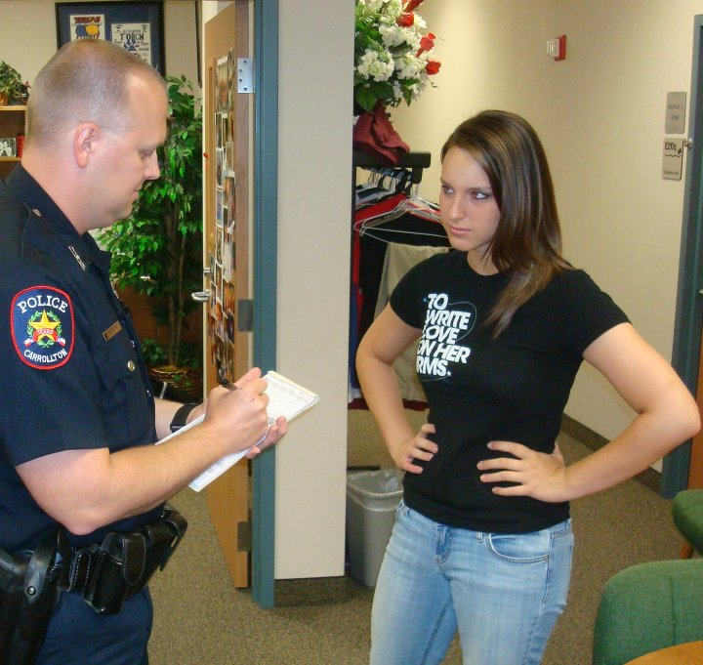
Class C Misdemeanors

Slide 18
Authority to Issue a Citation
CCP 14.06
A peace officer who is charging a person, including a child, with an offense that is a Class C Misdemeanor, other than (public intoxication) may, instead of taking the person before a magistrate, issue a citation to the person that contains written notice of the time and place the person must appear before a magistrate, the name and address of the person charged, and the offense charged.
Child=10-16

Slide 19
Arresting Juveniles for Class C Offenses
CCP 45.058
  Sets forth rules related to arresting juveniles for Class C offenses (including traffic and city ordinances)
  Public Intoxication is now included
  Statutory authority to release a child with a citation instead of taking them before a magistrate if the child is taken into custody

Slide 20
Traffic Offenses
Family Code 51.02
Traffic offense:
  Violation of a penal statute cognizable under Chapter 729, Transportation Code, except for conduct for which the person convicted may be sentenced to imprisonment or confinement in jail
  Violation of a motor vehicle traffic ordinance of an incorporated city or town in this state
Traffic offenses are ALWAYS heard in Municipal or Justice Courts
They can never be transferred to Juvenile Court

Slide 21
Traffic Offenses
TRC 729.001
A person who is younger than 17 years of age commits an offense if the person operates a motor vehicle on a public road or highway, a street or alley in a municipality, or a public beach in violation of any traffic law of this state, including (see list)

Slide 22
Traffic Offenses
TRC 729.002
OPERATION OF MOTOR VEHICLE BY MINOR
WITHOUT LICENSE
  (a) A person who is younger than 17 years of age commits an offense if the person operates a motor vehicle without a driver's license authorizing the operation of a motor vehicle on a:
  (1) public road or highway;
  (2) street or alley in a municipality; or
  (3) public beach as defined by Section 729.001.
  (b) An offense under this section is punishable in the same manner as if the person was 17 years of age or older and operated a motor vehicle without a license as described by Subsection (a), except that an offense under this section is not punishable by confinement or imprisonment.

Slide 23
These are NOT Traffic Offenses
  Class B and greater Fail to Stop and Render Aid and Hit and Runs (TRC 550.021, 550.022, 550.024, 550.025)
  DWLI (including Class C offense) (TRC 521.457)
  Racing (TRC 545.420)
  Wrong, fictitious, altered or obscured license plate (TRC 502.409)
  Falsification or Forgery (TRC 502.410)
  Bribery of county officer or agent (TRC 502.411)
  General violation (TRC 521.451)
  False Application (TRC 521.454)
  Use of Illegal License or Certificate (TRC 521.455)
  Delivery or Manufacture of Counterfeit Instrument (TRC 521.456(b))
  Violation of Chapter (TRC 601.008)
  Operation of Motor Vehicle in Violation of Suspension (TRC 601.371)
  General Offense (TRC 621.507)
  Manufacture, Sale, Possession, or Use of Counterfeit Placard (TRC 681.0111)
  DWI
  3rd DUI
All are Delinquent Conduct and heard in Juvenile Court

Slide 24
Reckless Driving
TRC 545.401
It is not Delinquent Conduct
It is always a traffic offense
It stays in Municipal Court even though it is a class B if committed by an adult
The maximum fine is $200

Slide 25
Juvenile/Class C Options
CCP 45.058
Issue a citation and release in field
Release to a responsible adult
Take to a Place of Non-Secure Custody
Take to a magistrate
May have a magistrate set bail
      CCP 17.03 allows for the release of a child on bail, including personal bond
If issue a citation for Public Intoxication, may release in the field to only to child's parent, guardian, custodian, or other responsible adult

Slide 26
Place of Non-Secure Custody
CCP 45.058
Unlocked, multipurpose area designated by the head of the agency
A lobby, office, or interrogation room is suitable if the area is not designated, set aside, or used as a secure detention area and is not part of a secure detention area
May be a juvenile processing office designated under Section 52.025, Family Code, if the area is not locked when it is used as a place of non-secure custody
Child may not be secured physically to a cuffing rail, chair, desk, or other stationary object

Slide 27
Place of Non-Secure Custody
CCP 45.058
Child may be held in the non-secure facility only long enough to accomplish the purpose of identification, investigation, processing, release to parents, or the arranging of transportation to the appropriate juvenile court, juvenile detention facility, secure detention facility, justice court, or municipal court
Residential use of the area is prohibited
The child shall be under continuous visual supervision by a law enforcement officer or facility staff person during the time the child is in non-secure custody
A child may not, under any circumstances, be detained in a place of non-secure custody for more than six hours
Note that there is no statutory requirement to allow a juvenile to be accompanied by a parent or attorney

Slide 28
Arresting Juveniles for Curfew
CCP 45.059
Mandates that an officer taking custody of a child, without
unnecessary delay:
Release the child to a parent
Take before a justice or municipal court judge
Take to a Juvenile Curfew Processing Office

Slide 29
Juvenile Curfew Processing Office
Designated by head of agency
Must be an unlocked, multipurpose area that is not designated, set aside, or used as a secure detention area or part of a secure detention area
The person may not be secured physically to a cuffing rail, chair, desk, or stationary object
The person may not be held longer than necessary to accomplish the purposes of identification, investigation, processing, release to a parent, guardian, or custodian, or arrangement of transportation to school or court
May not be designated or intended for residential purposes;
The person must be under continuous visual supervision by a peace officer or other person during the time the person is in the juvenile curfew processing office
A person may not be held in a juvenile curfew processing office for more than six hours
Note that there is no statutory requirement to allow a juvenile to be accompanied by a parent or attorney

Slide 30
Who can keep a gang database?
CCP 61.01 & 61.02
A “criminal justice agency” shall compile criminal information
into an intelligence database for the purpose of investigating or
prosecuting the criminal activities of criminal combinations or
criminal street gangs
  A federal or state agency that is engaged in the administration of criminal justice under a statute or executive order and allocates a substantial part of its annual budget to the administration of criminal justice
  It includes a municipal or county agency, or school district law enforcement agency, that is engaged in the administration of criminal justice under a statute or executive order

Slide 31
CIRCUMSTANCES REQUIRING NOTICE TO SUPERINTENDENT OR SCHOOL ADMINISTRATOR
CCP 62.054
A local law enforcement authority shall provide notice to the superintendent and each administrator under Article 62.053(e) or 62.055(f) (REFERENCE SEX OFFENDER REGISTRATION) only if:
(1) the victim was at the time of the offense a child younger than 17 years of age or a student enrolled in a public or private secondary school;
(2) the person subject to registration is a student enrolled in a public or private secondary school; or
(3) the basis on which the person is subject to registration is a conviction, a deferred adjudication, or an adjudication of delinquent conduct for an offense under Section 43.25 or 43.26, Penal Code, or an offense under the laws of another state, federal law, or the Uniform Code of Military Justice that contains elements substantially similar to the elements of an offense under either of those sections.
(b) A local law enforcement authority may not provide notice to the superintendent or any administrator under Article 62.053(e) or 62.055(f) if the basis on which the person is subject to registration is a conviction, a deferred adjudication, or an adjudication of delinquent conduct for an offense under Section 25.02, Penal Code, or an offense under the laws of another state, federal law, or the Uniform Code of Military Justice that contains elements substantially similar to the elements of an offense under that section.

Slide 32
WHEN STATEMENTS MAY BE USED
CCP 38.22
No written statement made by an accused as a result of custodial interrogation is admissible as evidence against him in any criminal proceeding unless it is shown on the face of the statement that:
  The accused, prior to making the statement, received warnings from a magistrate during arraignment
    Includes that the arrested is not required to make a statement and that any statement made by him may be used against him
  Miranda Warning from the person who obtained the statement
  The accused, prior to and during the making of the statement, knowingly, intelligently, and voluntarily waived his rights

Slide 33
No oral or sign language statement of an accused made as a result of custodial interrogation shall be admissible against the accused in a criminal proceeding unless:
  An electronic recording, which may include motion picture, video tape, or other visual recording, is made of the statement;
  Prior to the statement but during the recording the accused is given the Miranda Warning or warning by a magistrate during arraignment and the accused knowingly, intelligently, and voluntarily waives any rights set out in the warning;
  The recording device was capable of making an accurate recording, the operator was competent, and the recording is accurate and has not been altered;
  All voices on the recording are identified
If the accused is a deaf person, the accused's written, oral, or sign language statement is not admissible unless the warning is interpreted to the deaf person by an interpreter who is qualified and sworn as provided in CCP 38.31

Slide 34
Statement which contains assertions of facts or circumstances that are found to be true and which conduce to establish the guilt of the accused, such as the finding of secreted or stolen property or the instrument with which he states the offense was committed
Statement made by the accused in open court at his trial, before a grand jury, or at an examining trial
Res Gestae statement
Non-custodial statement
A voluntary statement, whether or not the result of custodial interrogation, that has a bearing upon the credibility of the accused as a witness
Any other statement that may be admissible under law

Slide 35
A seventeen year old is considered a missing child under Texas law.
true____ false____
An ISD Police Department can maintain a data base pertaining to criminal street gangs. true______ false_____
A report must be made within 24hrs to the district superintendent when a student is arrested for a felony.
        true____ false____
Notes:
35

Slide 36
CODE OF CRIMINAL PROCEDURE
INSTRUCTOR: OFFICER COLE LANGSTON
CARROLLTON POLICE DEPARTMENT
Notes:
36

