Slide 1
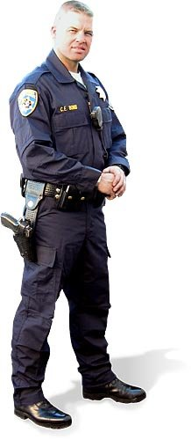

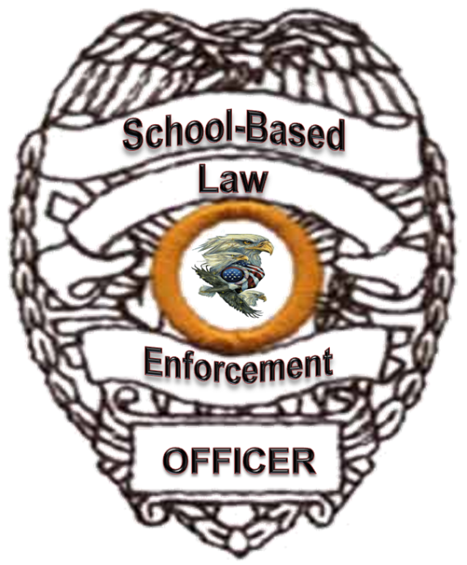

Texas D.A.R.E. Training & Development Institute
HOLISTIC TRAINING
PLAN & CONCEPT
Notes:
Core Lessons/Curriculums developed by true subject matter experts (SME) delivered (fielded and tested) by same experts and developed into simply user-friendly TRAIN-the-TRAINER formalized lesson plans (with detailed instructor notes and background information), PowerPoint's and Handouts – Standardized (Universal) lessons/curriculums. It identifies and develops (holistic – comprehensive training standards that provides highly) specialized knowledge, skills, intervention and prevention strategies and plans for action to deny, detect, delay and/or deter current threats facing our schools.
It is a “POSITIVE” step forward and action verses talking about problems and having no affirmative action plan in place and working.
It is tangible action in doing something to rectify and over come problems, challenges and obstacles faced by our officers and our schools on a daily basis.
It is about TEAM WORK and all of us working together to enhance safety and security of our schools and campuses.
It is about creating “FORCE MULTIPLIERS” within our schools and campuses using existing assets through cross-training.
It is the first standardized specialized training course in the state and/or nation.
The SBLE Holistic School Safety & Security Concept and Training Plan provides a strong and viable venue to bring all required resources together in a united coalition of assets. It is a Strategic Concept & Plan.
Don’t tell me this will not work, allow me to show you how it did work!......G.D. Little

Slide 2
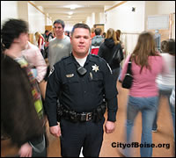
FORWARD
It is time to go to and listen to the men and women in Law Enforcement that work in our schools on a daily basis verses listening to men and women far removed from the realities of a school-based environment.
Notes:
We do not go to a dentist to receive major open heart surgery. Then why do we repeatedly listen to and take advice from people with no true vested interest, direct responsibility and accountability in school safety and security other than to defer to their Ph.D. and/or clasp for their position(s) to be funded or to receive a grant; than working with the ones most directly responsible for public safety and security; more specifically for School Safety & Security; to wit: Our SBLE Officers. Those that work on a school campus each and every day.

Slide 3

PURPOSE
Provide our SBLE Officers & Deputies with the means to:
  Deter,
  Detect,
  Delay and
  Deny
Tobacco, alcohol, prescription or over-the-counter drugs and/or illegal Drug use/abuse, bullying, gangs, teen suicide, other active threats of violence on/at our school campuses.
Notes:
Provide our D.A.R.E., SRO, G.R.E.A.T., and I.S.D. Law Enforcement Officers -Deputies, School administrators, staff & teachers, students (Schools) and parents to be better prepared to Deter, Detect, Delay and Deny tobacco, alcohol, prescription or over-the-counter drugs and/or illegal Drug use/abuse, bullying, gangs, teen suicide, other active threats of violence on/at our school campuses.
I remember an old Edmund Burke saying ”All that is necessary for the triumph of evil is that good men do nothing” or words to this effect.

Slide 4

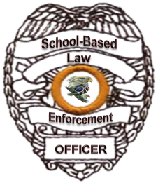
VISION
To develop a universal integrated holistic school safety & security model concept, Force Multiplier and training plan.
Notes:
Put the researched and developed School-Based Law Enforcement Holistic Concept and Training Plan for officer-deputy training in respects to School Safety & Security into its full potential and effect. To like the D.A.R.E. Program “Make a Difference” in tomorrow world by impacting todays training standards.

Slide 5
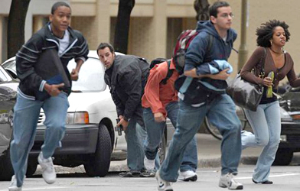
MISSION
To prepare our officers/deputies, law enforcement supervisors, school and law enforcement administrators/executives, school board members, staff/faculties, students, parents and communities to meet any need, emergency and/or active threat encountered on any school, college and/or university campus.
Notes:
To prevent further tragedy and/or massacre’s at our school campuses (Elementary through college/university) by preparing our officers & deputies to deal with all active threats facing our schools today and by; preparing our SBLE Law Enforcement supervisors; our Sheriff’s, Constable’s and Chiefs in addition to our School Administrators, Principals and Board members; school staffs to be properly trained and prepared for emergency preparedness and to; teach students; and parents, vital information they need to meet, assist and over-come through positive intervention and prevention practices and in alleviating all challenges and threats facing our Youth.
Tragedy (trag·e·dy /ˈtrajidē) Noun: An event causing great suffering, destruction, and distress, such as a serious accident, crime, or natural catastrophe. Or a play dealing with tragic events and having an unhappy ending, esp. one concerning the downfall of the main character.
Massacre (mas·sa·cre /ˈmasikər) Noun: An indiscriminate and brutal slaughter of people: "the attack was described as a cold-blooded massacre". Verb: Deliberately and violently kill (a large number of people). Synonyms noun. slaughter - carnage - butchery – bloodshed verb. slaughter - butcher - murder - slay – kill.
Please study these words carefully. We consistently treat the wound verses preparing layers of protection and training that would prevent further wounding. Does it have to happen to your Child before you get serious? Why not ask a parent, one who lost a child this December how they would have felt having a highly trained, knowledgeable, skilled, proficient and competent officer/deputy at Hook Elementary the day that tragedy and massacre hit their school?
How many armed officers-deputies and/or security guards do we have (not including secret service protection) for our own President and Vice-President children’s campuses? Are our children any less deserving? I do not believe our current President and Vice-President feel that way either; in my perception they felt impacted by this tragic event as did the actual parents (not to the same degree but still emotionally impacted). I truly believe they will do the right thing for the right reasons. You see they are concerned parents as well that truly care. That is just my opinion.

Slide 6
GOALS
Holistic integrated and specialized training based on “Best Practices” and Lessons Learned. (Reality not theory-based)
Affordable Cost Advantageous
Governed by stakeholders and not a college or university
Provide layers of protection
through TRAINING.
Notes:
Other more tangible and specific goals and objectives are in following sides and slide notes.

Slide 7
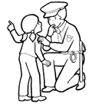
Get “The MESSAGE”
D.A.R.E. AMERICA
N.A.S.R.O.
School District POLICE
Notes:
REMEMBER THIS: “Never has a law enforcement officer stood so tall and valiant as when he/she stooped to help a CHILD”.
If our “FOCUS” is truly to help and protect our children where they can learn; then it is time to put-a-way our Childish ways, pettiness's, differences and political correctness and stayed the course!

Slide 8
Stakeholders
U.S. Department of Education
School District Chiefs of Police Association’s
Texas Sheriff’s Association (National Sheriff’s Association)
International Chiefs of Police Association (ICPA)
Notes:
These are the entities with the real dog in the hunt so-to-speak and be accurate. They include both D.A.R.E. Officers, N.A.S.R.O. – School Resource Officers (SRO) and G.R.E.A.T. Officers.

Slide 9
OBJECTIVES
Cross-train our officers-deputies
  D.A.R.E. Officers/Deputies
  S.R.O. Officers/Deputies
  G.R.E.A.T. Officers/Deputies
  Certified Crime Prevention Specialist (C.C.P.S.)
  Community Policing Specialist
  First Responders
  INTEL Specialist
  Special Response Team (S.R.T.)

Slide 10
OBJECTIVES – Cont’d:
Specialty (Highly Specialized) Training for
  Officers/Deputies
  Law Enforcement Supervisors (Leadership Training)
  Law Enforcement & School District Administrators (And School Board Members)
  School Staff & Teachers
  Students
  Parents

Slide 11

OBJECTIVES – Cont’d:
DETECT – DETER – DELAY – DENY
  Alcohol
  Tobacco
  Over-the-counter Drug Abuse
  Prescription Drug Abuse
  Illegal Drug Sale/Use/Abuse
  Bullying
  Teen Suicide
  Gangs
  Other Active Threats and/or Violence

Slide 12

OBJECTIVES – Cont’d:
Enhance Safety & Security for our Schools
Enhance Officer & Administrator/Faculty Relations
Enhance Officer & Student Relations
Enhance Officer/Agency & Community Relations
Enhance School & Community Relations

Slide 13

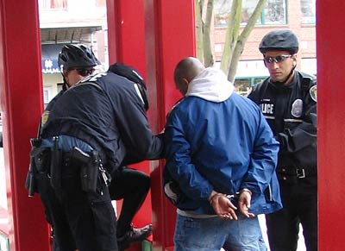

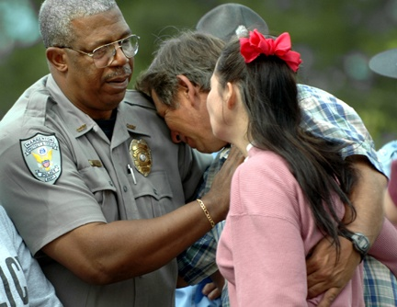
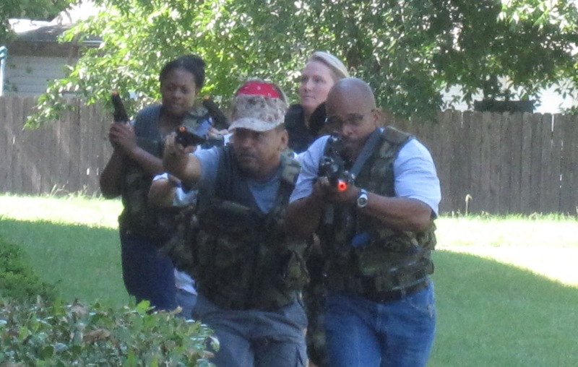
Prepare/Prevent
Protecting Schools from Tobacco, Alcohol, Drugs, Active Threats, (Terrorism – Shooters) Gangs and Violent Acts
Through Specialized Training
Evaluation
Response
Recovery
Notes:
The SBLE Officer Training Program is a force multiplier capable of mitigating, deterring, responding and recovering from any conceivable threat based on a holistic and all hazards approach and methodology. The primary and secondary school systems within the United States present an inviting and unprotected target to domestic active shooters, terrorist cells, drugs, gangs and other violent activities. The single greatest aggregation of children on a recurring basis is daily attendance at school (Elementary, Middle/Junior High, High Schools, Colleges and Universities). The first real documented attack by an active shooter was on August 1st, 1966 when Charles Whitman climbed to the top of the observation deck of the University of Texas in Austin and subsequently killed 16 people and wounded 31 others during a 96 minute rampage. Since that time the United States has experienced 57 (documented) active-shooter incidents on school campuses. This does not include gang attacks and gang related campus shootings, student suicides on campus, drug related shootings/deaths on campuses and/or domestic terrorist attacks such as David and Doris Young committed at an elementary school in Coker Wyoming in May 1986 or the potential suicide bomber at the University of Oklahoma football game in 2008 that was basically covered-up. In respects to potential international terrorism the attack on the school in Beslan, Russia (September 2004) should be viewed as a possible new trend based on the successful completion of the attack and attainment of the associated terrorist agendas that demonstrates the viability of the primary and secondary schools as an easy target for the committed terrorist. Project SBLE Officer Certification Training Program is not just another Homeland Security initiative focusing on just active shooters or potential threat of a terrorist attack. It is a holistic all hazards approach designed to meet all the threats of violence faced by our campuses to day. Such as drugs, gangs, bullying, dating violence, teenage suicides, truancy, absenteeism, bomb threats, bombing incidents, concealed weapons, as well as other disrupted and violent behaviors that plague our campus classrooms, administrators, staff, educators, students, parents, law enforcement and security officers on a daily basis.

Slide 14
Research & Development
Input from officers in schools, feedback from officers taking the course and course evaluations
Input from I.S.D. Chiefs
Texas D.A.R.E. Training & Development Institute TCLEOSE Advisory Board
Best practices from lessons learned across the state and nation
Independent evaluations
Notes:
The Texas D.A.R.E. Training & Development Institute Holistic School Safety & Security Concept and Training Plan was modeled after the ICJS-Texas Plan that was independently evaluated by Parks Place, LLC, Edwards Risk Management and the Texas ACLU shows SBLE Basic Course is on-track and meeting training needs of officers.
Feedback from officers confirms it is what they need to effectively do their jobs.
It identifies and develops (holistic – comprehensive training standards that provides highly) specialized knowledge, skills, intervention and prevention strategies and plans for action to deny, detect, delay and/or deter current threats facing our schools.
Core Lessons/Curriculums developed by true subject matter experts (SME) delivered (fielded and tested) by same experts and developed into simply user-friendly TRAIN-the-TRAINER formalized lesson plans (with detailed instructor notes and background information), PowerPoint's and Handouts – Standardized (Universal) lessons/curriculums.
D.A.R.E. America (As opposed to N.A.S.R.O. and others) already have Training Centers by Policy & Procedures established in every state – most likely deliver platform.

Slide 15

LEVEL I – SBLE Officer Courses
Phase I: Basic Officer-Deputy Course
Phase II: Intermediate Officer-Deputy Course
Phase III: Advanced Officer-Deputy Course
Phase IV: Masters Officer-Deputy Course
Phase V: Other select supplemental courses such as N.A.S.R.O. specialty lessons.
Highly Specialized
TRAINING

Slide 16
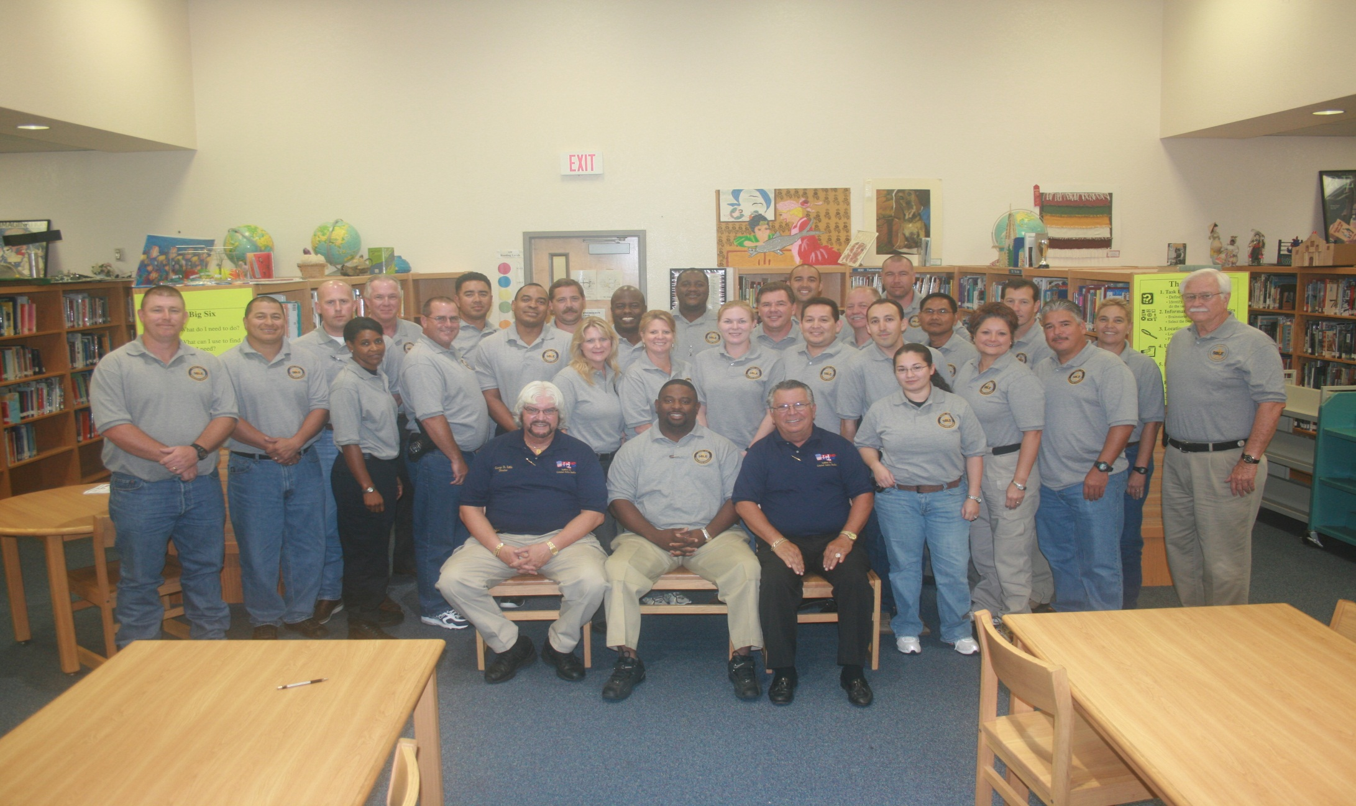
Phase I Levels I – IV & V
Officer-Deputy SBLE Training

Slide 17
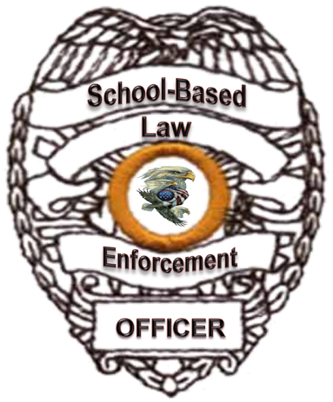
OVERVIEW of
SBLE Basic Officer
Specialized Training Course
LEVEL I
PHASE I - Basic

Slide 18
Basic Officer Course/Lessons
History of School-Based Law Enforcement (SBLE)
Gangs (Overview – what to look for & officer safety)
Juvenile Law & Juvenile Case Law
Alcohol Code & Health and Safety Code
Law Enforcement Ethics
Notes:
History of School-Based Law Enforcement (SBLE)
Juvenile Law & Juvenile Case Law
Alcohol Code & Health and Safety Code
Law Enforcement Ethics
ADD: Education Code Chapter 37 – Generic to Texas Only

Slide 19
Basic Officer Course – Cont’d
Sharing of Information Law (FERPA)
Search and Seizure in Schools - Handling and Processing Juvenile Offenders
Recent School Case Law
Penal Code & Code of Criminal Procedure
Alternative strategies for writing tickets to enforce school discipline.
Notes:
Sharing of Information (FERPA)
Search and Seizure in Schools - Handling and Processing Juvenile Offenders
Recent School Case Law
Penal Code & Code of Criminal Procedure
Chapter 37 Texas Education Code

Slide 20
Basic Officer Course – Cont’d
First Responder Terminology/Threats Chemical-Biological & Radiological (CBR)
First Responder Health & Safety Response Protocols for CBR
Improvised Explosive Devices (IED) Awareness
Counter-Terrorism (Domestic & International) - ISI
Notes:
First Responder Terminology/Threats Chemical-Biological & Radiological (CBR)
First Responder Health & Safety Response Protocols for CBR
Improvised Explosive Devices (IED) Awareness
Counter-Terrorism & Active Shooters in our Schools

Slide 21
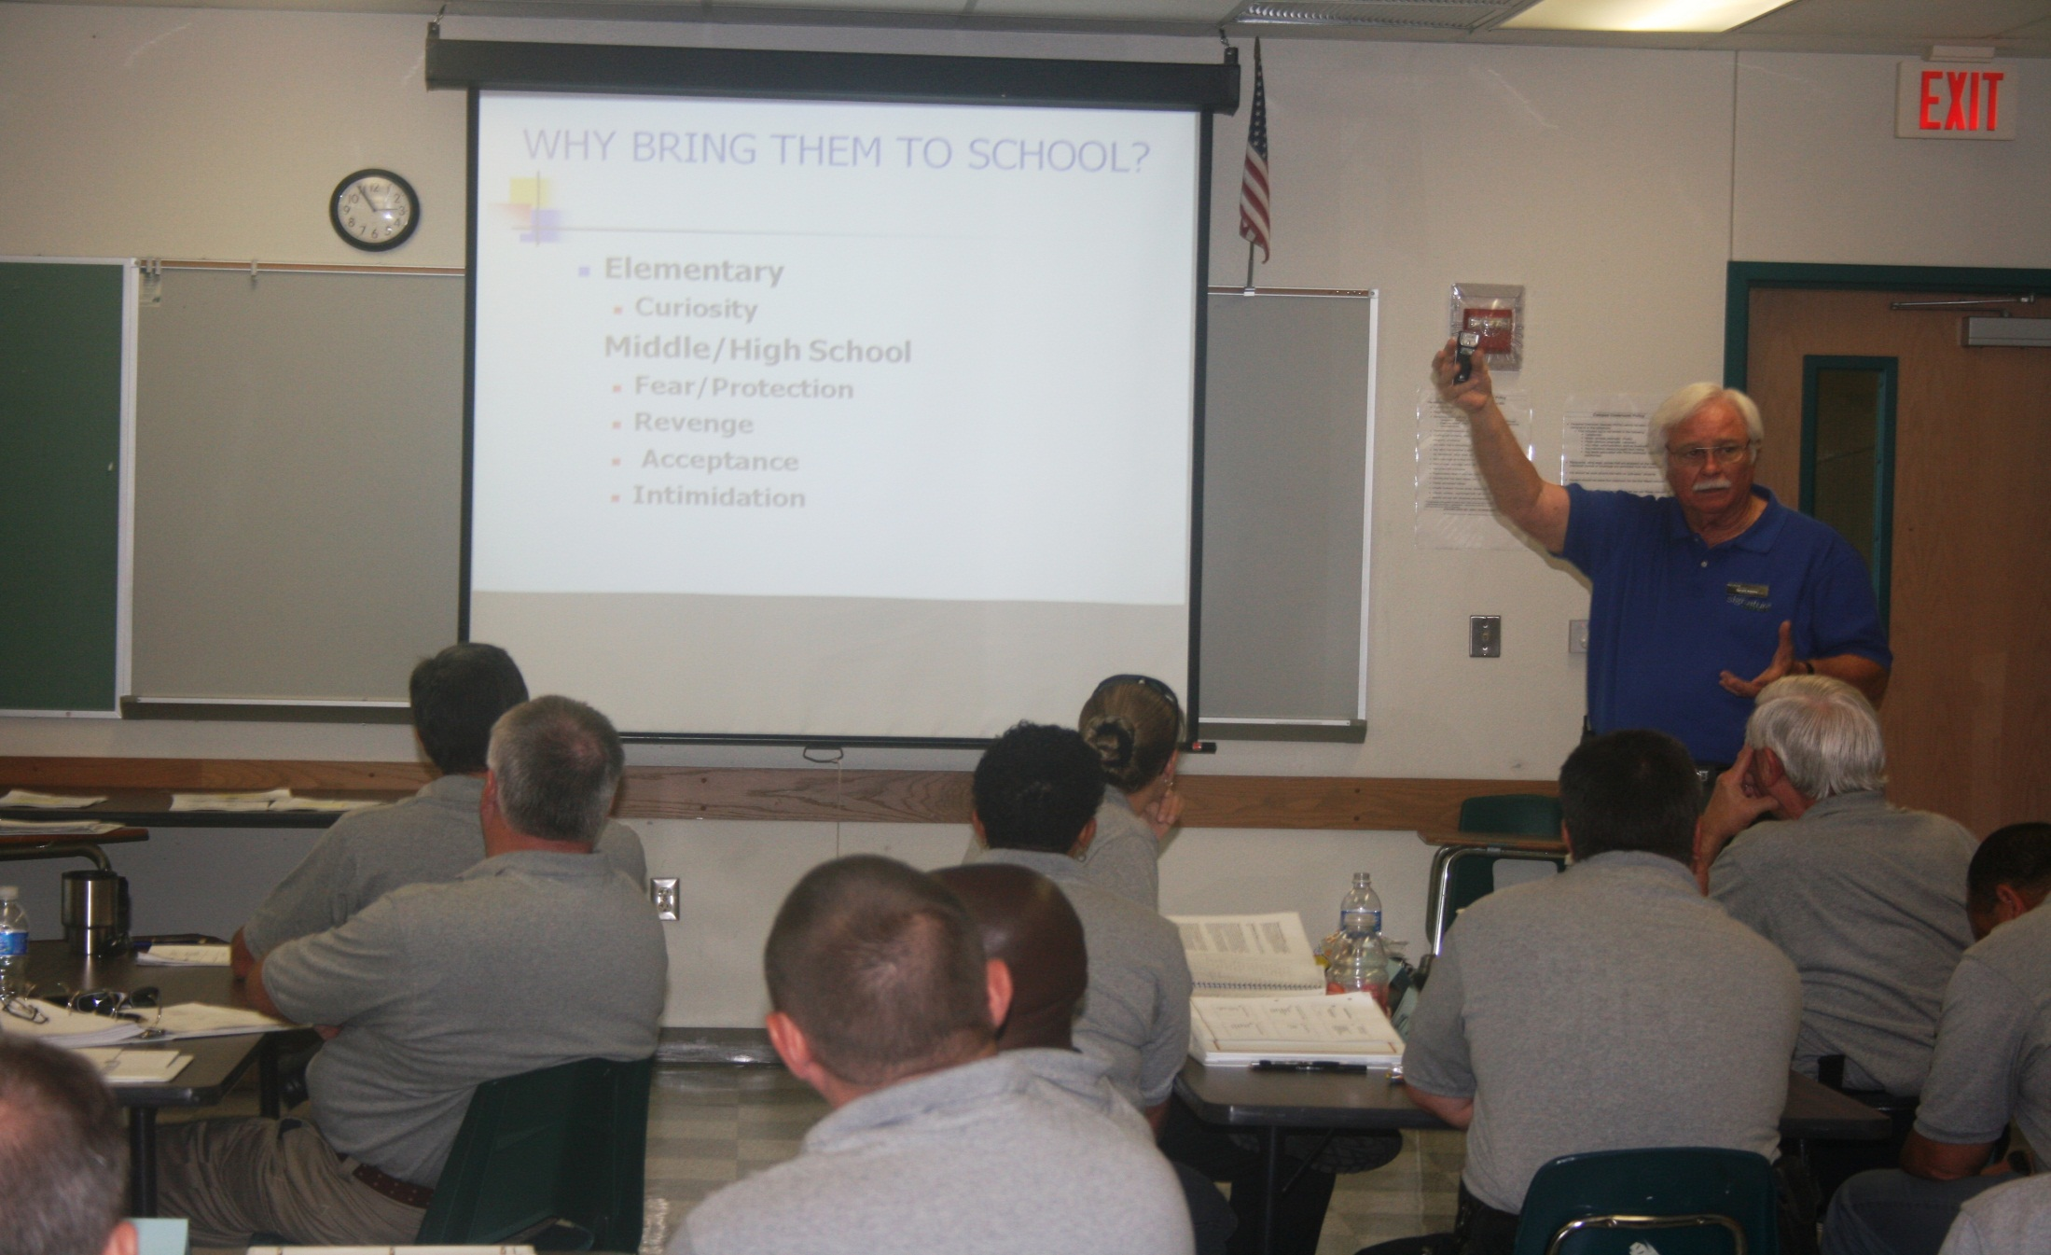
Confrontation Management and Concealed Weapons
Notes:
Confrontational Management In a School Environment
Hidden (Concealed) Weapons

Slide 22

Basic Officer Course – Cont’d
CPTED for Schools
School Violence “Cause & Effect”
Bullying & Cyber-Bullying
Drug Awareness Part I (Concealment)
Mitigating School Mass Active Threats
Krav-Maga (Israeli unarmed self-defense – Officer & student safety) ISI
Notes:
Crime Prevention Through Environmental Design (CPTED) for Schools
School Violence
Bullying
Gangs (Overview)
Mitigating School Mass Shootings - Active Shooter
Introduction to Krav Maga (Israeli Unarmed Self-Defense)
Officer – School Staff, Students & Parent Relations

Slide 23
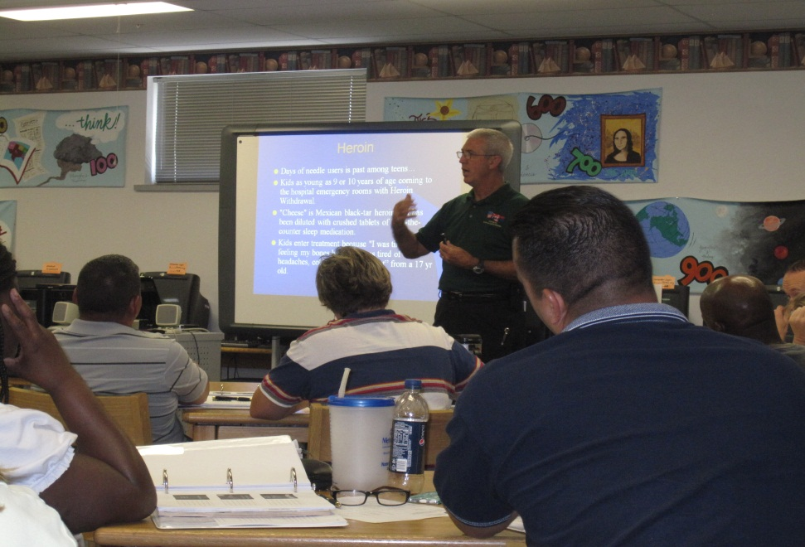
Drug Awareness

Slide 24
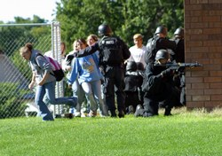

Basic Officer Course – Cont’d
SBLE Officer, School Staff, Student and Parent Relations Part I
Overview of/for Developing comprehensive Emergency Operations Plans (EOP) or Emergency Action Plans (EAP)
Scenarios (Critiques & Evaluation)
Open Forum & Discussion
Notes:
Reminder: Lessons can be changed but remember the objective is to make this holistic training plan universal (develop same training standards with minor deviation with respect to state juvenile laws only). The safe caution (acceptance) here is to ensure that everyone will need (require) this training to ensure all are on the same page across the country. Some may have a basic knowledge of what is being taught – those can help ensure others do understand. In reality the officer/deputy on the campus will be the true First Responder, and responsible for initial (immediate) safe evacuation of innocent children; not a S.W.A.T. team.

Slide 25
OVERVIEW of
SBLE Intermediate Officer
Specialized Training Course
LEVEL I
PHASE II - Intermediate

Slide 26
Intermediate Officer Course
Gang Investigations (Intervention Strategies)
Juvenile & School Case Law (Updates)
Action Planning – Problem Solving
SBLE Officer Role in Discipline & Enforcement (Keep Kids In School)
School Special Reaction(Response) Teams (SSRT) 16-hours ISI
Notes:
School Special Reaction Team Make-up (Components)
Law Enforcement Officer/Deputy (D.A.R.E., G.R.E.A.T. and/or SRO)
Assistant Principal
School Nurse
Janitorial Staff
Counselors

Slide 27
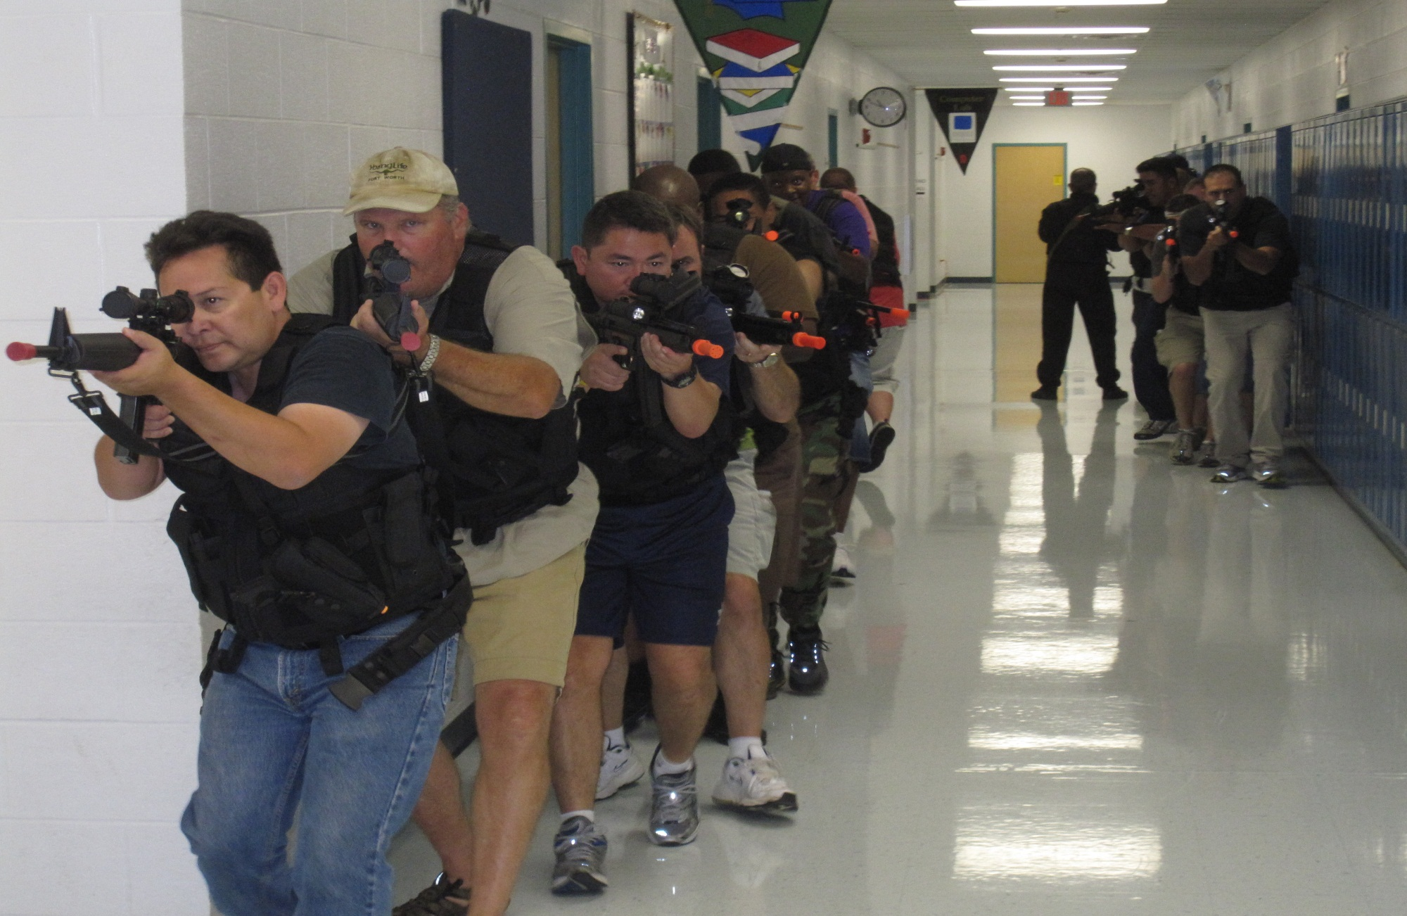
School Special Reaction TEAM
Tactical & First Responder & Other
Active & Specialized Threat TNG

Slide 28
Intermediate Course – Cont’d
Collecting, Analyzing, Reporting and storing Intelligence for SBLE Officers
SBLE Officer Stress Management
Drug Awareness Part II (Symptoms & Signs)
SBLE Officer Fitness, Wellness and Professional Development
SBLE Officer how to work with the media.
Dating Violence & Stalking in Schools

Slide 29
Intermediate Course – Cont’d
Identifying potentially dangerous and/or violent persons or students
SBLE Officer Role as a “Problem Solver”
SBLE Officer, School Staff, Student and Parent Relations Part II (Cultural Diversity)
Developing School Safety Teams (Special Reaction (Response) Teams) – SSRT (ISI)
Hostage Rescue (Initial
Negotiations)
Notes:
Special Reaction (Response) Teams – Emergency Response Team
Elementary & Middle/Junior Schools
Law Enforcement Officer/Deputy (D.A.R.E., G.R.E.A.T. and/or SRO)
Assistant Principal
School Nurse
Janitorial Staff
Counselors
High School
Law Enforcement Officer/Deputy (D.A.R.E., G.R.E.A.T. and/or SRO)
Assistant Principal
School Nurse
Janitorial Staff
Counselors
Add specially trained Law Enforcement Explorers and JROTC

Slide 30
OVERVIEW of
SBLE Advanced Officer
Specialized Training Course
LEVEL I
PHASE III - Advanced
Notes:
Just another block (or the next step or level) in the building block process of/in creating highly knowledgeable, skilled and professional law enforcement officers/deputies.

Slide 31
Advanced Officer Course
SBLE Officer Crisis Intervention & Prevention
Collecting, Analyzing and Reporting INTEL Part II (Know what is going on)
Drug Awareness Part III (Most abused drugs)
Gang Intervention & Prevention Strategies
Truancy (Why we need to keep kids in schools)
Notes:
Crisis Intervention and Prevention is a sorely need skill that must be developed.
Collecting, analyzing and time reporting of INTEL can (will) reduce risk to our children and our schools. We must over-come misnomers and spins placed on INTEL that falsely portrays it (INTEL) as an invasion on human civil liberties and individual rights and remember that our ultimate focus is on preserving all human life, including the lives of violent (potential) perpetrators. Everyone in a free society has a right to live.
The illegal drug world is constantly involving with ever new forms of a way to get-high are being sought out. It is imperative that our officers/deputies are aware of this ever-changing and evolving drug cult within our free society. The more knowledge we provide our officers/deputies in what to look for and how to identify these menacing and detrimental (family destroying) illegal and harmful drugs they easier it will be to intervene and prevent drug abuse. Tun Zu in the art of war described it best “to defeat an enemy one must first understand his traits and characteristics” i.e. know thy enemy and you can defeat him. In our case if we can identify a potential drug user/abuser we can possibly get to him/her before drug dominance subsides.
Gangs are taking over our society for a myriad of reasons. If our officers/deputies can be taught the signs to look for maybe we can dry up the source by implementing positive intervention and prevention strategies. We must first seek to understand the why and subsequently develop strategies that will reduce potential sources (i.e. our young children) that allows gangs to perpetuate. Dry up the well so-to-speak. We will need positive alternatives and programs to do this and an education process that will help us achieve this desired goal.
Truancy is still a major problem in our country. We need to keep our kids in school and seeking not only a minimal education, but a higher and continuing education whereby they may all enjoy a better quality of life. By looking at the cause and effects of truancy we can better intervene and prevent it. “In every adversity lies the seed of an equal or greater benefit” providing we are willing to seek the positive in the negative and learn from it.

Slide 32

Advanced Course - Continued
Establishing and Empowering Teen Courts & Peer Review (Positive alternatives designed to keep kids in schools) using Student Councils.
Establishing Neighborhood School Watch Programs (Community-based)
Special handing of mentally challenged students or students with special needs
Physical restraint & de-escalation tactics – use of force continuum for schools
Notes:
We are missing out of one of the most important assets we have, that is empowering our children to become responsible and accountable young future adults. We can establish Youth Advisory Boards (as we have successfully done in, with and through the D.A.R.E. Program taking it to the next level and teaching them how to govern themselves. Make them responsible for enforcing discipline within our schools by establishing and training them to have and hold teen courts. Make them part of the solution not keep them as part of the problem. Cultivate their potential. The absolute best way to teach a child is a positive role model (child) teaching them. Give them realistic scenarios (as we do with and through D.A.R.E. Keepin-It-Real curriculums and facilitate their learning process empowering them to teach other kids (their peers). We need to teach our officers/deputies how to do this; how to work with their school districts and kids to establish this concept as a vital reality in our schools. Give kids a reasonable challenge, believe in them and they will deliver beyond our wildest expectations.
We have focused on establishing Neighborhood Watch Program though our Crime Prevention initiatives (and where proper training and assistance provided) these programs have worked achieving a high degree of success. Why can’t we take that and do a School Watch Program designed to enhance our school safety and security at minimum financial drain. Where are our schools, for the most part located directly within our communities. We can seek volunteers from AARP, our retired/disabled veterans as we actually have a plethora of un-tapped resources just sitting there, many looking for and desiring something to do. Use this resource and reach our officer/deputies how to develop and tap into these resources. Now add to this concept presented here the additional option of using these same assets identified (and that are properly screened – required background checks) to volunteer their time to teach citizenship, patriotism, duty, honor country in addition to helping provide our schools much needed mentor resources for English (Or English as a second language), math, history and the sciences. Put a veteran that lives in the community (with nothing to do) in our schools and you have a person already trained to defend, trained in basic first aid, self-disciplined and add that person now as an additional School Special Reaction Team member. Finally there is a historical fact that is it much older than I, ”there is counsel in the wisdom of our elders”.
We need to give our officers/deputies highly developed (based on the best of Best Practices) knowledge and skills on handling with mentally challenged students, especially students with special needs. Traditionally our response has been “good luck out there” what about giving them the training they need. Protecting a child from hurting his/herself and or other students should be (needs to be) a priority. There are numerous well grounded/founded companies like “Controlled Force” that have developed this into a discernible and easily acquired skill. Kids are not adults but for those of you that have never had to deal with it, it can be very overpowering if you are not trained and/or prepared. Does an officer/deputy, school staff member or child need to get hurt before we take positive intervention and prevention steps to reduce violence even on our own part?
We need physical restraint and de-escalation techniques taught to all our officers/deputies. We need to teach them how to properly use verbal judo to de-escalate a potentially violent situation. This requires a sensitive as well as vigilant approach and technique. Again however we are quick to teach aggressive and over-assertive minimal uses of brute force to respond. Why not apply and use effectively (protecting all concerned) new, innovative means of physical restraint and de-escalation of use of force and response to violence. There are positive alternatives that are safer, more conducive to violator or perpetrators as well as innocent persons, officers & deputies.

Slide 33
Advanced Course - Continued
Teen Suicide intervention and prevention
Responding to School Bomb Threats
Understanding Child development & psychology
Cultural diversity on school and college campuses
Conducting Campus Safety & Security threat assessments
Notes:
The latest data available from the Center for Disease Control and Prevention indicates that 38,364 suicide deaths were reported in the U.S. in 2010. This latest rise places suicide again as the 10th leading cause of death in the U.S. Nationally, the suicide rate increased 3.9 percent over 2009 to equal approximately 12.4 suicides per 100,000 people. The rate of suicide has been increasing since 2000. This is the highest rate of suicide in 15 years. Now that was the latest statistics I could find that are now over 2-years old. With 16% of our teenagers within the United States have considered or have contemplated committing suicide (a profound form of self-inflicted violence) it is time that we taught our officers & deputies of the warning signs of what to look for. In addition to teaching them positive intervention and prevention strategies. Finally teach them community resources available to our teens and youth. We take it for granted that out teen no where to turn when faced with these violent thoughts…Wrong Answer they don’t despite the best intentions of Public Service Announcement (PSA).
Please do not try and tell me that we have this down to a science now in regards and respect to Bomb Threats. We give (handout) a brochure or card telling us what to do in the event that someone calls in a bomb threat. What real training do we give? Do we teach our officers-deputies what they should teach, or do the same thing here is a card if someone calls in a bomb threat here is what to do! Remember I too came up in the ranks and have worked with law enforcement agencies all across the United States at both federal, state and local level. I will not perplex you with the war stories I have heard from officers literally all across the country on the realities of life and duty as a law enforcement officer. This requires knowledge and skill level and practice. Well how can be test or evaluate something we take for granted until God forbid we actually get a call and calamity, chaos and a lot of very unsafe acts take place. Prepare today for tomorrow and rehearse and practice those skills which you may (will) need to remember.
America has the “Mother load” of cultural diversity. We literally have representation from every nation in the world now living in our great county as American citizens. It is imperative that our officers and deputies become sensitive to many cultural beliefs and practices especially in regard to children. Example we have been taught to pet a child on the head as a form of reward and recognition, yet to do the same to a Muslim child in a serious cultural offense; even through they now live in America they are still entitled to their beliefs, morays and norms as they attempt to acclimate to becoming American citizens and adapting to an American culture. There is an old biblical song “Red, Yellow, Black, Brown or White they are precious in HIS sight” and mine too. We need to learn respect before we can truly ever show it and much less expect it. This requires at minimum some basic understandings.
We need to teach our officers & deputies that work in our schools how to do a good “Threat Assessment”, however we chose to hire private companies that have no true vested interest other than getting a school, local or state governments funding. To teach our officers & deputies of what to look for and how to do a proper threat assessment will pay long time dividends, because they will then be vigilant and know what to look for bringing immediate intervention and prevention technology and strategies based on best practices where and when they are needed. Remember these are men and women that walk the halls of our schools every single day and that do not have the tied down obligations of conducting a class or running a school. The approach is a Train the trainer approach that will enable and empower our officers & deputies to pass on the skills to janitors, etc. that can help them keep the vigil and stay proactive at a minimal expense.

Slide 34
Advanced Course – Continued
Structuring, composition, role, responsibility and accountabilities of Special Reaction (Response) Team members
Developing comprehensive Emergency Operations Plans (EOP) or Emergency Action Plans (EAP)
Hostage Rescue and/or initial negotiation
Scenarios (Critiques & Evaluation)
Notes:
We have many resources that in the event of a tragic event can be immediately mobilized to support (reinforce) our officers & deputies working with our schools. WE can use existing resources until the literal reinforcement arrives to sustain and prevent further loss of life. We can teach our officers & deputies how to build their own campus Special Reaction Teams using assistant principal(s), school counselors, school nurse and janitorial staff. For example while SBLE Officer provides security the school nurse can immediately began life-saving measures; the janitor can detect any unusual (out-of-place) objects (potential explosive devices), the school assistant principal and/or counselor can began evacuating children and staff that may be in danger area or assist in collection of intelligence from/by fleeing students; but all this requires training, then practice and a rehearsal. Emphasis on highly specialized training and new skill level for our officers-deputies.
Many of our schools do not have Emergency Operations Plans in place, some have but never bothered to obtain law enforcement officer input and most all have never been rehearsed until actually facing a live, viable active threat. The time to figure out you need a plan is not when you are in the heat of battle, you should have had that plan prior to the fight with built in contingency plans; and you should have rehearsed it before going into actual battle. We need to teach our officers and deputies again based on “Best Practices” on what to look for and teach them how to effectively recommend needed changes and/or modifications in order to be current and surreal. If they have never had the training how will they know what to look for?
Again, this is all a very structured and normal progression building block process.
We need to teach proper and proven successful models for hostage rescue and initial negotiations. If an officer/deputy manages to isolate a perpetrator but the perpetrator managed to grab some innocent hostages (children) the last thing the officer-deputy needs to do is start shooting. This is definitely where calmer heads need to prevail. It is an art to keep an already violent offender from becoming more violent. Cardinal rule in negotiation is never tell the perpetrator “NO” as this can send him/her into a violent totally out-of-control spiral to say the least. Just some basic training until a professional and highly trained negotiator can arrive and take over.
All of these lessons require a Define & Process component, in addition to having to pass a comprehensive 100 question test. Participant critiques and course evaluations helps serve as a compass to ensure this training stays the course and meets officer-deputy needs.

Slide 35
OVERVIEW of
SBLE Master Officer
Specialized Training Course
LEVEL I
PHASE IV - Master
Notes:
This is where the SBLE Officer/Deputy develops his/her presentation skills while acquiring basic knowledge and content of the SBLE School Staff, Student and Parent Curriculums/lessons. The must Define & Process then present each lesson from each curriculum (modeled after a D.A.R.E. Officer DOT (2-week training). In addition they will receive other school safety and security sensitivity related training.

Slide 36

Master Officer Course OBJECTIVES
Neutralizing threats (w/practical's)
Analyzing Threat INTEL
Threat intervention & prevention strategies based on Best Practices and Lessons Learned
Facilitator and presentation skills enhancement
Preparation, practice and delivery of the following curriculums/lessons:
Notes:
Neutralizing threats (w/practical's) diverse scenarios designed to create instinctive motor memory and instantaneous responses
Analyzing Threat INTEL while protecting civil liberties, individual rights and preserving life.
Threat intervention & prevention strategies based on Best Practices and Lessons Learned (Real Life – Real World scenarios) cultivated from lessons learned and “Best Practices” models.
Facilitator and presentation skills enhancement. Teaching our officers-deputies instructor, presenter and facilitation skills designed to enhance performance, achieve learning objectives and deliver realistic and quality training.
Preparation, practice and delivery of the following curriculums/lessons:
School Staff Curriculum/Lessons
Student Lessons (additional to D.A.R.E. Lessons)
Parent Lessons

Slide 37


Master Officer Course OBJECTIVES
SBLE Officer will learn and be able to deliver the SBLE School Staff training curriculum
SBLE Officer will learn and be able to deliver the SBLE Student training curriculum
SBLE Officer will learn and be able to deliver the SBLE Parent training curriculum
SBLE Officers must Define & Process each of the curricula lessons.
Other identified specialized training required
Notes:
As you will see from the individual courses described here and later in this presentation all have been researched and designed to create a “Force Multiplier” and “Force Protection” cause and effect; in addition to bringing all resources to bear on keeping our schools safe and secure, through positive intervention and prevention strategies.
This is where the SBLE Officer/Deputy develops his/her presentation skills while acquiring basic knowledge and content of the SBLE School Staff, Student and Parent Curriculums/lessons. They must Define & Process, practice then present each lesson from each curriculum (modeled after a D.A.R.E. Officer DOT (2-week training). In addition they will receive other school safety and security sensitive related training.

Slide 38
LEVEL I PHASE V
Supplemental Education
Courses on controlling mentally disturbed persons using minimal force (adults and juveniles).
Advanced INTEL collection, analysis and sharing (preserving civil liberties and life)
Advanced Tactics (dealing with myriad of threats)
Other courses requested by officers & deputies vested with responsibility to serve and protect
Notes:
We must remain open-minded and remember to listen to the voices of those charged with the principal responsibility to maintain order while serving and protecting our citizens and children.
We always worry about budgets to the point of sacrificing what we need most – TRAINING. The first line-item looked to in respect of saving money is our law enforcement training budget. It has traditionally become a systemic detrimental problem; yet we continue to ignore the reality that we cannot expect our law enforcement officers & deputies to meet extremely high professional standards and expectations, without providing them “The means” to achieve these high professional standards and expectations. It seems no one wants to admit that this has been a perpetual problem for fear of being viewed as being politically incorrect (or in perceived controversy with political individuals and/or entities. We must admit the problem before we can cure it (fix it)! It has gotten so bad that we accept officer/deputy instructors reading from a book verses submersing our officers/deputies into practical and real world scenarios (situation) in a controlled training environment teaching them “The Right Way”. There is wrong way to do the right thing and there is no right way to do a wrong thing!
We wonder why there is such a gap between our citizens and law enforcement. We ponder why our officers & deputies sometimes cannot communicate with our citizens and their exist a mutual lack of respect from all parties. Whatever the cause and effect we desire, the solution lies within our training regiment (how we train and what we train on).
Saving life cost money…..the Rhetorical Question remains is preserving human rights, liberties and life worth the expenditure?
I firmly believe law enforcement officers and people (especially in highly stressful situations) will respond to their level of training.
For over 200 years the basic premise and concept of/for law enforcement is to prevent crime. Yet all of our resources today are allocated to responding verses intervention and prevention. What ever happened to the colloquialism “An ounce of prevention is worth a pound of cure”? Where and when did we lose sight of this meaning? The way to deal with crime and violence is to early detect, deny, delay and deter them.
The solution is to provide quality, state-of-the-art, best practices curriculums and lessons that are designed to enhance performance, knowledge and skill level that will adhere to early intervention and prevention strategies that will detect, deny, delay and deter crime and violence within our society; the way to achieve this is TRAINING.

Slide 39
LEVEL I PHASE V
Supplemental Education – Cont’d
N.A.S.R.O. Courses:
  Basic S.R.O.
  Advanced S.R.O.
  S.R.O. Active Shooter Response
  Interview and Interrogation techniques for the S.R.O.
  School Security Officer (SSO) course
  Enhancing Lock-down Procedures for S.R.O.
  School Law Up-dates for S.R.O.
Notes:
The Basic School Resource Officer Course is a forty-hour block of instruction designed for any law enforcement officer with two years or less experience working in an educational environment and school administrators. The course emphasizes three main areas of instruction:
Functioning as a police officer in the school setting
Working as a resource and problem solver
Developing teaching skills
Attendees will gain a solid working knowledge of the School Resource Officer concept and how to establish a lasting partnership with their schools.
The Advanced School Resource Officer Course is a twenty-four (24) hour block of instruction designed for any law enforcement officer working in an educational environment. This course, following the SRO Triad model, advances the SRO's knowledge and skills as a law enforcement officer, informal counselor, and educator.
NASRO in cooperation with Tactical Defense Institute (TDI) is pleased to present "SRO Active Shooter Response" course.
This is an intensive five day hands-on course which focuses specifically on a one and/or two officer response to an active shooter or random violent incident on a school campus. NASRO and TDI instructors presenting the course are all certified firearms instructors with several years of tactical experience.
Interview & Interrogation: This 24-hour course is designed to provide SROs with the knowledge and skills to understand and interpret verbal and physical deception signals in an interview situation and correctly identify stress and/or deception in written statements. This course is taught in a three day, eight hour format. Classes begin promptly at 8:00 am each morning and conclude at 5:00 pm each evening. Attendees are required to attend all sessions in order to obtain the National School Resource Officer Interview and Interrogation Course Certificate.
School Security Officer: is a 3 day/ 24 hour training course for non - sworn safety and security officers working in schools with an SRO or solo. The course will emphasize three main areas of instruction:
Functioning as a security officer in the school setting Working effectively with students School Safety and Emergency Planning . Attendees will gain a working knowledge of the School Safety Officer concept and how to establish a lasting partnership with their schools.
Enhancing Lock-down Procedures: is a 16-hour course that will focus on moving beyond the traditional lockdown and provide optional responses, based on the circumstances at hand, to school resource officers, school administrators, teachers. and school staff should there be a violent situation on campus. Participants will be provided instruction on key components of an organized and thoughtful Emergency Operations Plan with emphasis on Survival Strategies.
School Law Up-dates: This one-day, specialized National School Law Update has been designed at the urging of School Administrators and School Resource Officers from across the country. By addressing such timely subjects as search and seizure, student interviews, custody issues, sexual harassment, and civil liability. It is taught by Dr. Bernard James, J.D., Professor of Constitutional Law at Pepperdine University.

Slide 40
FORCE MULTIPLIER
CROSS-TRAINING CONCEPT
  D.A.R.E. Officer
  N.A.S.R.O. Officer certification courses
  Crime Prevention courses
  G.R.E.A.T. Officer certification
  Community Policing & S.A.F.E. training courses
All rolled into one elite force
for “GOOD”
Notes:
CROSS-TRAINING – FORCE MULTIPLIERS
D.A.R.E. Officer certification (2-week course)
N.A.S.R.O. Officer certification courses to enhance SRO knowledge and skill level.
Crime Prevention courses designed to certify officer/deputy as a certified crime prevention specialist (C.C.P.S.)
G.R.E.A.T. 40-hour certification course offered in Texas at annual summer training conference
Community Policing certification courses
Logic and Rationale:
It is cost advantageous in regards to:
One officer/deputy trained to do the job normally expected of five (5) different individuals.
This concept will reflect definitely justifiable to any budget hearings
Maximum use of existing resources.
It serves to improve police & community relations
It promotes and enhances officer as well as citizen safety and security
This will take a street level officer and take him/her to the next level. The Agency will get an officer/deputy exceeding any normal expectations of knowledge, skill, competency and professionalism.
A D.A.R.E. Officer-Deputy with genuine passion, commitment and resolve connects with students and establishes:
Trust relationships between students and officer-deputy (Bond)
Positive “Role-Model” – Mentor platform
Pulse on what is happening going on at his/her campus (from a “Positive” Safety aspect)
Ability to easily and quickly detect, deter, delay and/or deny crime and/or juvenile crime (i.e. bullying, assaults, illegal drugs, gangs, teen suicide, other active threats, etc.)
Visual and Physical Deterrent (Pro-Active) Intervention and prevention strategies, skills and techniques by/through his/her “Active-Listening” skills and through rapport they build with students. (Strengthens potential DHS identified soft-target)
Improved inter-discipline built through “Respect”.
Virtual Reality – “HOTLINE” for intervention and prevention
Provides positive “SAFE” & Secure learning environment.
A D.A.R.E. Officer-Deputy with genuine passion, commitment and resolve: Makes better patrol officers (studies have shown that D.A.R.E. officers and/or deputies connect much better with community after their tour in D.A.R.E. Some principal resounding findings were;
D.A.R.E. Officer-deputy verses non-D.A.R.E. (Patrol officer) were not as over-bearing
D.A.R.E. Officer-deputy verses non-D.A.R.E. (Patrol officer) were not as or out-of-tune with public
D.A.R.E. Officer-deputy verses non-D.A.R.E. (Patrol officer) were better “Active Listeners”
D.A.R.E. Officer-deputy verses non-D.A.R.E. (Patrol officer) were more vigilant yet less aggressive
Natural connection through D.A.R.E. Officer-Deputy duties to communities (parents/grandparents – CITIZEN’s) through various venues they service;
Parent Teacher Association (PTA)
Parent Teacher Organization (PTO)
This is not theory it has been practiced for over 29-years. Law Enforcement agencies that dropped D.A.R.E. due to funding and/or budget cuts have suffered from gap in/between police and community relations.

Slide 41



LEVEL II – Phase I SBLE Supervisor Courses
SBLE Supervisor Course - Basic
Notes:
These supervisor courses are designed to strengthen leadership within law enforcement agency. Many times Sergeants are promoted without providing them with necessary leadership training and special skills required of today's leaders. It is like here are your stripes now good luck…..my friend and that is the reality. I guarantee no Sheriff, Constable or Chief will ever admit this, but it is a hard cold fact that does exist. If there are some agencies that took the time to develop a training program I can assure you these agencies are few, far and wide between. We need universal training standards. In Texas if you are elected as a Sheriff or Constable and/or you are appointed as a Chief you must (by state law) attend mandatory leadership training. What about all the sergeants, lieutenants, captains, commanders, Chief Deputies and Deputy Chiefs; if they have any leadership training they sought it out on their own imitative. We have no continuing leadership training and education programs for these most essential personnel.

Slide 42
Level II Phase I Leadership Training for Supervisors
Leadership Basic Terms module
Psychology of Human Behavior module
Types/Styles of Leadership module
Risk Management module
Goal Setting (w/practical exercises)
Counseling module
  Professional Development
  Performance & Evaluation
  Corrective
Notes:
Here are the basics needed by todays sergeants, lieutenants, captains, majors, commanders, etc.
Psychology of Human Behavior: By establishing what is normal behavior it becomes easier to pick-up on and identify potential risky behaviors and/or violent tendencies. By reviewing and studying past cases indicators and propensities of abnormal behavior and characteristics surface. It will help officers identify potential dangerous behavior and save lives, to include that of the perpetrator (or subject).
In learning from proven and highly successful leaders one can improve one own leadership potential. There are different styles and by exploring the different type it is hoped that we can help the attendee find his/her own style.
Goal Setting is designed to help the leader clearly understand that he can not hit a target he/she cannot see, neither can his/her subordinates. It is essential to set achievable goals to help the agency achieve and accomplish its primary missions and task/sub-task required. Visual and Achievable (Realistic). Sets standards and expectation levels. Done right shows everyone within the agency that each officer and civilian is invaluable and essential to the agency's mission; as well as to respect of agency from/by the population it serves.
Risk Management is as diverse as it is essential to being pro-active and reducing liabilities and risk whenever and where ever possible. Training is an essential solution to reducing risk and liability to the officer-deputy and to his/her agency.
Counseling (Doing It The Right Way) can lead to a substantial risk reduction for agencies and avoid time consuming and costly litigation by reducing liability in the form of required documentation. We have good officers that we can continue to help improve as well as some officers who never should have been hired to begin with and have no place in public service. That said one must avail every opportunity to assist a person in improvising, adapting and over-coming at least to ones that are responsive to counseling and that are willing to listen and cooperate.

Slide 43

Level II Phase I Leadership Training for Supervisors – Cont’d:
Leadership Traits module
Leadership Characteristics module
Scheduling & Assignments module
Leadership Ethics module
Manpower and Budgeting surveys and justifications module
Organizational Effectiveness module(Group general session, breakouts and review)
Summary
Notes:
Leaders are developed not made. A person desiring to become a leader must first seek to understand if he/she hopes to ever be understood. A good leader (potential leader) is like a living sponge soaking up every bit of knowledge he/she can to enhance their potential in becoming an agency multiplier and asset. Teaching potential leaders established and proven to be successful traits and leadership characteristics help potential leaders to develop themselves into viable, knowledgeable and skilled agency and community assets.
Scheduling and Assignments are no easy tasks even by a veteran with years of experience. There are many things one must consider such as pre-requested leaves, holidays, sick call-in’s just to name a few.
ETHICS & LAWENFORCEMENT: Laws are malleable and law enforcement officials are entrusted with a considerable amount of latitude when enforcing laws. Unfortunately, many law enforcement officials abuse this power. Whether by mishandling evidence, practicing discriminatory profiling techniques or conducting warrantless searches, the acts of these officials raise important ethical questions about permissible activity regarding law enforcement.
FOREWARD: Law enforcement personnel interact with the general public in personal settings and have access to private and confidential information. They deal with individuals in close quarters which can lead to the crossing of personal boundaries unless the situation has been previously addressed, at least in theory. Therefore, most law enforcement departments have a strict ethical code they require all personnel to agree with and to sign.
Tasks like Manpower & Budget require expertise and skill normally not associated with law enforcement and more acclimated to a business world environment.

Slide 44

LEVEL II – Phase II SBLE Supervisor Courses
SBLE Supervisor Course - Advanced
Notes:
Leadership is a continuing education and training process. A building block process if you will. Designed to take a person with potential and help them develop into a fair, just, agency goal/mission oriented and supportive leader.

Slide 45

Level II Phase II Leadership Supervisor Training
SBLE Basic Course – Overview (Define & Process)
SBLE Intermediate Course – Overview (Define & Process)
SBLE Advanced Course – Overview (Define & Process)
SBLE Master Course – Overview
(Define & Process)
Notes:
Supervisors will have opportunity to see and grasp all learning objectives from all four Level I Officer-Deputy Training Phases (I – IV)
This provides supervisors an evaluation standard for their officers/deputies. Now the supervisors will know what their officers/deputies have received as far as training standards, basic knowledge and skill levels provided through this training concept and plan. Universal Standards/Expectations established.
N.A.S.R.O. Supplemental S.R.O. Supervisors and Management Course: a three day (24 hr.) SRO Supervisors and Management course for police supervisors and school administrators who have the responsibility of implementing, supervising, managing, and evaluating school-based police officers and/or programs. The goal is to provide managers with information, skills and strategies to develop, coordinate and maintain a successful SRO program in their school community.

Slide 46


LEVEL III PHASE I SBLE
Executive Management & Administrators Course
SBLE Management Course
Superintendents & Principals
Sheriffs – Constables & Chiefs
School Board Members
Notes:
This is a five (5) day course designed to be delivered in a conference venue. It is for Sheriff’s/Chiefs, School Superintendents/Principals and School Board Members and Presidents of Colleges/Universities. It is for all senior executive management leaders responsible for schools/campuses.
This provides a venue in which each participant will clearly understand the duties and responsibility of all components within their purview. It will provide venue for role reversal during serious incident type situations. . To be understood you must first seek to understand.
It brings the Power-Brokers (Stakeholders) together training them to a universal standard concerning:
Effective use of SRO,D.A.R.E., G.R.E.A.T. Officers
Defined Role of Law Enforcement officer/deputy discipline vs. enforcement
Keeping Children in School and deferred from Juvenile Justice System (Positive Alternatives)
Integrated Interoperability (Enhance Capabilities) and Knowledge Base

Slide 47

Level III Phase I Learning Objectives/Modules
Role of D.A.R.E./G.R.E.A.T. and/or SRO verses Principal or other School Staff.
Difference between violation of local, state and/or federal law verses discipline.
Enforcement of school rules, regulations, policy & procedure verses law enforcement.
Keeping Children in School and deferred from juvenile court system.
Notes:
LEVEL III Phase I LEARNING OBJECTIVES
Overview of SBLE Officer/Deputy Courses
Understanding the SBLE Role as Problem
Understanding the SBLE Role as Educator
State Laws as they apply to Texas Education System
Discipline verses Enforcement: Keeping Kids in school and deferred from juvenile justice system)
Key Component overviews (Knowledge Base)
Active – Shooter Profiles
Terrorist Profiles
Threats Chemical-Biological & Radiological (CBR)
Gang Updates - Gang Intervention & Prevention Strategies
Importance of Collecting, Analyzing and Reporting Intelligence
Developing Organizational Effectiveness
Role of D.A.R.E./G.R.E.A.T. and/or SRO verses Principal or other School Staff.
Difference between violation of local, state and/or federal law verses discipline.
Enforcement of school rules, regulations, policy & procedure verses law enforcement.
Keeping Children in School and deferred from juvenile court system.

Slide 48

Level III Phase I Learning Objectives/Modules
Preparation of Emergency Operations Plans (EOP)
Emergency Operations Practicums
Review Summary & Recommendation(s)
Notes:
LEVEL III Phase I LEARNING OBJECTIVES – Cont’d:
Preparation of Emergency Operations Plans (EOP)
Emergency Operations Practicums (scenarios in which Chief will change role with Administrator and with role reversal (doing regular duty).
Review Summary & Recommendation(s) Synergy from open dialogue and group discussion.

Slide 49


LEVEL IV PHASE I SBLE
School Staff Training Course
Notes:
These are Campus Staff lessons that can be taught throughout the school year at school staff meetings and/or In-Services. Each lesson is designed to be presented in a 45 to 60 minute block of instruction by the Master Level SBLE certified Officer. These courses are designed to create a “FORCE MULTIPLIER” assets within a school using existing assets.

Slide 50

LEVEL IV PHASE I SBLE
School Staff Training Course
Taught by SBLE Officer Master Level Officers
SBLE School Staff Course
  Active Threat Response
  IED Awareness (Bomb Threats)
  INTEL Reporting (Violent behavior detection, Gang & Drug Prevention)
  Gang & Bullying (Intervention & Prevention)
  Teen Suicide Intervention
  Prevention
Notes:
Lesson 1: Active - Threat
Campus Staff as a Force Multiplier – Immediate Actions
Psychological Profiles
Lesson 2: Domestic Terrorism Awareness
Campus Staff as a Force Multiplier – Immediate Actions
Type (Domestic & International) - Psychological Profiles
Deny - Barricade – Resist – Survive & Escape (what to do when exiting)
Lesson 3: Potential School Violence Intelligence Reporting
If something does not look right report it immediately
What is suspicious activity
INTEL for Preservation of Life not discipline
Lesson 4: Gang Awareness
Clothing – Jewelry – Colors – Tattoos/Marks – Physical Indicators
Behavioral Indicators (Warning Signs)
Best Practices Intervention and Prevention Strategies
Lesson 5: Drug Awareness
Symptoms of Drug Use/Abuse - Indicators
Behavioral Signs (Altered Behavior Patters) Indicators
Lesson 6: Drug and Weapon Concealment areas in schools
What to look for
What to do
Lesson 7: Violent Behavior – Discipline Management
Psychological Behaviors Indicators – Vigilant Observation
Bullying – Communicating Threats & Reporting
Bullying & Cyber-Bullying Intervention & Prevention Strategies.
Lesson 8: Teen Suicide
Psychological Behaviors - Warning Signs (What to look for)
Active Listening & Importance of Reporting
Lesson 9: School Bomb Threats & School Bombing Incidents
What to do when it happens (Proper Reporting - Safety Actions)
Campus Search Teams (What to do and not to do)
Lesson 10: Weapons Familiarization (elementary – Junior/Middle School & High School – College level)
How to load and unload a weapon
Weapon Safeties
What to do when you have access to firearm (one dropped or left leaning against a wall, etc.)
Lesson 11: Confrontational Management (Verbal Judo)
De-escalation of Violence when confronted
Surviving in a violent situation
Lesson 12: Developing Realistic Emergency Operations Plans
Define Assess Respond & Evaluate potential threats.
Universal plans that can be easily adapted and implemented
Plans designed to deny threat, detect threat, deter threat, and/or delay threat (reduce casualities)
Simple not complex

Slide 51
LEVEL IV PHASE I SBLE
School Staff Training Course
SBLE School Staff Course – Cont’d:
  Violence Intervention & Prevention
  Situational Awareness
  Best Practices Protocols
  Confrontational Management (De-escalation)
  Emergency Preparedness
  Developing Practical Emergency Operations Plans
  Much more……..

Slide 52


LEVEL V Phase I SBLE
Student Courses
Notes:
The first and most important to consider here is what works. What we do have is new, innovative, based on best practices and that is evidence based curriculums. The answer is the New D.A.R.E. Keepin-It-Real curriculums. It is completely different program as opposed to D.A.R.E. ‘s past. There are some (educators and law enforcement executives) that possess skewed knowledge , and others that are simply Neanderthal, linear thinkers and practitioners with their own self-serving agendas that will claim (say) that D.A.R.E. does not work. In all fairness and for those that “Think Outside the Box” will clearly see upon evaluation of new D.A.R.E. Keepin-It-Real curriculums do work.
It is too expensive, it is? (What value do we place on our children and human life?) To use a Machiavellian philosophy “Will the (Does the) ends justify the means” and in this case with the new “D.A.R.E. Keepin-It-Real” curriculums it does. Remember this is an evidence-based and longitudinal studies/evaluations that can show(has shown) success; to date all studies of Keepin-It-Real show positive results.
Finally are we going to waste time talking about taking action or will be simply embrace and support what is there for all? D.A.R.E. has been in our schools for over 29-consecutive years. How does this weigh-in (in a realistic and practical world)? Embrace D.A.R.E. and all (including nay-sayers) commit to making it better now that would be cost advantageous and effective! That truly makes and passes the litmus test for common sense.
Disclaimer: These are not the words of D.A.R.E. America they are my own – based on my 40 (Plus) years of veteran experience and first hand knowledge. You know from one who has literally worked in the environment on a daily basis for over 19-consecutive years, verses one who writes how to do something they have never personally experienced (but think will work best) point-of-view.

Slide 53


LEVEL V Phase I SBLE
Student Course (Elementary)
Introduction to D.A.R.E. Keepin-It-Real – (Elementary Curriculum)
Drug Information for Responsible Decision-Making
Risk & Consequences
Peer Pressure
Dealing with Stressful Situations
Notes:
Taught by D.A.R.E., N.A.S.R.O. (SRO’s) and School District Officers-Deputies that successfully complete required 2-week (100-hour) certification course. There is a regional D.A.R.E. America Training Center in every state. This is where D.A.R.E. certified Mentor-Trainers and N.A.S.R. certified instructors can work together to become delivery contractors of this proposed School Safety & Security SBLE holistic concept and training plan. The D.A.R.E. mentors and N.A.S.R.O. Instructors would be trained by the Core Teams of SBLE subject matter experts via Mobile Training Teams (MTT) designed to Train-the-Trainers (TTT) in each state. This allows the state trainers then to go out throughout their individual states taking the training to the stakeholders (those directly responsible for school safety & security) verses making agencies come to them thereby reducing agency training cost. This delivery system has been test in Texas and found to have been highly successful and well-received by the stakeholders. It works!
D.A.R.E. Keepin-It-Real Curriculum: The D.A.R.E.’s keepin’ it REAL Elementary Curriculum is designed based on the Socio-Emotional Learning Theory (SEL). SEL identifies fundamental, basic skills and developmental processes needed for healthy development including:
self-awareness and management
responsible decision making
understanding others
relationship and communication skills
handling responsibilities and challenges
The curriculum uses this theory to teach youth to control their impulses and think about risks and consequences resulting in more responsible choices. We believe that if you can teach youth to make safe and responsible decisions, this guides them to healthy (and Safe) choices not only about drugs and violence but across all parts of their lives. As they grow to be responsible citizens, they will lead healthier and more productive (positive) drug and violence - free lives.
The ten lessons are arranged in a scaffolding process, starting with the basics about responsibility and decision making and then building on each other allowing students to develop their own responses to real life situations. The very first lesson starts with responsibility and introduces decision making with subsequent lessons applying these skills in increasing complex ways to drug use and other choices in their lives.
It is D.A.R.E.’s vision that youth who think their way through situations, make better choices that are not impulsive, communicate, and relate to people, will be drug-free and more successful in all areas of their lives. This is our vision for success and the journey that begins with lesson one.
45 to 50 minute block of instruction

Slide 54
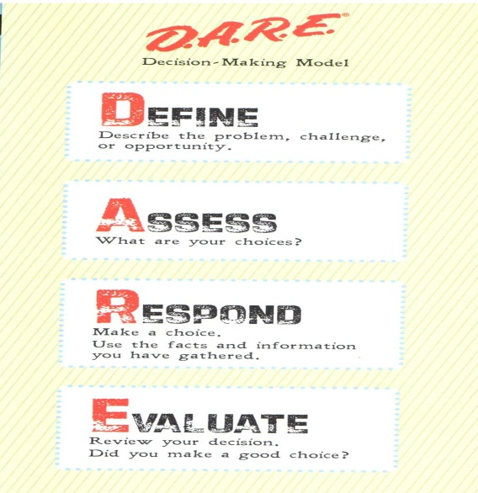

LEVEL V Phase I SBLE
Student Course (Elementary) – Cont’d
Basics of Communication
Non-Verbal Communications & Active Listening
Bullying
Helping Others
Getting Help from Others & Review
Notes:
The D.A.R.E. officer (and/or certified N.A.S.R.O. D.A.R.E. Officer - Deputy) remains the key to delivering the curriculum. Officers are vital in making the lessons come to life while playing an incredibly positive role for D.A.R.E. students. The curriculum is based on the D.A.R.E. Decision Making Model and teaching communication and life skills through the effective “from kid through kid to kids” narrative approach that are the hallmarks of D.A.R.E.’s successful middle school keepin’ it REAL curriculum. Lessons begin with a story about characters and real life situations the students will learn to know and care about. These stories are based in the actual experiences of students in schools around the country. Situations and role plays are integrated into the lessons to provide practice for each skill. Hopefully, students will be encouraged to tell their own stories by continuing to use the “someone I know” dialogue method. This is what makes the lessons “real” to them. The D.A.R.E. Decision Making Model helps students process their thoughts and help them make safe and responsible choices.
Based on the core principles, we constructed a ten lesson curriculum. Simply teaching something once is not enough for most young learners. That’s why each skill is broken down into parts, “scaffolding” or building upon concepts so that they appear over and over again in lessons, each time in a more advanced and sophisticated way. The best example of this is the D.A.R.E. Decision Making Model. DDMM is introduced and modeled in lesson 1. In lesson 2, students use the “D” to define a problem involving drugs. In lesson 3, they define and assess risks and consequences in situations in which they often find themselves. In lesson 4, they define, assess and decide how to respond in stressful life situations. In lesson 5 they are using the entire model to define, assess, respond and evaluate strategies for handling peer pressure. In lessons 6-9, they are refining and expanding their decision making skills
The same basic lesson structure allows for consistency in delivery of each lesson:
Review previous lesson
Animated introduction story to engage, review previous lesson, and introduce this week’s lesson
Explain the basic concepts
Describe the concepts and skills
Practice the skills
Apply DDMM
Review and Journaling
Closing Story
This is a golden opportunity here for SRO’s and/or ISD Police Officers to start building positive, lasting and effective relationships with students (eventual parents and members of our society and community) that will produce long last (residual) effects towards enhancing police community relations. These certified D.A.R.E. Officers/deputies would have an entire school year (leaving them time for Crime Prevention and/or other Community Policing innovations. It is an opportunity for Sheriff’s/Constable’s and Chiefs to include School District Policing agencies to create vial FORCE MULTIPLIERS in/through their existing officers by having them cross-trained. Again this just makes good common sense and is a positive and effective use of resources.

Slide 55

Learning Objectives
Keepin-It-Real (Elementary School)
Define Responsible and Identify Responsibilities
Identify harmful effects of illegal drugs, and alcohol and tobacco
Define Risk and apply to realistic scenarios
Define and recognize source of Peer Pressure
Identify signs of stress
Notes:
LESSON ONE: Introduction to DARE’s keepin’ it REAL
Define what it means to be responsible
Identify student responsibilities in their daily lives
Name the steps in the D.A.R.E. Decision Making Model (DDMM)
LESSON TWO: Drug Information for Responsible Decision Making
Identify how alcohol and tobacco use affects student responsibilities
Examine information on alcohol and tobacco
Understand the health effects of alcohol and tobacco on the body
Use the DDMM to define the problem in scenarios related to alcohol or tobacco
LESSON THREE: Risk and Consequences
Define risks and consequences and apply to real life situations
Assess the positive and negative consequences in the choices made about risky situations
Use the DDMM to assess how to make responsible decisions involving risky situations
LESSON FOUR: Peer Pressure
Define pressure and peer pressure
Recognize the sources of peer pressure
Identify ways to respond to peer pressure
Use the DDMM to generate responses to peer pressure
LESSON FIVE: Dealing With Stressful Situations
Identify possible signs of stress
Recognize the physical and behavioral signs of stress
Use the DDMM in evaluating stressful situations

Slide 56
Learning Objectives – Cont’d
Keepin-It-Real (Elementary School)
Explain & demonstrate importance of effective communication
Define & demonstrate active listening skills
Define & recognize Bullying and its adverse effects.
Identify importance of becoming a productive citizen
Provide community resources designed to HELP for students in need
Notes:
LESSON SIX: Basics of Communication
Define and explain the importance of communication in daily living
Demonstrate confident communication
Use the DDMM to evaluate and generate alternative options for effective communication
LESSON SEVEN: Nonverbal Communication and Listening
Define effective listening behaviors
Demonstrate effective listening using verbal and nonverbal behaviors
Use the DDMM to evaluate and generate alternative options for effective communication
LESSON EIGHT: Bullying
Define and recognize characteristics of bullying
Identify bullying behaviors
Differentiate between tattling and telling
Use the DDMM to practice safe ways to report bullying
LESSON NINE: Helping Others
Identify the importance of being a good citizen
Recognize the importance of reporting bullying to an adult at school and at home
Demonstrate the use of the DDMM in reporting bullying behaviors
Reinforce knowledge and positive behaviors to stop bullying
LESSON TEN: Getting Help from Others and Review
Identify people in student’s lives they can go for if they need help
Recall previously learned key terms

Slide 57

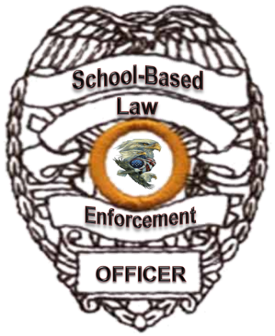
LEVEL V Phase II SBLE
Student Course (Middle School)
D.A.R.E. Keepin-It-Real (Middle/Junior High curriculum)
Options & Choices
Risks
Communication and Conflict
Refuse
Explain
Notes:
There is a golden opportunity here for D.A.R.E. and N.A.S.R.O. (SRO’s) and/or ISD Police Officers that are already permanently assigned to a middle school campus to teach this lesson at their campus. They have an entire year to get the lessons delivered to target 7th grade students. Again this just makes good common sense and is a positive and effective use of resources.
The D.A.R.E. keepin’ it REAL curriculum represents over 20 years of research by the Drug Resistance Strategies Project (DRS) about why our youth use drugs. Out of this research a middle school substance abuse prevention program, keepin’ it REAL, was developed collaboratively by Penn State University, Arizona State University, D.A.R.E. America, and schools around the country. Grounded in cultural norms, the program teaches youth how to live drug-free lives confidently, drawing on the strengths of the students, their families and communities.
The acronym REAL is the central message of the curriculum and teaches youth four ways to refuse drug offers -- Refuse, Explain, Avoid, and Leave. These strategies help youth stay away from drugs by preparing them to act decisively and responsibly in difficult situations. The curriculum teaches students how to resist drugs offers by presenting practical strategies that are easy for them to remember and use.
The keepin’ it REAL curriculum is ideally organized as a 10 lesson program to be delivered over 10 weeks. Each lesson requires one 40 - 45 minute class period and is designed to promote interaction between students and instructors. Engaging activities are included to involve students in their own learning. Through sharing their own stories, practicing decision making and role-playing the REAL resistance strategies students gain mastery of new skills. The program’s key learning tool is a series of videos that show high school youth and their own, real stories about drugs and drug offers. The videos model or demonstrate how students use REAL strategies to resist drugs in real life situations in rural, urban and suburban communities.
The core of the program is the REAL strategies for resisting drug offers: Refuse, Explain, Avoid, and Leave. By highlighting these four strategies, the program helps students learn effective decision making and communications skills which helps them resist the temptation to use drugs.

Slide 58

LEVEL V Phase II SBLE
Student Course (Middle School) – Cont’d:
Avoid
Leave
Norms
Feelings
Support Networks
Notes:
The keepin’ it REAL lessons incorporate personal stories and language that youth find familiar. The lessons teach risk assessment, decision making, communication, and life skills including the REAL strategies. The lessons are designed to promote interaction among the students as well as between the students and the instructor. Engaging activities are included to allow students to practice the REAL resistance strategies incorporating sound decision making skills. The keepin’ it REAL lessons include a variety of teaching modalities aimed at encouraging active student participation such as:
Cooperative learning group activities
Questions to promote higher level thinking
Role-plays
Think/Pair/Share discussion
Each lesson includes:
Curriculum guide and instructions
Overheads or PowerPoint slides
Key terms
Student Planner pages
Homework page
The students' performance on the homework assignments allows instructors to assess how well they are grasping the skills and knowledge taught in class.

Slide 59
Learning Objectives
Keepin-It-Real (Middle School)
Resistance strategies of Refuse, Explain, Avoid, and Leave.
Define the term risk and identify harmful risks
Identify and describe the components of the D.A.R.E. Decision-Making Model
Explain the REAL strategy of Refuse
Demonstrate the REAL strategy of Explain
Notes:
Lesson 1: Options and Choices
In this lesson students will identify the keepin’ it REAL resistance strategies of Refuse, Explain, Avoid, and Leave. An introductory video presents an overview of these core resistance strategies. Through class discussion and activities the concepts of options, choices and consequences are defined with the idea that all choices have consequences. Students learn to differentiate between a simple preference and a wise choice.
Lesson 2: Risks
Students will define the term risk and identify risks that could be potentially harmful to them.
The Guessing Game activity is an opportunity to explain how a risk may affect their choices. Through the Guessing Game students are given factual information regarding the actual number of students currently engaging in drug use.
Lesson 3: Communication and Conflict
Students will identify and describe the components of the D.A.R.E. Decision-Making Model to make wise choices and sound decisions. They will articulate what it means to agree to disagree and explain the differences between assertive, aggressive and passive behaviors. A group activity allows students the opportunity to work cooperatively to use the D.A.R.E. Decision-Making Model to solve conflict scenarios.
Lesson 4: Refuse
Students will be able to explain the REAL strategy of Refuse and be able to articulate “no” in a clear and assertive way. A video is shown that models this strategy. Through discussion and sharing their own stories, students learn verbal and non-verbal assertiveness techniques for Refusing.
Lesson 5: Explain
Students will demonstrate the REAL strategy of Explain and be able to state the reasons for their actions in a clear way. A video is shown that models this strategy. They will use “I Statements” in order to articulate their personal preferences and share their opinions or beliefs.

Slide 60
Learning Objectives – Cont’d
Keepin-It-Real (Middle School)
Define the REAL strategy of Avoid
Explain the REAL strategy of Leave
Explain concept & terms of normative behavior
People express emotions in different ways, & they have unique feelings and reactions to situations.
REAL skills can be used in their network of friends, family and peers
Notes:
Lesson 6: Avoid
Students will define the REAL strategy of Avoid and be able to list three ways they can avoid a situation. A video is shown that models this strategy. Through discussion, sharing their own stories, and role play scenarios student learn how to use the D.A.R.E. Decision-Making Model to practice ways to avoid potentially harmful situations.
Lesson 7: Leave
Students will be able to explain the REAL strategy of Leave. A video is shown that models this strategy. Through discussion, sharing their own stories, and role play scenarios students learn to identify situations where they can use the Leave strategy.
Lesson 8: Norms
Students will be introduced to the concept of normative behavior and will be able to define the terms, norms and peer norms. They will identify accurately the norms of drug use among their peers. Students learn that, contrary to what many of them believe, the majority of students their age do not use drugs. They will be able to explain how norms can influence their decisions.
Lesson 9: Feelings
Students will identify how people express emotions in different ways and that they have unique feelings and reactions to situations. Role play scenarios are used to help students resolve conflict situations and express their feelings in a positive manner. They will learn to acknowledge the validity of their feelings and the feelings of others.
Lesson 10: Conclusion
Students will learn how their REAL skills can be used in their network of friends, family and peers. They will use an ECO-MAP to explain the concept of a social support network and identify members of their personal social support network where they might go for help. The keepin’ it REAL Review offers students the opportunity to review the concepts and skills they have learned in the previous lessons.

Slide 61
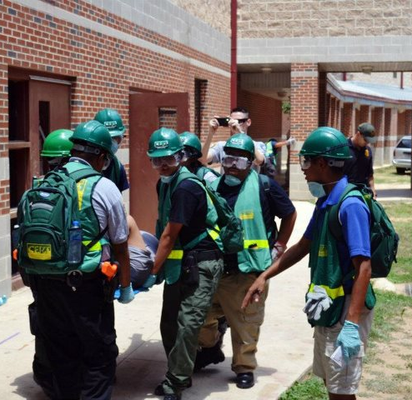

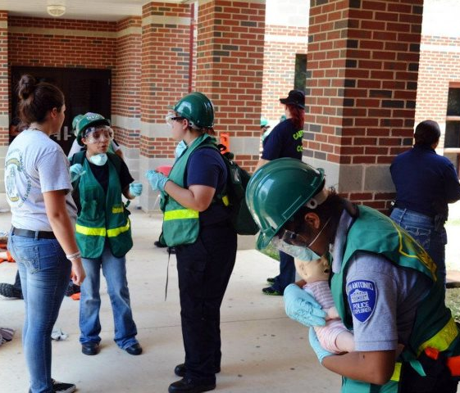
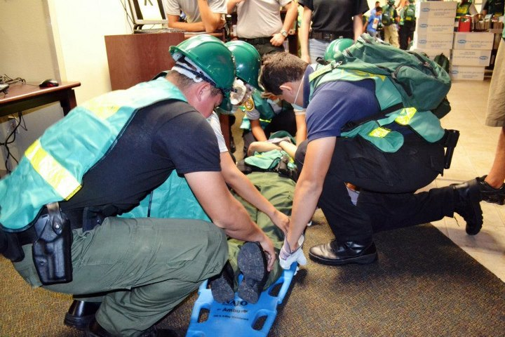
LEVEL V Phase III SBLE
Student Courses
Notes:
These are courses developed and delivered by SIERRA3 (Part of the SBLE Core Team of Trainers & Subject Matter Experts) and its core team of instructors have highly successful (proven) curriculums/lessons designed by experienced operators to maximize internal assets creating enhanced preparedness within every school. There are several models one in California where students (Explorer Scouts) were taught Emergency Operations during critical incident as well as several models within San Antonio (specifically South San Antonio I.S.D. Police Department and Southside I.S.D. Police Departments have developed highly trained Explorer Scouts (model programs) certifying them (Explorer Scouts) in Teen CERT as well as a myriad of other diverse response capabilities; therefore this is not theory it has been proven to work. By empowering youth you enhance your immediate response capabilities.

Slide 62

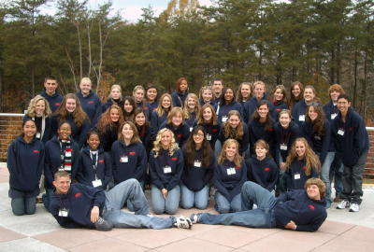

LEVEL V Phase III SBLE
Student Courses – Cont’d:
Protocols/Procedures for lock-downs.
Protocols/Procedures for Emergency Evacuation (First Responder (Support Training)
Establish Statewide Youth Advisory Board
Establishment of Teen Court
Notes:
Select Middle/Junior High and High School Students
Law Enforcement Explorer Scouts
J.R.O.T.C.
Student Council
Can be after school or weekend classes for select students.

Slide 63



Additional Resources for our Schools & benefit of our students
Mentorship program (VFW, AARP, Etc. Volunteers)
    Math, Sciences, Reading and Writing
    Citizenship, duty, responsibility & accountability
    Core Family Values
    Patriotism, Duty, Honor and Country
Notes:
Mentorship program (VFW, AARP, Etc. Volunteers)
Math, Sciences, Reading and Writing
Citizenship, duty, responsibility & accountability
Core Family Values
Patriotism, Duty, Honor and Country
How many useful people with veteran experience and/or knowledge are just sitting there with nothing to do – many who are looking for some way to continue to contribute or even help them feel of value again. This could even be very therapeutically good for some of our young wounded veterans in helping them recover (after being cleared by competent medical staff).
The SBLE Holistic School Safety & Security Concept and Training Plan provides a strong and viable venue to bring all required resources together in a united coalition of assets. It is a Strategic Concept & Plan.

Slide 64


LEVEL VI PHASE I – SBLE
Parent Course
Notes:
D.A.R.E. Parenting Lessons
Other informative and educational lessons

Slide 65

LEVEL VI PHASE I – SBLE
Parent Course
Taught by SBLE Officer Master Level Officers
SBLE Parent Course
  Parenting Skills
  Trouble Indicators
  Violent Behavior (Warning Signs)
  What to look for (Drugs & Weapons)
  Community Resources
  Much more……
Notes:
These are Parent Lessons that can be taught throughout the school year at PTA/PTO or as a stand-a-lone after school program for parents. Each lesson can be taught in 50 minute to1 ½ to hour segments. One day, each evening after school or at other community venues.
Lesson 1: Most Common Abused Drugs & Symptoms
Inhalants & Over-The-Counter Drugs
Lesson 2: Harmful Effects of Drug Use & Abuse
Alcohol & Tobacco
Illegal Drugs (Marijuana – Meth – Rave Drugs)
Lesson 3: Behavior Associated with Drug Use/Abuse
What to look for
What to do if you find drugs
Lesson 4: Gang Affiliation Indicators
Clothing, jewelry, colors, superficial hand-drawn tattoos or markings
Who you’re children are hanging out with
Lesson 5: Gang Intervention & Prevention Strategies
Alternatives
Counseling
Lesson 6: Internet Safety
Blogs – My Space -
Parental Controls – Checks & Balances
Predators
Lesson 7: Teen Suicide
Warning Signs (What to look for)
Where to seek and get help
Lesson 8: Parents On Patrol (POPS) Program and School Watch Program (SWP)
Lesson 9: Active Listen Skills
Lesson 10: Managing Violence (Anger Management)
Self-Discipline & Self-Control Strategies
Managing stress without violence
Lesson 11: Peer Pressure
Bullying
Self-Esteem
Lesson 12: Parental Responsibilities
Teaching Responsibility & Accountability
Consequence of actions (self & others)

Slide 66

LEVEL VII
On-Line Learning Courses
Notes:
Continuing educations programs many that have no associated cost and that have been established by the federal government and other organizations.
Examples:
FEMA Courses
Emergency Management Courses

Slide 67

LEVEL VII
On-Line Learning Courses
Phase I SBLE Officer On-line Courses
Phase II SBLE Supervisors Courses
Phase III SBLE Administrator & School Boards
Phase IV SBLE School Staff Courses
Phase V SBLE Student Courses
Phase VI SBLE Parent Courses
Notes:
SBLE Campus Law Enforcement
Crime Scene Processing
Criminal Investigations
Juvenile Investigations Courses
Interviewing Juveniles
Interviewing and obtaining statements from juvenile suspects
Maintaining Juvenile Offender Files
Child Abuse & Neglect Investigations
Juvenile Law Courses
Drug Awareness: Up-to-date information on most Common Used & Abused Drugs by young people (Teenagers to young adults in college)
Inhalants & Marijuana
Methamphetamines & Rave Drugs
Drug Concealment
Gang Awareness & Gang Intervention and Prevention Strategies
Handling the mentally challenged student
Criminal Intelligence collecting, analyzing and developing predictability models.
Handling Violent Offenders
Confrontational Management intervention and prevention strategies
Identifying potential violent offenders based on known behavior characteristics and mannerisms.
Dating Violence and others.
Additional Parent Lessons
Training Classes
On-line Training
On-line Resources
Additional Student Lessons
Training Classes/lessons
On-line interactive Training
Specialized Campus Staff Training
Training Classes/Lessons
On-line learning
FEMA Courses available on-line:
IS-1Emergency Manager: An Orientation to the Position
11.0IS-3Radiological Emergency Management
11.0IS-5.aAn Introduction to Hazardous Materials
11.0IS-7A Citizen's Guide to Disaster Assistance
11.0IS-8.aBuilding for the Earthquakes of Tomorrow: Complying with Executive Order 12699
0IS-15.bSpecial Events Contingency Planning for Public Safety Agencies -(7/22/2010)0.41.0
1.0 (When combined with IS-19, IS-20, IS-21, IS-33, IS-106, IS-107 and IS-101.b)
IS-19.12FEMA EEO Supervisor Course 2012 -(1/26/2012)0.11.0
1.0 (When combined with IS-18, IS-20, IS-21, IS-33, IS-106, IS-107 and IS-101.b)
IS-20.12Diversity Awareness -(1/30/2012)0.11.0
1.0 (When combined with IS-18, IS-19, IS-21, IS-33, IS-106, IS-107 and IS-101.b)
IS-21.12Civil Rights and FEMA Disaster Assistance -(1/30/2012)0.11.0
1.0 (When combined with IS-18, IS-19, IS-20, IS-33, IS-106, IS-107 and IS-101.b)
IS-22Are You Ready? An In-depth Guide to Citizen Preparedness -(10/25/2010)11.0
1.0 (When combined with IS 102.b, IS 293, IS 634)
IS-27Orientation to FEMA Logistics -(2/8/2011)0.41.0
1.0 (When combined with IS-245.a and IS-246)
IS-29Public Information Officer Awareness -(11/3/2011)

Slide 68



QUESTIONS

Slide 69
Curriculum/Lesson Contributors
Subject Matter Experts
Gerald R. “Jerry” Adams, Special Agent in Charge Federal Bureau of Investigation (F.B.I.) Criminal Investigations, Covert and Tactical Operations, INTEL, – Retired.
Dan H. Tiller, former Department of Public Safety (DPS) Trooper - Retired, former Sheriff, Senior instructor Institute for Criminal Justice Studies (ICJS) – Retired and Senior instructor Law Advisory Group.
Judy Renick, founder and first Director of the Texas School Safety Center, author and expert on Gangs, Bullying and Emergency Preparedness for schools.
Steve Ledbetter, Senior Narcotics Investigator and subject matter expert on over-the-counter, prescription and illegal drug sale/use/abuse for the Dallas Police Department .
Robert “Bob” Fletcher, Warrant Officer and Senior Army INTEL Analysis.
Mary Fischer, former Agency Analysis and INTEL Specialist
Hanan Yadin, former Israeli Defense Force (IDF) Counter-Terrorism Unit and Shin-Beth Counter-Terrorism expert. Tactics Expert.
Notes:
Hanan Yadin, former Israeli Defense Force (IDF) Counter-Terrorism Unit and Shin-Beth Counter-Terrorism expert. Hanan is the only Subject Matter Expert with real world with actual practical tactical experience in School Safety & Security. He has actually lived and applied his real world experience in urban combat (school Assaults). He knows from his real world experience proven intervention and prevention strategies concerning School Safety & Security; and is the only person (with real live experience) in the United State today. He grew-up In Israel and experienced violence in schools up-close and personal and was directly involved in addressing School Safety & Security within Israel. He knows tactics better than anyone in the country when it comes to true and realistic school safety and security.

Slide 70
Curriculum/Lesson Contributors
Subject Matter Experts – Cont’d:
Chief David R. Rider, Chief of Police Ft. Bend Independent School District.
Chief Richard Palomo, Chief of Police Southside Independent School District, San Antonio, Texas and Navy Chief USN (Reserves).
Chief Deputy J.C. Mosier, former Public Relations Officer (PAO) Houston Police Department, former Texas Commission on Law Enforcement Standards and Education (TCLEOSE) Commissioner and Chief Deputy Constable’s Office PCT#1 – Houston, Texas.
Adam Hamilton, Signature Science (Chemist), Nuclear, Chemical and Biological and explosives expert.
Gary Avery, Attorney, School, law enforcement and juvenile law expert – Law Advisory Group.
Steve Garst, Certified Crime Prevention Specialist (C.C.P.S.), Senior Crime Prevention Instructor – curricula developer, Sergeant Little Elm Police Department.

Slide 71
Curriculum/Lesson Contributors
Subject Matter Experts – Cont’d:
Detective Cole Langston, School Resource Officer and Juvenile Law instructor and juvenile investigator Carrolton, Texas.
Dr. Robert J. “Spider” Parks Ph.D., U.S, Army Special Forces (SOG), alcohol and drug counselor, studies and evaluations and owner Parks Place, LLC.
Thai Taitano, U.S. Army Special Forces (SOG) and “Delta Force”.
Richard Poe, former U.S. Army Special Forces, SIERRA3 security concepts, preparedness and tactical training. Operations and Training, personal protection specialist.
Patrick Perez, SIERRA3: a former U.S. Army communications specialist, Platoon Sergeant and Project Manager; Agency Protective Security Detail Leader and Security Specialist. Master of Science in Psychology and Bachelor of Science Degree in Management. Leadership trainer and certified in World-wide Protective Services.

Slide 72
Curriculum/Lesson Contributors
Subject Matter Experts – Cont’d:
Penny Jost, retired Texas teacher and educator. I taught for 28 years classroom experience as a teacher in the Texas public school system. I graduated from Texas A&M University in 1973 with a Bachelor’s degree. I taught for 3 years in Bryan ISD, during that time I earned my Master’s degree from Texas A&M University. In 1977 I moved to New Braunfels, Texas, and begin teaching in Comal ISD. I taught for 25 years in Comal, until I retired in 2003
Other Consultants to/for further holistic curriculum development should be:
  LTC Dave Grossman
  Phil Chambers

Slide 73
Curriculum
Author/Designer
George D. Little, 1SG/E-8 U.S. Army Military Police –Retired with 20 years honorable service in criminal investigations, evidence custodian, counter-drug investigations/operations, Force Protection, Physical Security Specialist, Counter-Terrorism operations, investigations, tactics and INTEL collection and analysis. Former Deputy Sheriff/Drug Abuse Resistance Education (D.A.R.E.) Coordinator for Bexar County Sheriff’s Office – Retired 20-years honorable civilian law enforcement service, Past President Texas D.A.R.E. Officers Association, Certified Crime Prevention Specialist (C.C.P.S.), former Director Institute for Criminal Justice Studies – Texas School Safety Center – medically retired; Deputy Chief INTEL, Homeland Security & Training Bexar County Constable’s Office PCT#4; Texas D.A.R.E. State Coordinator and 2011 TCLEOSE Professional Achievement Award recipient; with 19-years working in our schools as an SBLE; and a veteran and experienced certified School Safety & Security Subject Matter Expert.
Notes:
This culminates from 40-consecutive years in law enforcement; training and working in a school-based environment combined with the diversity of colleagues, associates that are literally “TRUE SUBJECT MATTER EXPERTS” within their highly diversified field.
This has been a labor of love, passion and commitment to the men and women of law enforcement and to our Children.
The SBLE Holistic School Safety & Security Concept and Training Plan provides a strong and viable venue to bring all required resources together in a united coalition of assets. It is a Strategic Concept & Plan.

Slide 74









Partners
SIERRA 3
Tactical & First Responder & Other
Active & Specialized Threat TNG
Notes:
Partner Statements
Texas State University is a premier public, student–centered, doctoral granting institution dedicated to excellence in serving the educational needs of the diverse population of Texas and the world beyond. The Texas School Safety Center (TxSSC) is the Texas State University premier Center for Campus - School Safety and Security initiatives. The Texas School Safety Center (TxSSC) includes other divisions, the Institute for Criminal Justice Studies (ICJS), the Center for Youth Initiatives (CYI) and TxSSC support Staff. TxSSC is a multi-division training and technical assistance center focused on health and safety issues with an emphasis on youth involvement and leadership. TxSSC-ICJS trains law enforcement and educators, facilitates community mobilization, and develops youth as leaders. At TxSSC, our mission is to create safe and secure communities and schools for all Texans by promoting collaboration, coordination, cooperation, self-initiative and the best training curriculums in the country.
The Texas School Safety Center (TxSSC): was created in 1999 by then Governor George Bush and authorized by the 77th Texas Legislature in 2001 to serve as a central location for school safety information, and to provide schools with research, training, and technical assistance to reduce youth violence and promote safety in the state. TxSSC is charged to conduct safety training that includes: development of a positive school environment and proactive safety measures to address local concerns, school safety courses for law enforcement officials, assistance for districts in developing a multi-hazard emergency operations plan, security criteria for instructional facilities, and a model safety and security audit procedure for the state. The center also collects school safety data for the state and provides a report to the public.
The Institute for Criminal Justice Studies (ICJS): was created in 1974 as part of the Department of Criminal Justice at the former Southwest Texas State University (now Texas State University). ICJS has trained more than 75,000 criminal justice, law enforcement and crime prevention practitioners from throughout Texas, in addition to 46 other states as well as from Canada, Guam, Mexico, Great Britain, Australia, Costa Rica and Saudi Arabia during the past 36-years. ICJS has partnered with leading experts in the field of law enforcement, school safety, counter-terrorism, and other homeland security related subjects to research, develop and deliver the most current, state-of-the-art, realistic, interactive and best practices from lessons learned law enforcement and crime prevention curriculums and trainings in the country. Some of our new partners include Signature Science, LLC.; Instinctive Shooting International Incorporated (ISIINC), former Israeli soldiers who bring state-of-the-art mitigation and defense training along with a plethora of first hand experience in dealing with and countering terrorism; Responsive Learning; and Parks Place, LLC. ICJS is continually researching and forming partnerships with the best expert companies and organizations in the country, to ensure we deliver the absolute best training possible. ICJS retains the most experienced, veteran subject matter experts using the innovative and cost saving ICJS Adjunct Contractor (Vendor) Instructor pool. This by design reduced full-time operation staff associated cost and only utilizes training cadre/personnel as required by specific training needs. Instructors are paid for each training/delivery and this is by individual contract.
Signature Science: uses a multidisciplinary approach to solving Homeland Security problems. By combining science and engineering expertise with law enforcement and military experience, we became a nationally-recognized provider of Homeland Security services—well before September 11th. Our science and engineering expertise includes chemistry, microbiology, statistics, meteorology, toxicology, and numerous other technical disciplines. We recruit the best candidates and hire only those that pass our rigorous screening process. The technical challenges and corporate culture help us retain the best staff (less than 1% annual turnover in our corporate history) and provide consistently excellent service to our clients. Our tactical and strategic capabilities include individuals experienced in law enforcement, military operations, crisis management, school safety, and logistics. Our Austin based company has partnered with ICJS to help in the research, development and delivery of Project SBLE Officer Training Program curriculums/lessons.
ISI Training Center (ISI.Inc) Since 1993, ISI Worldwide LLC., has successfully provided high caliber training and consulting services to Police Departments, SWAT teams, Military Personnel, Government Agencies and Private Security entities throughout the United States. At ISI, we believe in training that not only meets, but exceeds current professional training standards. We firmly believe in proactive, innovative and practical training methods that work in the real world which is why ISI is a partner in the Project SBLE Officer Training Program. Operational excellence is best achieved by elevating individual as well as team capabilities. The result is a well prepared team that has the confidence, competency and skill level to rapidly execute an effective response to a range of hostile situations while reducing the risk of injury or loss of life. ISI has the distinct advantage of providing you with the finest mix of custom training solutions available on the market. ISI sets itself apart from other vendors by offering tactical and counter-terror courses that are tailored to simulate the actual operating environment (bus, airplane, urban, etc.) of the individual and team. American and Israeli expertise, by merging American and Israeli “know how” in a spirit of cooperation we have set unmatched new standards of excellence in the counter-terrorism and tactical training industries. ISI Worldwide has adapted the best practices learned from real world examples to design sophisticated training modules and scenarios that are applicable to the conditions, threat levels and requirements of American agencies. Today’s operators have high-level responsibilities and are focused on their immediate duties as well as fighting the war against terror. That’s why ISI maintains a mobile team of diverse instructors who are experts in their fields in order to bring world class training directly to you. The mission of ISI is to deliver value and best-in-class training to your operators. They are why we stay focused. They are why we continually seek improvements. They are why we are in business.
Responsive Learning (On-line course developers): is a professional development, project Management Company. They capture knowledge and expertise and translate it into a learning format that can be shared when needed, where needed, and as needed. Responsive learning uses e-Learning technology and techniques to design and deliver powerful training and learning solutions specifically for schools, districts, and education agencies. Responsive Learning was created for schools by school people. We are the architects who design and build the systems to connect the experts, resources, and training. Schools and institutions have an enormous knowledge base, full of specialized instruction, policies, procedures, systems, fact sheets, and other resources. Efficiently and effectively transferring that knowledge to stakeholders is the challenge. We help institutions and schools plan, prepare, collaborate, communicate, and respond to this challenge by developing learning systems to organize, manage, and deliver their experience, expertise and shared resources. Multi-hazard Emergency Management and Response Planning for Communities and Schools is one key focus. School violence, hurricanes, and other natural disasters are stark reminders of how critical it is for our nation to approach emergency management in a coordinated, consistent, efficient manner. Responsive learning will be our web-based on-line learning resource center to support Project SBLE Training Program.
National Association of School Resource Officers (NASRO): is a not-for-profit organization for school based law enforcement officers, school administrators, and school security/safety professionals working as partners to protect students, school faculty and staff and the schools they attend. NASRO officers are some of the most highly trained and experienced SBLE officers in the country today. NASRO as our newest partner will assist TxSSC-ICJS with curriculum research and development (through the NASRO Training Committee). The SBLE Concept can easily be adapted to the needs of any community, desiring safe schools, and effective community partnerships. NASRO has a well established structure in place for national curriculum delivery.

Slide 75
Contact Information
George D. Little, C.C.P.S.
Texas D.A.R.E. Training & Development Institute
14080 Nacogdoches PMB 322
San Antonio, Texas 78247-1944
210-590-D.A.R.E. or glittle1@satx.rr.com
(3273)
www.texasdarestatecoordinator.org
Notes:
Texas D.A.R.E. Training & Development Institute consistently looks for funding to off-set cost to individual agencies.
Average training cost for a 40-hour course to deliver the Texas D.A.R.E. Training & Development Institute SBLE Holistic School Safety & Security Concept and Training Plan is $2,500.oo per student at 50 students per class. As the Train-The-Trainer component is integrated (established with each state this cost will substantially be reduced to around $450.00 per attendee/participant at state level.
Texas D.A.R.E. Training & Development Institute will always works with Chiefs and Sheriffs to offer the highest caliber, state-of-the-art, realistic and interactive law enforcement training based on best practices from lessons learned. Texas D.A.R.E. Training & Development Institute uses only the best and highest qualified, veteran subject matter experts as instructors. We currently use former F.B.I., Scientist, Sheriffs, Chiefs and veteran law enforcement subject matter experts, some of the best in the country through our partnerships.

