Slide 1
The Justice Academy

Slide 2
Geographic Information Systems
Introduction: The concept of Geographic Information Systems (GIS) basically involves the linking of traditional databases with computer generated graphics to produce a user friendly environment which provides a visually oriented method of accessing information. If you stop and think of how the human brain gathers, stores, and accesses data and information, you will inevitably come to the conclusion that it is oriented around visual cues (visually impaired persons use a slightly different method). The brain stores pictures of different events, organizes them by time slice, cross references them based on major category, and then stores the images for later reference. If for example you were asked to recall where you were at Thanksgiving dinner last year, who was seated to the left of you, and where on the table was the turkey, your brain would run a short movie of the event allowing you to visualize the scene. From this visualization, you would locate and identify the desired information elements and be able to recall the specific facts.

Slide 3
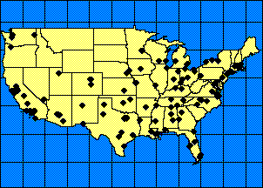
Through the use of computer mapping and database association, GIS achieves the same basic method of collecting, storing, and dissemination of information. GIS provides a Bird's Eye View of a geographic region, allowing you to visualize the area and then associates data to specific locations. Additionally, GIS provides the ability to make "queries" by asking questions using Structured Query Language (SQL) to isolate only those specific facts you are currently interested in. Most GIS systems have evolved from a command line interface to a graphical user interface, making them much easier to master and thereby eliminating the need for long hours of practice to achieve a relatively high degree of proficiency. This "push button" approach makes the actual utilization of these systems rather straight forward, but the concepts of GIS are still relatively complex for the novice user. This class will concentrate upon the theoretical concepts of GIS and during the laboratory sessions, will demonstrate how these concepts are put into practice using MapInfo for Windows.

Slide 4
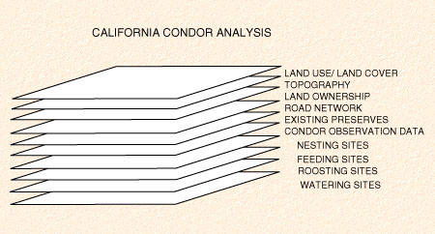
GIS and Analysis The unique environment afforded by GIS systems, provide many benefits to the end user. In addition to the graphical user interface and the visualization of data and maps, the main benefit provided by GIS systems is that they provide access to multiple data sets at the same time. Not so long ago, this could only be achieved by an accomplished computer programmer. The benefit that this capability brings to end users is significant. Since most data are collected in isolated data structures, it is difficult under traditional computing practices, to access all of the data elements necessary to perform a comprehensive analysis. GIS allows the user to "layer" one set of data on top of another relative to a specific digital map. This concept will be dealt with in detail later, but this process is critical if GIS is to be used as a serious research tool, instead of merely a method for looking at the geographic distribution of phenomena. Such an ability facilitates advanced multiple correlation studies, causal factor analysis, theoretical and geographic distribution analysis, and multiple spatial correlation and regression studies.

Slide 5
File Types GIS systems generally handle information in a similar manner no matter the manufacturer or hardware platform. Four basic file types are used to portray information. Map files are the foundational element. They can best be described as digital representations of geography, but within GIS, they are not simply pictures that are displayed on computer. Rather, they are sets of data which the GIS system converts into a graphical representation. Each line segment has a beginning and ending latitude and longitude value, an address range, a type value, and a regional value. Boundary files are the next layer up from the map files and are used to represent polygonal geographic areas which represent political zones, zip codes, study areas, countries, counties, rainfall boundaries, etc. They too are not simply computer art, but distinct databases which contain beginning and ending nodes for each line segment of the polygon, a boundary name, the number of segments which constitute the boundary, and other pertinent data. Again, the GIS software turns these data into a recognizable region. The third layer up is normally the traditional database or "pointfile". It is a structured set of information, usually generated by software apart from GIS, that is compared to the map or boundary based on a specific field value such as street address, census tract, county, state, etc., (and if successfully matched to a value on the map), a singular latitude and longitude value is assigned for each record in the database. This process is referred to as "geocoding". The last layer of a GIS system are considered "raster files" which are either air/satellite photographs of a geographic region which are synchronized to the map and boundary files, or they consist of line art or textual renderings which embellish the map for readability. The purpose of the raster file is to enhance the presentation or analytical quality of the display, but they contain no data upon which to base analyses.

Slide 6
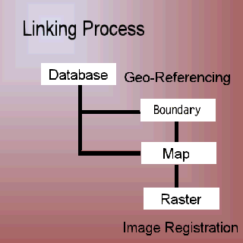
Component File Layering You will become increasingly familiar with the concept of "component file layering" over the course of this semester, but it basically involves the stacking of each type of file used by GIS system on top of one another. The goal of this process is to align all of the pertinent data relative to a distinct geographic area facilitating the ability to look down through the individual layers and discover the relationships that exist. The graphic below illustrates this concept. As you can see, the raster image or photograph is usually placed at the bottom of the stack, followed by the mapfile which is the computer rendering of the roadways, rivers, and railroad tracks. On top of this, we can add several boundary files which can represent the city, county, state or other such region within which these road features exist. Finally, we "geocode" the various databases which are relative to these areas. The aggregate result is a detailed profile which can be used to describe the phenomena under study and which may also be used to conduct inferential analysis of the region. You will find that the order in which the various layers are stacked matters only to the presentation quality of the aggregate map. For example, raster images generally cover over other types of files completely which subsequently makes them invisible. If your desire is to look at all of the layers and how they relate to one another, then the raster image must be place on the bottom of the stack. The other layers generally do not impair the visibility of each other, so it really doesn't matter what order you put them in.

Slide 7
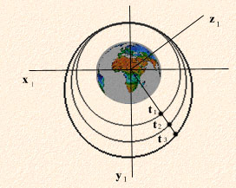
GIS and the Fourth Dimension: You will find over the course of this training, that data is collected and maps are created relative to a definite temporal consideration. This means that each set of data you collect and each map that you have included in the stack, represents how the world looked at a particular time. Since GIS allows you to stack one set of data upon another, you must always be mindful of the slice of time represented by the individual layer. It is generally improper to co-mingle incongruent temporal slices and then infer relationships between these layers, unless you are specifically engaged in time-series causation analysis and you are studying the effect that one phenomena has on another over time. All other types of analysis generally require that synchronous time slices be used so that the data is valid. More will be said about this concept of " temporal aggregation" in later lectures.

Slide 8
Symbolic Representation versus Spatial Exactness GIS systems and conventional mapping practices generally involve the symbolic representation of information and should not be misconstrued as exact pictorial representations of the real world. Although GIS comes closer than ever before, it is still only a representation of the real world and some discrepancies between the exact location of an object and the way in which it is represented on the computer will occur. Some students find this fact troubling at first and wrongly dismiss the utility of GIS because it is not exact. The degree of inaccuracy varies from map to map, but most GIS systems can get within 2 to 3 feet of spatial accuracy. For most analysis that you will undertake, this is more than enough. Subsequently, GIS systems can be used effectively to satisfy your analytical needs. Very rarely will you ever find a situation where exactness matters so much, that GIS systems cannot be used as a sufficient analytical tool.

Slide 9
System Difficulties The benefits of GIS are self evident, but with this most helpful tool comes several challenges not normally faced by PC level computer users. These systems require that users pay close attention to some very fundamental issues. End users must pay close attention to issues of relational, spatial, and temporal accuracy. Violating these rules can result in untrue observations of phenomena and subsequently incorrect assumptions about the relationships that exist between variables. Most end users are not well versed at conforming to these type of issues (at first), but as your familiarity with GIS, database design, and analyses progresses, these somewhat initially uncomfortable issues will be dealt with matter-of-factly. Also the learning curve for GIS concepts is somewhat steep. Many users find this problematic, but over the course of the semester, what appears insurmountable now, will seem insignificant by then.

Slide 13
Relational & Spatial Database Theory
Introduction: An integral part of any Geographic Information System is the database component. In fact, the ability to integrate data with maps and construct "queries" to process these data, is what distinguishes GIS systems from mapping software. Virtually all GIS manufacturers build-in some feature for designing and processing database layers. In order for students of this discipline to maximize the benefits of GIS software, the must become familiar with the various strategies of database design and how to effectively integrate data with digital maps. Relational Database Theory: Generally speaking, databases are collections of information which represent facts about real-world phenomena which have been structured or organized in a specific fashion. Depending upon the particular software manufacturer, the formal type of structure used to collect and handle these data may vary, but typically most software developers are using what is termed relational database design strategies. In some respects similar to a spreadsheet program, relational database management systems (RDBMS) divide data into rows and columns. These RDBM systems however, go far beyond the capability and intricacy provided by spreadsheet programs in their ability to process and handle information.

Slide 14
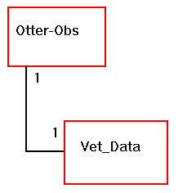
Entities and Attributes: Information about phenomena becomes data when it is quantified. From a computer science perspective, these data must be not only quantified, but categorized, input into a recognizable structure, and stored for later processing and analysis. With regard to GIS systems, we will be using a variety of data that has been collected. In some instances the data used will have been collected personally (as in the case of research observations) and other data will come from outside sources (such as information about rainfall, vegetation, or animal species domination). No matter the initial source of data, GIS systems can import and utilize all information assets, provided that we follow a few simple rules governing relationships.

Slide 15
Using relational database theory within GIS, we must first develop what is termed an Entity Relationship Diagram that portrays the various major categories into which data will be placed. An "entity" can best be defined as a class of real or abstract objects. It is the highest level or category into which data will be placed. Our ERD will contain a number of different entities which will be linked together. Some examples of "real" object entities are categories like: (Employee, Customers, Students, Vegetation, and Soils). Some examples of "abstract" entities are categories like: (Health Condition, Student Loans, and Course Offerings). Within each entity are what is termed "attributes". Each entity will contain a number of different attributes or sometimes referred to as "fields". The attributes are the specific subcategories into which observations (quantified data) about something are placed. Some examples of attributes are things like: (Height, Weight, Age, Number of Legs, Hair Color, or Grade Point Average). These attribute values are quantified, based upon observations about all of the participants under examination and the result is a comprehensive data table that provides a major categorical distinction from other sets of data about the same phenomena which can be linked to other tables and queried.

Slide 16
Relational database theory suggests that by categorizing information into entities and attributes, one can manage the information better. It also suggests that not all of the information about phenomena should be stuffed into an all encompassing entity. Several entities should be used so that data can be controlled and managed properly. This practice consequently enhances the integrity of data. Sometimes, from an operational perspective, it just makes good sense to break information down into smaller components. If for example we were making field observations of animals in the wild, we may want to collect attributes like the age, weight, color, and gender of each animal at the time capture.
This data would logically belong in an entity called "Field_Observations". By the same token, as scientists we would also be interested to know the present physical and health conditions of these animals. Therefore while in the field, we would collect blood, tissue, fluid samples for each animal and submit these to the lab for analysis. Although still directly pertinent to the animal, these data belong to a distinctly different class or entity, perhaps called "Veterinary_Data". The trick here is to realize that both sets of data have relevance to the animals captured in the field and that a strategy for linking the two different types of data together must be developed. Eventually we will want to ask questions from these data that may crossover the boundaries of the categorization method employed. A query that tries to extract the age, weight, and blood type of all animals observed, will require that two elements (age and weight) be drawn from the "Field_Observations" table and that the blood type be drawn from the "Veterinary_Data" table.

Slide 17
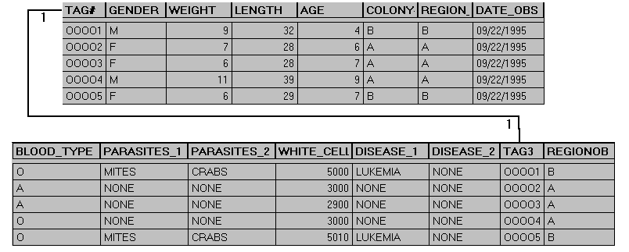
Before this type of query can be constructed, some link must be made between the two entities. This link is accomplished by the use of what are termed "key fields". A key field is an attribute that is contained in both entities. For our animal study, it would be necessary to assign each animal captured a unique number and to create an attribute or field in both entities called something like "Animal_Number". Both tables would contain the exact same number of observations, and through the use of this "key field“ we could then exploit the conceptual link between the two tables, and employ Structured Query Language (SQL) to develop a query which delivers the desired results.

Slide 18
Spatial and Temporal Keys: Because of the complexity of Geographic Information Systems and their requirement to layer multiple data sets onto digital maps, we must not only concern ourselves with the traditional RDBMS requirements for relational "key fields", but we must expand our database structures to include "spatial key fields". GIS systems integrate databases with maps by assigning a spatial position to each record in the database based upon a comparison between the value in the database to a corresponding location on the map. A specific latitude and longitude value is assigned to each record of the database if the comparison between the database and the digital map matches. This process is called "geocoding". Before any database can be used inside of a GIS environment, it must first be geocoded. To facilitate this process, we must naturally design our database structures with this eventual process in mind. To achieve the goal of developing a database which can be incorporated into a GIS environment, we simply must design the structure so that data relative to spatial orientation can be included for each record. Traditionally, fields or attributes such as: street address, city, county, state, census tract, zip code, area code, and country are used to satisfy this requirement. By comparing the value in a particular database record (123 Huntington Street) for example, with the range of acceptable values contained within the digital map, we can determine if the address in question falls between the known range and, if so, we can calculate its latitude and longitude and subsequently append the database. This way, the GIS system will remember the spatial location of individual each record and we will not have to geocode each time we want to use the database. We will go into greater detail about the concepts of Geocoding and Geo-referencing in later readings.

Slide 19
With regard to the concept of temporally oriented key fields, we must remember that all maps and databases symbolically represent facts about real or abstract phenomena of the world. Since the real world exists relative to time and space (according to Einstein's Theories of Relativity) , we must build computer based representations of the real world with both space and time in mind. Consequently, both the databases and digital maps that we produce must be temporally correct. If they are not, any descriptive and inferential analysis based on these maps and data will be incorrect. The most obvious consequence brought about by failing to consider that time is an important element in GIS development is observed when you stack two layers together that represent two different temporal slices. GIS systems will allow this to happen because of the spatial relevance between the two layers, but the GIS systems cannot distinguish the temporal incongruity between the two layers. It presumes that you either have accounted for the difference and synchronized the two layers by presorting the database or that you intentionally wish to observe the spatial distribution based upon the variance in time. The GIS system simply stacks the two layers together and allows you to look down through the layers without distinguishing the temporal slice that each layer represents. In order to account for the potential problems caused by this practice, it is advisable to construct databases with a "temporal key". By inserting a "date field" into the structure, information about when the data was collect or when, in time, the data was valid can be affixed to each record. This practice allows you to either presort data before geocoding or to programmatically exclude non desired records based upon their temporal value.

