Slide 1
The Justice Academy
Crime Forecasting and Enforcement Effectiveness
Judge Hal Campbell, Ph.D.
Executive Director
hal.campbell@justiceacademy.org

Slide 2
Lesson Overview
Correlation Analysis
Simple Linear Regression
Time – Series Forecasting
Seasonal Analysis and Forecasting
Crime Prevention Assessment
Cost Benefit Analysis
Judge Hal Campbell, Ph.D.

Slide 3
Correlation Analysis
One of the most popular and accepted methods of crime forecasting involves the use of correlation analysis to determine the degree of association between crime frequency and whatever it is your comparing it to. At this point in the lecture, we need to focus on correlations as a basis for determining the strength of the association, which lets us know how much reliability we can place on our forecasts.
Linear correlation reflects the degree of relationship or association between two continuous variables within one sample. It indicates the degree and direction or change in one variable that is related with the corresponding change in the other variable. In other words, it indicates the extent to which changes or differences in one variable change or differ with the other; how one variable varies with another; or how variations in one mirror the variations in the other. It is NOT a cause and effect relationship, but rather a measure relationship.
A Coefficient of Correlation which is used to measure this association or relationship is a single number that normally ranges from
-1.00 through 0.00 to +1.00.

Slide 4
Correlation Analysis
A +1.00 correlation would be a perfect positive correlation. Explained differently, as one variable increases, the second one increases. On the other hand, a -1.00 correlation would be considered an inverse correlation or a perfect negative correlation. This means as one variable increases, the other one decreases. A correlation of 0.00 would be no correlation at all between the variables. Within the behavioral sciences, perfect correlations are not expected since measurements on human beings are often imprecise.
Pearson’s r – or the Pearson Product Moment Correlation Coefficient is a commonly used measure of correlation with two continuous variables. It may be evaluated in terms of its statistical significance, its strength and direction, the amount of shared variance accounted for, and its value in terms of prediction. It is a ratio of how things vary together divided by how they vary separately. If these two are the same, then a perfect correlation exists. The research hypotheses for r states that there is a significant relationship between variable X and variable Y within the sample.
The null hypothesis for this type of analysis states no relationship or r = 0.0.

Slide 5
Correlation Analysis
Statistical Significance - the format for Pearson r is much like other tests for statistical significance. Critical values for the .05 and .01 levels may be found by computing the degrees of freedom in a given case and consulting a table of values that identifies what is need at the .05 and .01 levels of significance.
Formula: df = N-2.
Since two means are computed in the use of r, one degree of freedom is lost for each mean. Statistical significance is directly related to the size of the sample with r; the larger the N, the better the chance for statistical significance. Restricting or truncating the range or limits of values on one of the variables normally produces a low r.
The formula for Pearson r is : Exy
NSxSy
x = deviation of any X value from the mean in the X distribution.
y = deviation of the corresponding Y value from Y mean.
Exy = sum of all the products of deviations, each x deviation times its corresponding y deviation.
Sx and Sy = standard deviations of the distributions of X and Y values.

Slide 6
Correlation Analysis
Magnitude and Direction - any correlation coefficient should be interpreted only within the context of the particular study in case. Some general descriptors are given below, and relate to both
negative and positive values
.00 to .20 weak
.21 to .40 weak to moderate
.41 to .60 moderate
.61 to .80 moderate to strong
.81 to .90 strong
.91 to 1.0 very strong
A negative correlation indicates an inverse relationship.

Slide 7
Correlation Analysis
Coefficient of Determination - equals r2 and reflects the amount of shared variance that is involved. This provides a proportion of how closely the changes or differences in one variable are accounted for by corresponding changes or differences in the other variable; the proportion of shared differences or shared variance; the proportion of the time the two variables are dependent upon one another.
A moderate r of .60 or -.60 indicates a proportion of shared variance of (.60) x 2 or .36. This can be interpreted to mean that there is a 36 percent shared variance between the two variables. In other words, they are dependent upon one another 36 percent of the time.

Slide 8
Correlation Analysis
Coefficient on Non-Determination - equals 1 - r2 or k2. Indicates the proportion of time that two variables are independent of each other, and outside variables evidently account for the remaining shared variance. If r = .60 , then r2 = .36. The Coefficient on Non-Determination therefore equals 1 - .36 or .64. It can also be said that sixty-four percent of the time variables X and Y are independent of each other.
Predictability - a further interpretation of r is in terms of its predictability. By knowing how closely two variables are related, and by knowing a particular value of one of them, a prediction can be made as to the probable value of the other variable. A valid and reliable r will provide or a high degree of predictability, particularly
if it is large. This is very important when forecasting based on
a correlation coefficient.

Slide 9
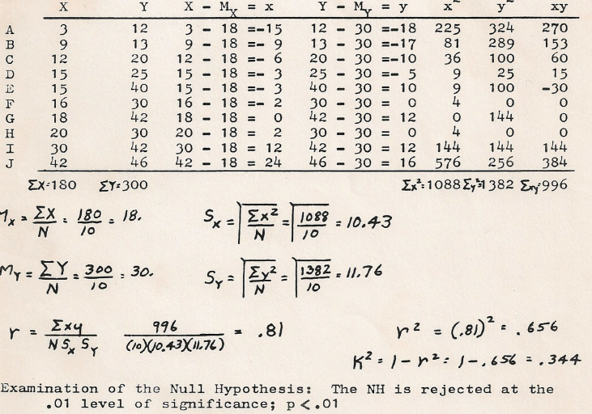
Required Computations

Slide 10
Simple Linear Regression
This form of forecasting or estimating is predicated on the degree of correlation that exists between the two variables being examined. Changes in the value of the independent variable [X] contribute to changes in the dependent variable [Y].
The greater the correlation coefficient, the higher the degree of association between the two variables and the more likely the forecasted value of Y will be based on a shift in the value of X.
The formula for Simple Linear Regression is really quite simple, and is expressed as;
Y’ = a + bX1
where Y’ is the predicted value of the dependent variable,
[a] is the slope intercept or the point where the regression line crosses the Y axis
[b] is the regression coefficient or the multiplier to be used for a prediction beyond measured ranges.

Slide 11
Simple Linear Regression
The example provided below represents how to use Simply Linear Regression to forecast the number of robberies expected to occur in a jurisdiction based on an increase in the number of liquor licenses issued within that same jurisdiction. Let’s assume that the correlation coefficient for this comparison is .81 and the Standard Deviation (SX) of X is 10.43 and the Standard Deviation (SY) of Y is 11.76.
We also need values for the Mean of X (30) that represents the average number of liquor licenses in the regions we examined and a Mean for Y (Average Number of Robberies) which we will assume was 18.
The following regression formula would be adjusted with these values but first we have to compute the iterative statistics for [b] and [a]….
Y’ = a + bX1
b = Pearson’s r times SX divided by SY, or (.81) x 10.43/11.76 = .81 x .886 or .91
a = MX – My x b = 30 – 18 x (.91) which would compute to 13.6
Now we are prepared to calculate any projected robbery frequency based on a shift in the number of liquor licenses issued.
If we presume that the City Planning Commission had approved 50 new liquor licenses within the city we could compute the expected number of robberies by creating a regression equation with that new value.
So the regression equation would become Y’ = 13.6 + .91 (50) 13.6 + 45.4 or 59.1 robberies for the year based on the issuance of 50 new liquor licenses.

Slide 12
Time-Series Analysis
Time-Series Analysis is a derivative of Linear Regression and uses Time as the Independent variable. The theory is simple and suggests that time contains all of the dynamics that normally occur within a jurisdiction and can be used to forecast future events based on linear growth.
The formula is the same Y’ = a + bX1, but the X variable becomes the next increment of time as opposed to the number of liquor licenses that we used in the previous example.
This is an exceptional powerful approach as long as crime is experiencing a linear growth pattern.

Slide 13
Time-Series Analysis
Year | Year Number | Reported Felonies
1970 | 1 | 1545
1971 | 2 | 1640
1972 | 3 | 1750
1973 | 4 | 1800
1974 | 5 | 1925
1975 | 6 | 1880
1976 | 7 | 1945
1977 | 8 | 1970
1978 | 9 | 2010
1979 | 10 | 2035

Slide 14
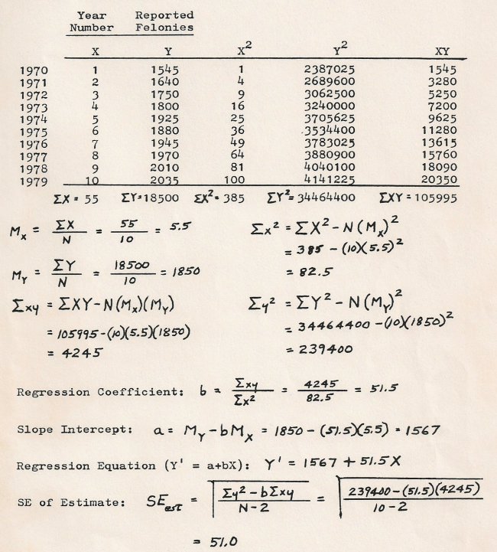
Time-Series Analysis

Slide 15
Seasonal Analysis and Forecasting
Seasonal forecasts of crime are based on Time-Series Analysis but represent slices of time that are congruent. The reason is because crime types and frequencies vary depending upon the season such as in the case of residential burglary in the summer which is a very different in its orientation than in the winter, fall, or spring.
As applied to residential burglaries, for example, we know that they increase during the summer months when children between the ages of 14 and 18 are out of school and unsupervised. Using a Time-Series Analysis and projection for an entire year would be ineffective if the objective was to design and implement a directed patrol operation that targeted residential burglary prevention. You certainly could forecast it for the upcoming year, but calculating four separate projections based on season might garner much more accuracy because the Standard Deviation would be less based on seasonal analysis.
Remember that regression is predicated on probability based on historical averaging and is only 68% accurate. You can apply Confidence Intervals or even Standard Deviations to provide the lower and upper range of the projection, but no matter how you structure the forecast, the lower the Standard Deviation, the more accurate will be the forecast.
You will find it advantageous to break crime forecasting down to even smaller increments such as weeks or days. This is especially helpful for directed patrol effectiveness assessment. By having minute time segments that represent equal time values (such as the first week of 2010 and the first week of 2011 to forecast the projected crime for the first week of 2013 you assure congruity. Obviously you need many more time slices to increase the accuracy of your forecast, but you get the idea.
BTW the minimum number of time sets that I use is 10 for any forecast. Fewer than that increases the value of the standard deviations and lessens the accuracy of the projection because it is not a true representation of history

Slide 16
Seasonal Analysis
Time Period | Period Number | Crime
Q4 - 2008 | 1 | 109
Q4 - 2009 | 2 | 125
Q4 - 2010 | 3 | 140
Q4 - 2011 | 4 | 170
Q4 - 2012 | 5 | 201
Forecasting the expected crime frequency for the 4th Quarter of 2013
can be accomplished using the same Time-Series approach that we
discussed previously.
Breaking the time element into a more actionable slice of time, gives
a level of specificity that coincides with the traditional operations planning
approach. Ideally all jurisdictions or patrol sectors would be assessed using
this approach and a determination of the areas where crime is expected
to exceed to level of tolerance is made. Enforcement assets are then
redistributed from other regions to the targeted area to impact crime.
Try computing the projected crime frequency yourself based on this data.

Slide 17
Seasonal Analysis
Time Period | Period Number | Crime
Week 1 – Dec 2009 | 1 | 43
Week 1 – Dec 2010 | 2 | 51
Week 1 – Dec 2011 | 3 | 57
Week 1 – Dec 2012 | 4 | 63
Under this configuration, the Time – Series method is focused
on fractional time slices to increase specificity in the forecast
and to minimize the Standard Deviation of large samples.
An important note is the congruity of the time periods. Essentially
they all represent the same slice of time (Week 1) for the past four
years. Using this approach you can forecast the upcoming crime rate
for Week 1 of December 2013 well in advance of its arrival and decide
if the forecasted crime level is acceptable or not, and what to do about
it before it happens. Try computing the forecast yourself and see what
crime frequency you come up with.

Slide 18
Crime Prevention Assessment
Since I mentioned directed patrol effectiveness assessment previously, we should look at this process more closely.
If, for example you forecast expected burglaries for a one week period, in a specific region to be 100, and you determine that this level of criminality is too high, then you can take positive steps to reduce the crime rate. Let’s presume that before that week happens you redirect patrol resources, from other jurisdictions and patrol areas, to that targeted region to elevate the police presence, and combine this action with increased public awareness through news media coverage that a directed patrol operation is underway using enhanced patrol coverage, undercover operations, air units, and a few other tactical enforcement strategies at your disposal, you would logically think that it should have an effect by reducing the frequency of burglaries in that jurisdiction because of deterrence.
If your forecasted burglary frequency were 100 and the actual number of reported burglaries experienced during the week were 35, then you could safely subtract 35 from 100 to discern that your actions prevented 55 burglaries from occurring.

Slide 19
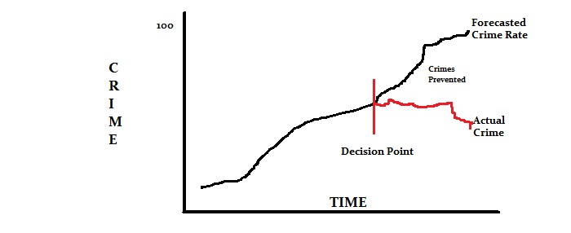
Crime Prevention Assessment

Slide 20
Range of Effectiveness
110 + 2 Standard Deviations
100
90 – 2 Standard Deviations
C R I M E
35 – Crimes Reported
Time

Slide 21
Cost-Benefit Analysis
Using the previous example you might also conclude that since the average loss per burglary is $2500 dollars per incident, then $2500 multiplied times the number of prevented occurrences (55) would result in a net loss prevention rate of $137,500 in savings to the residents in avoided loss.
You can even extend this dollar loss prevention calculation to a cost-benefit ratio by dividing the savings by the cost for added enforcement.
Let’s presume that our cost of enhanced enforcement was $50,000 dollars for the week. We would then divide $137,500 by $50,000 to compute a cost-benefit ratio of 2.75.
That means that for every dollar of cost over and above normal operations, we saved the residents of the community $2.75 in anticipated loss. Hopefully your computations would reflect a greater return on investment, but I thought that it would be helpful to keep the math simple so you can easily understand the process.
The important point here is also that you are well positioned to know when to scale back on added enforcement because the cost-benefit ratio will tell you that the program is no longer viable (relative to cost savings).
If for the first week you save the residents $37 dollars for every dollar over and above normal enforcement cost, and the second week you see a return of $15 dollars in cost-benefit savings, but the third weeks ratio drops to $1.25, then you know it’s time to move your forces elsewhere.
You can garner residual benefit form not telling anyone you are moving them and stepping up your public relations campaign to make people think it’s still in effect, but you get the idea that there is point in time when you have exploited the strategy for all you’re going to get out of it and you could move those assets elsewhere for a better return on investment.

Slide 22
Summation
Judge Hal Campbell, Ph.D.
Executive Director
The Justice Academy
hal.campbell@justiceacademy.org

