Slide 1
Verso Corporation Escanaba Mill
Environmental Health and Safety Visitor/Contractor Safety Orientation

Slide 2
Introduction
The information in this course is a representation of the general safety information necessary to safeguard your visit here at Verso’s Escanaba Mill.
Additional policies and procedures apply and must be followed. Consult with the Verso Designated Representative (VDR) responsible for bringing you to the mill to determine if additional specific conditions must be addressed.
Everything in this presentation applies to all Verso employees, visitors, contractors, vendors, customers and consultants while working for Verso’s Escanaba mill or on any Escanaba mill owned working properties.

Slide 3
Objectives
Verso EHS Policy
Safety Training Requirements
Workplace Conduct Expectations
Mill Policies
Test

Slide 4
Verso’s EHS Policy
Verso Corporation is committed to protecting human health, the environment and to utilizing resources in a responsible and sustainable manner. This commitment applies to each employee, our contractors, visitors, and to the communities in which we operate.
We, as employees of the Escanaba mill, demonstrate this commitment by accepting personal responsibility for working safely and operating the mill in a manner that minimizes its impact on the environment and our neighbors. In order to accomplish this, our daily activities are guided by a set of core values and beliefs.
We believe:
We are responsible for our own safety, the safety of our co-workers, visitors and contractors.
All accidents are preventable.
Putting ourselves or others at risk is a violation of trust.
The mill will be operated in a manner that minimizes its impact on the environment.
We commit to:
Comply with all safety, health and environmental regulations and policies, going beyond the letter of the law when necessary to protect human health and the environment.
Create a workplace free of occupational injuries and illness by addressing unsafe behaviors and conditions.
Work to eliminate environmental incidents and minimize our impact on the environment.
Continuously improve by integrating safety, health and environmental strategies into our daily operating decisions and long-term business plans.
Manage forest resources in a manner that complies with industry’s Sustainable Forestry Initiative and enhances a balance between future productivity and bio-diversity.
Communicate openly, honestly and with integrity with all stakeholders on all safety, health and environmental issues or concerns.

Slide 5
Safety Training Requirements
It is the responsibility of the contractor to assure that its team members meet the training requirements of the Michigan Occupational Safety and Health Administration (MiOSHA) and ensure the proper safety training is current and documented as per local, state and federal regulations.
Contractor Management shall certify that all their team members have been informed of the safety, health and environmental policies/procedures of the Escanaba Mill and understand the need to comply with them.
Any sub-contractors brought on site must also receive all of the information from this safety orientation. It is the responsibility of the lead contractor to make sure each sub-contractor has taken the mill’s contractor orientation.

Slide 6
Workplace Conduct Expectations
Verso Corporation has expectations of acceptable conduct in the workplace. Any conduct that is unlawful and/or threatens the welfare of any person, the facility and/or the company may be considered a violation and should be reported to the Loss Prevention Department (mill extension 2676).
The following items are strictly prohibited and will not be tolerated under any circumstances and will result in immediate removal from the premises.
Theft or unauthorized removal of possessions or property of Verso or others; fraud or any misrepresentation and/or omission of information relative to a mill/company policy, procedure or practice.
Reckless behavior resulting in damage/destruction of company property and/or the property of anyone on Verso’s Property.
Harassing actions, comments, inappropriate physical contact, sexual advances or any other conduct that is intimidating or otherwise offensive or hostile.
Violation of established safety or company rules, policies or procedures or bulletin that defines workplace conduct.
Threats or acts of retaliation or retribution against anyone who makes use of a complaint procedure or anyone who provides information about such complaints.
Any conduct that is unlawful and/or directly or indirectly threatens the welfare of any person, the facility and/or company.

Slide 7
Mill Policies

Slide 8
Mill Policy - Traffic
Railroad Crossing
Trains move frequently through the millsite so always be aware. You must stop at all railroad crossings, do not rely solely on the lights.
Do not speed up in an attempt to beat a train to a crossing; the results could be tragic. Anyone that tries to "outrun" a train will be removed from the millsite.
It is imperative that you obey all traffic signs that are posted in your path of travel.

Slide 9
Mill Policy - Traffic
When Traveling on mill property:
Always come to a complete stop at stop signs.
The Mill Site Speed Limit is 15 MPH outside on mill roads unless otherwise posted. Inside the mill buildings the speed limit is 5 MPH or equivalent to a brisk walk.
Follow all designated walkways. Do not take short cuts, walk under cranes, or climb through trains or equipment.
Be aware that vehicles have the right away. Always make sure to have visual contact with operators, to make sure they see you before proceeding.
Do NOT enter motor control center (MCC) rooms or pass through red barricade tape unless authorized to do so.
Do NOT enter the chip pads, log deck, chip or bark reclaim areas in the Woodyard without prior approval from operations.

Slide 10
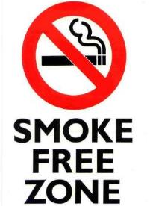
Mill Policy – Drug, Alcohol and Smoking Policy
Drug-Free Workplace
Verso’s Drug-Free Workplace Policy is to strictly prohibit :
The use, manufacture, distribution, dispensation, or possession of alcohol, drugs, or controlled substances while on the job or on company property.
Reporting to work under the influence of alcohol, drugs or unauthorized controlled substance present in one’s system.
Smoke-Free Workplace
Verso’s Smoke-Free Workplace Policy prohibits the burning of a lighted cigar, cigarette, pipe or any other matter or substance that contains a tobacco product throughout the entire facility.
Vaping and E-Cigarettes of any type and/or style are prohibited.
The use of smokeless chewing tobacco is not permitted in the E1 Paper Machine System or PS&D (Roll Shipping) areas due to FDA requirements.

Slide 11
Mill Policy – Weapons Policy
Prohibition of Weapons
The possession, carrying or use of weapons of any type on Verso property without the explicit authorization of Verso is prohibited.

Slide 12
Mill Policy – Lock Out
The term "Lockout" has been expanded to include all potential sources of energy - electrical, mechanical, hydraulic, pneumatic, chemical, etc.
Whether it is an single point lockout or group lockout, you need to ensure all energy sources are locked out and proven safe before work begins.
You must apply your own lock to any/all lockout(s) prior to working on/in the equipment. Never apply or remove anyone else’s lock or allow someone else to apply or remove yours.
Never cut a lock off without approval from Loss Prevention (mill extension 2676).
All contractor/visitor locks must have the following information on them:
The person’s name
The company name
The person’s phone number

Slide 13
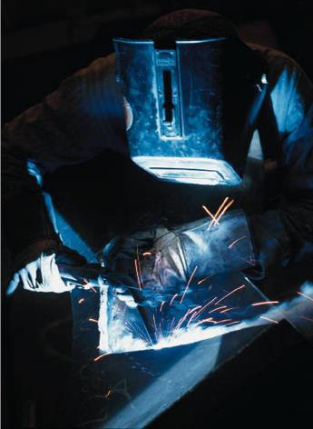
Mill Policy – Hot Work
All hot work introduces a potential ignition source.
Hot work is classified as brazing, cutting, welding, soldering, thawing pipes, using torches to apply roofing, grinding or any operation that involves open flame or sparks.
All hot work must be performed under a hot work permit. These permits must be filled in completely by the individuals performing the hot work and signed by the VDR responsible for the work.
It is very important that we take extreme caution keeping combustibles at least 35 feet away from the work and have an adequate water supply to extinguish an incipient stage fire.

Slide 14
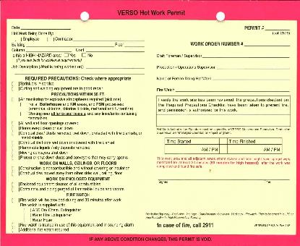
Mill Policy – Hot Work
Hot Work Permits are to be placed in any area hot work is taking place (visible to others).
A Fire Watch must be assigned to the job (including all floor levels exposed to the hot work, above and below) and must be easily identifiable.
Multiple Fire Watch personnel may be necessary.
A Fire Watch is required while the hot work is taking place AND 30 minutes after the hot work has been completed (60 minutes for high hazard areas)
Fire Watch cannot serve dual roles (such as confined space attendant) and cannot leave the area until specified time has ended.
NO non-work related cell phone use is permitted.

Slide 15
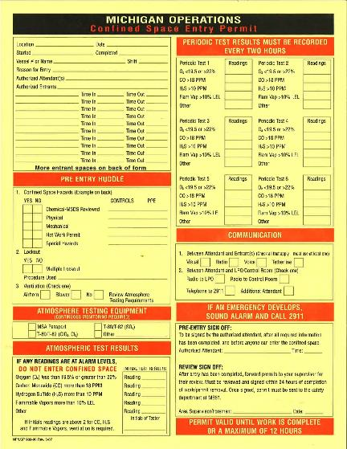
Mill Policy – Confined Space Entry
Many different kinds of confined spaces are found at the Escanaba mill. For example: storage tanks, manholes, pulpers, boilers, conveyor pits, etc.
A confined space must meet all of the following criteria:
It is large enough to allow an employee to bodily enter and perform assigned work;
It has limited or restricted means of entry or exit; and
It isn't designed for continuous occupancy.
All entries into confined spaces must take place under a confined space entry permit.
Do not leave any fields empty on the form, print “N/A” if not applicable.

Slide 16
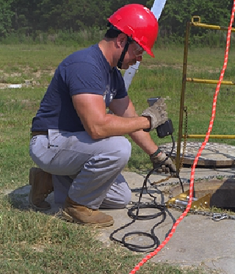
Mill Policy – Confined Space Entry
Attendant Responsibilities:
Call the Loss Prevention Department to report entry into a confined space prior to entering.
Call for help if issues arise inside or outside of the space (for emergencies, call 2911 or 906-233-2911 from a cell phone).
Must be trained as an “Authorized Attendant”.
Maintain constant communication w/entrants to ensure individuals and conditions are safe.
Ensure entry in/out log is accurate at all times.
NO non-work related cell phone use is permitted.
Cannot do confined space work or serve duel roles.
Must stay at the confined space location whenever the space is occupied.
LOSS PREVENTION DEPARTMENT
Mill Phone Extension: 2676
Cell Phone Line: 906-233-2676

Slide 17
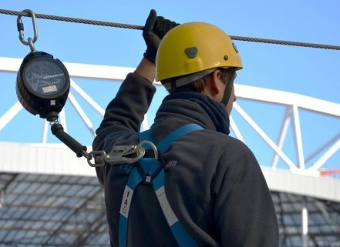
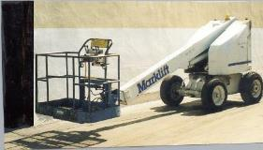
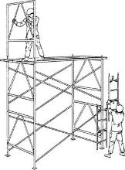
Mill Policy – Elevated Work
Elevated work is any work taking place 4 feet or more above the working surface for general industrial work. At this height a worker needs to be tied-off or otherwise protected from an unprotected fall hazard (use of barriers, scaffolding, etc.).
The equipment must be inspected prior to use and the worker(s) should be protected prior to reaching the 4’ height. If equipment is found to be defective or damaged, it must be removed from service immediately. All equipment must be industrial grade and clearly marked to identify the owning company.
Workers are required to be tied-off in any aerial lift platform.
It is critical that ladders and scaffolding used for elevated work be free of defects and must be in good working order. Portable ladders must be held by a co-worker or tied-off to something.
All scaffolding must be tagged prior to use with the inspection date noted and assembled/disassembled by trained team members.

Slide 18
Mill Policy – Line Breaking
It is the policy of the Escanaba Mill that all individuals involved in initial line breakage and equipment opening, for any reason, shall comply with the Line Breaking Policy.
When lines, pumps, vessels, tanks, or any other equipment are opened and/or disassembled and the potential exists for injury due to the possible contents of the line or equipment, the Line Breaking Policy shall apply. If the closed system is a vessel or tank opened for the purpose of entry, the Confined Space Policy shall also apply.
A line breaking permit is required to be completed and followed in its entirety. Do not leave fields empty on the form, print “N/A” if not applicable.
Permit is to be displayed where line break and/or equipment opening is taking place.

Slide 19
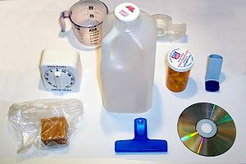
Mill Policy - Plastic
Plastic is a very highly damaging contaminant in the pulp and paper making process. We ask that you monitor and contain any plastic you bring in.
Please take the time to pick up any stray plastic you might see. This includes pens, sandwich bags, glasses, material wrapping or packing, or any other form of plastic.
If you notice any plastic getting into our system, immediately contact your VDR so we can minimize potential damage.

Slide 20
Mill Policy – Waste Disposal
Disposal of Batteries:
Do NOT dispose of batteries in mill trash. Bring all used batteries to the Storeroom (millwide location 33-054) and place them in the proper barrel (NiCad and alkaline batteries or lead acid, mercury and lithium batteries). These barrels are near the Storeroom window and clearly marked.
Disposal of Light Bulbs:
Do NOT throw light bulbs in mill trash. All used light bulbs need to be collected and stored in CLOSED containers. This program is managed by the mill’s electrical department. Contact your VDR for the closest drop-off location.
Disposal of Aerosol Cans:
Aerosol cans must be emptied AND depressurized prior to disposal. To do so, hold the nozzle down until you can't see or hear anything escaping, shake the can to be sure it is empty (no more than 3% remaining) and dispose with mill trash. Occasionally, an aerosol cannot be emptied because of a malfunction of the container or the nozzle. Try changing the nozzle to empty the can. If this still fails, take it to the Storeroom (millwide location 33-054) where it can be stored until properly disposed of.

Slide 21
Mill Policy – Radioactive Materials
Radioactive Material
There are a number of sealed radiation sources located at the Escanaba Mill. These sources are primarily tank level gauges, flow meters, and density gauges. These sources should not present any hazard to you.
All of the mill sources have signs on them that read "Caution, Radioactive Material." The mill also has a Radiation Safety Program to help ensure the safe operation of our gauges.
If you are near a source and have concerns, please contact your VDR.

Slide 22
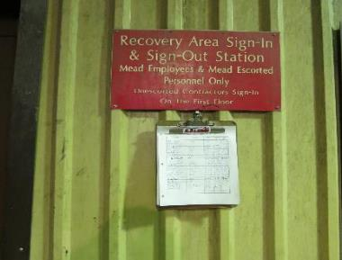
Mill Policy – Onsite Registration
All visitors to the Escanaba Mill must register at the front gate prior to entering and exiting the facility.
If you will be in the Recovery and Utilities (R&U) Department around the boilers or turbines, you must sign in at the control room located at the top of the stairs on the second floor. Notification is also needed if you are going into the Waste Water Treatment Plant (phone number is posted on their door).
If you will be in the Kraft Mill, you must sign in with the Kraft Mill control room. The control room is located on the 4th floor.
When in the Woodyard or Pulp Make Down buildings, you must check in or call the control room (phone numbers are posted on their doors).
Always inform each operating control room if you will be in their area for an extended period of time. This will ensure that you are made aware of any hazards which might otherwise be unknown, and improve communication during the course of your visit.

Slide 23
Mill Policy – Contractor Parking
Only Parking lots or areas that are designated for contractor parking shall be used. Parking passes are issued at the Back Gate.
Expect to have any packages or containers inspected when entering and exiting the property. This includes, but isn’t limited to, lunch pails, vehicles, tool boxes, etc.
Parking personal vehicles is only permitted in the fenced in area next to the contractor offices (Log Cabin), additional parking may be available during larger outages. Some company vehicles are permitted on the millsite (with prior approval).

Slide 24
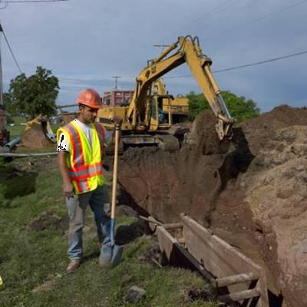
Mill Policy – Excavating & Trenching
All excavation work taking place on the mill site must follow the procedures in the mill Excavation Policy. This includes initial research to determine the location of underground lines that may pose a hazard to the excavation work.
When the excavation area is left unattended for any period of time, lighting and the appropriate barricades must be utilized.
Your VDR or an Escanaba team member trained in excavation practices must review all of the preparations before the excavation can take place. The excavation permit is used to maintain this information.

Slide 25
Mill Policy – Electrical Safety
For Portable electrical equipment, all power cords shall be grounded with a three-prong type plug including extension cords.
Ground Fault Circuit Interrupters (GFCI’s) shall be utilized for all electrical equipment connections and must be tested prior to use.
Portable electrical equipment (including extension cords) are only permitted for temporary use and must be inspected prior to use to assure proper grounding.
Extension cords shall not run across aisles, doorways, stairs, or liquids.

Slide 26
Mill Policy – Compressed Air
Check hoses and couplings before each use. Only use hoses that are designed to handle compressed air.
All hose couplings must have a positive locking device.
Compressed air, used for cleaning purposes, is to be reduced to less than 30 psi when the nozzle end is obstructed or dead-ended. Safety glasses with side shields must be worn during this type of operation.
The use of compressed air to clean you or co-workers is strictly prohibited.

Slide 27
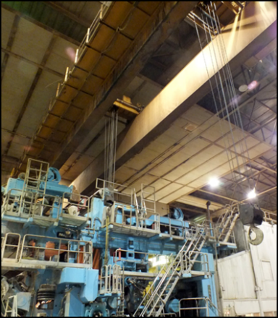
Mill Policy - Overhead Cranes
There are many hazards associated with overhead cranes and strict safety practices must be observed by both crane operators and anyone in the vicinity.
The primary rule of crane operation is never go under or allow anyone under a suspended load for any reason.
All equipment used for rigging including the crane should be inspected for defects before use. Defective equipment must be removed from service immediately.
Never rationalize that you can use damaged rigging equipment because the "load isn't that great" or "you only have one more lift" to complete the job.
Operators must always make sure that material being lifted is safely and properly rigged and the path and destination for the load is clear of obstructions and personnel.
Make sure you have a clear path of travel and watch where you are going if you need to walk along with the load. You must be able to see the load, hooks, etc. A “Spotter” must be utilized whenever the operator has limited sight due to the load or obstructions in the area.
Only personnel trained in how to properly operate an overhead crane are allowed to use the crane.

Slide 28
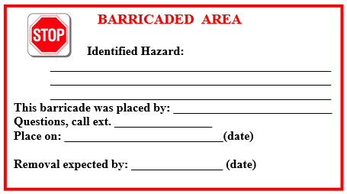
Mill Policy – Flagging & Barricading
Barrier Tape
Red Barrier Tape (Example: “DANGER DO NOT ENTER”) is intended for use when there is an imminent danger that no untrained, unequipped, unauthorized person is to be exposed to.
Yellow Barrier Tape (Example: “CAUTION” or “CAUTION-WORKERS ABOVE”) is intended to control access and warn people of a potential danger they need to be aware of before they proceed beyond the tape, or request permission to proceed.
Barrier tape must be cloth only – no plastic.
Barrier Sign
A barrier sign/tag is a communication device that informs anyone confronted with the barrier tape:
Who installed it
Why is was installed
When it was installed
Estimated duration

Slide 29
Mill Policy - Personal Protective Equipment
Hard Hats
An American National Standards Institute (ANSI) Z89 approved hard hat is required to be worn in all operating areas (inside and outdoors) other than an office, a control room, or rest room.
A hard hat will be issued to visitors upon registering with Loss Prevention.
The brim of the hard hat must be worn facing forward. This offers additional eye and face protection in case of overhead spills or falling objects.
The only exception to wearing a hard hat is when the hard hat itself creates a hazard, such as the risk of it falling into a paper machine (while running).

Slide 30
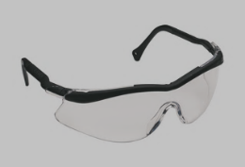
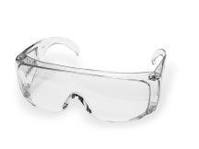
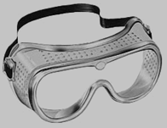
Mill Policy - Personal Protective Equipment
Eye Protection
ANSI Z87 approved safety glasses are required on the millsite in all operating areas, from the Front Gate turnstile to the Back Gate. Rigid side-shields are required on all safety glasses. Shaded safety glasses are allowed in outside areas only.
It is important that the safety glasses you select provide a tight fit on your face. This will minimize the chances for you to suffer an eye injury due to a foreign body. If you do not already have safety glasses, an approved pair will be issued to you upon your registration with Loss Prevention.
Some operations may require you to use specialized eye protection (examples include grinding where a full face-shield would be required in addition to safety glasses, working with chemicals that may present an eye hazard would require the use of chemical splash goggles.)

Slide 31
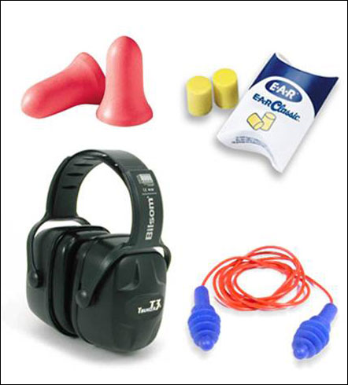
Mill Policy - Personal Protective Equipment
Hearing Protection
Hearing protection is a required piece of PPE. The foam style ear plugs offer you the best protection from noise if they are properly inserted.
Hearing protection is mandatory in all operating areas (inside and outdoors). Ear plugs will be issued to you upon your registration, if you do not have any.

Slide 32
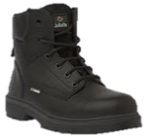
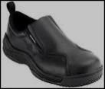
Mill Policy - Personal Protective Equipment
Foot Protection and Clothing
The Escanaba mill requires that all non-mill personnel wear safety shoes or boots when working onsite.
Non-safety shoes are permitted for visitors or mill tours, not performing “work”.
Open toe/open heel shoes are not permitted on the millsite at anytime (including the parking lot).

Slide 33
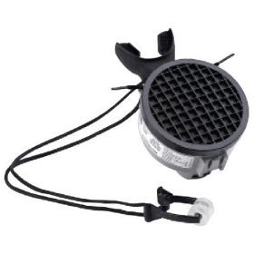
Mill Policy - Personal Protective Equipment
Respirator
A personal escape respirator must carried with you while in the Fiberline and Recovery and Utilities (R&U) areas.
If alarms sound and lights are activated, the escape respirator must be donned and you must evacuate the area immediately.

Slide 34
Mill Policy - Personal Protective Equipment
Glove Policy
Team members must carry a pair of gloves (most commonly required in their work area) on them at all times (when not on their hands).
Glove selection shall be based on performance characteristics of the gloves, and the hazards and conditions present at the point of use.
It is unacceptable to wear gloves while working around moving equipment or operating a rotating machine tool (ex; lathe, drill press, etc.).
Team members must wear gloves for every task, unless the gloves create a hazard.

Slide 35
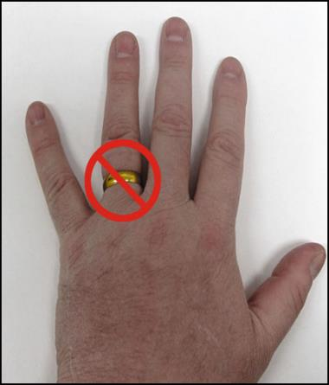
Mill Policy - Personal Protective Equipment
Jewelry
No jewelry is allowed to be worn when in a mill operating area except when just passing through an area (on a tour). The Administration Building is not considered a “mill operating area.”
Jewelry includes, but is not limited to, dangling necklaces and earrings, wrist bracelet, wallet chains, etc.
Wrist watches that have bands that continue under the watch face are not allowed on the manufacturing floor. Any watch with break-away pins are acceptable.
Rings shall not be worn while on the millsite. This applies to the entire Escanaba facility.

Slide 36
Mill Policy - Personal Protective Equipment
Clothing Requirements
Shirt or blouse covering the entire upper torso with sleeves covering the shoulders. The shirt or blouse must be solid material; no fishnet-type materials are to be worn.
Full length slacks or jeans and must be worn at all times.
Clothing is to be a first line of defense/protection and needs to be maintained in good condition.
Members are not to wear loose fitting clothing (i.e. untucked shirt tails, baggy clothing, pants, etc.) or neck ties that can be pulled into nip points or caught on rotating equipment.
Pants and shirts with holes that reduce the barrier of protection are not acceptable.
Hair Requirements
Hair length cannot be worn below the collar in mill operating areas, except when just passing through an area. The exception applies only to office support and visitors folks.
Hair lengths extending below the bottom of the normal shirt collar must be contained by tying AND tucking inside a shirt or underneath a cap, hard hat, hair net or other suitable head covering (includes facial hair longer than 4 inches).

Slide 37
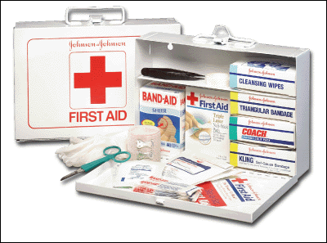
Mill Policy - Medical and Emergency Information
For emergencies, call 2911 (from a mill phone) or 906-233-2911 (from a cell phone) 24-hrs/day.
Should an injury occur to a contractor or visitor, please report it to your VDR and/or the mill nurse (phone ext. 2696 or location 52-120) asap.
If necessary, the mill’s medical first responders (MFRs) will respond to the scene and provide emergency care. Ambulance transportation to the hospital will also be provided, if needed.
All incidents need to be reported immediately to your VDR, per the mill’s Immediate Reporting Policy.

Slide 38
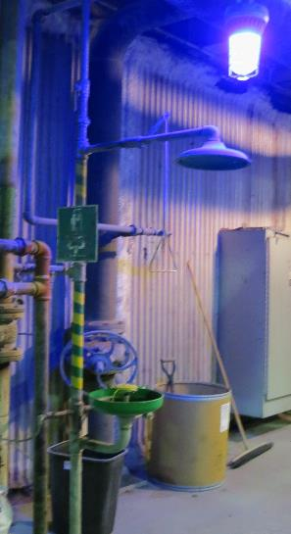
Mill Policy - Medical and Emergency Information
Safety Showers
There are safety showers and eyewash stations throughout the mill, identified by a blue light.
The effects of chemical spills can be greatly reduced by flushing with large amounts of water. Always locate the nearest safety showers and eyewash stations closest to where you will be working.

Slide 39
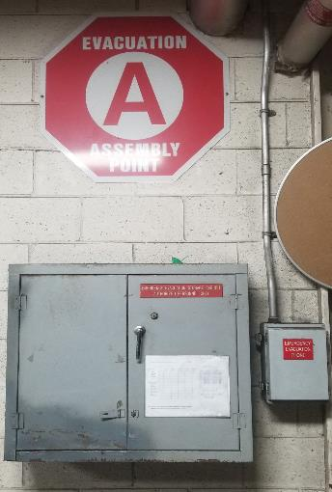
Mill Policy – Emergency Evacuation
If the evacuation alarm is sounded, stop what you are doing, shut off tools and equipment, and exit the building via the nearest evacuation route.
Discuss your evacuation route with your VDR prior to starting work.
Evacuation routes are posted throughout the mill.
If evacuated, meet at the designated assembly point, as posted on the evacuation maps.
Each company supervisor is responsible to account for their team members if an evacuation occurs. If someone is missing or cannot be accounted for, notify the Incident Commander at the evacuation point.

Slide 40
Mill Policy - Chemical Safety
The Escanaba Mill complies with the MIOSHA chemical hazard "right to know" standard by having a full compliment of Safety Data Sheets (SDS) for chemicals we use. The SDS give information for the properties, hazards and emergency response guidelines for the chemical. A hard copy of each SDS is kept at the Loss Prevention Front Gate.
Personal protective equipment, and other specific safety information is identified on tanks and containers with labels. Pipelines are labeled to provide you with contents and direction of flow. If you have any questions, contact your VDR.
Always take the time to become familiar with the alarm systems and exits in any area where you may be working. No matter where you are working, the potential exists for emergency evacuation. This could result from an emergency alarm being activated, or perhaps you think you smell something out of the ordinary, or someone from the operating department comes out and tells you that you need to leave the area.

Slide 41
Mill Policy - Chemical Safety & Alarms
Hydrogen Sulfide (H2S)
Gases such as Hydrogen Sulfide are sometimes formed by decaying stock or pulp. Hydrogen Sulfide can be released by accidental mixing of chemicals during process upsets or when initially opening process vessels or equipment.
To alert personnel to the possible presence of Hydrogen Sulfide, alarm systems are provided in those areas where H2S may be present.
Hydrogen Sulfide (H2S) Alarms
The mill’s kraft pulping process uses sulfur compounds and caustic soda. This process produces alkaline pulping liquors. Accidental mixing of these pulping liquors with acids is the greatest potential for the release of Hydrogen Sulfide which is also present in the wood digesting and liquor processing equipment vent gases.
H2S alarm systems are composed of a rotating beacon and an oscillating horn that are activated by sensors monitoring for H2S in suspect areas. When the alarm is activated, follow the instructions located on the sign adjacent to the alarm lights for your evacuation route. Suspect areas include:
Recovery and Utilities
The Lime Kiln
The Pulp Mill
Effluent Plant Mix Box
Waste Water Treatment
Any time you think you smell rotten eggs in a mill area, even if the alarm has not been activated, back out of the area and call 2911 (or 906-233-2911 from a cell phone) immediately.
H2S has the ability to totally eliminate your sense of smell as the concentration increases. At high concentrations, Hydrogen Sulfide can be very hazardous because you are unable to detect its presence.

Slide 42
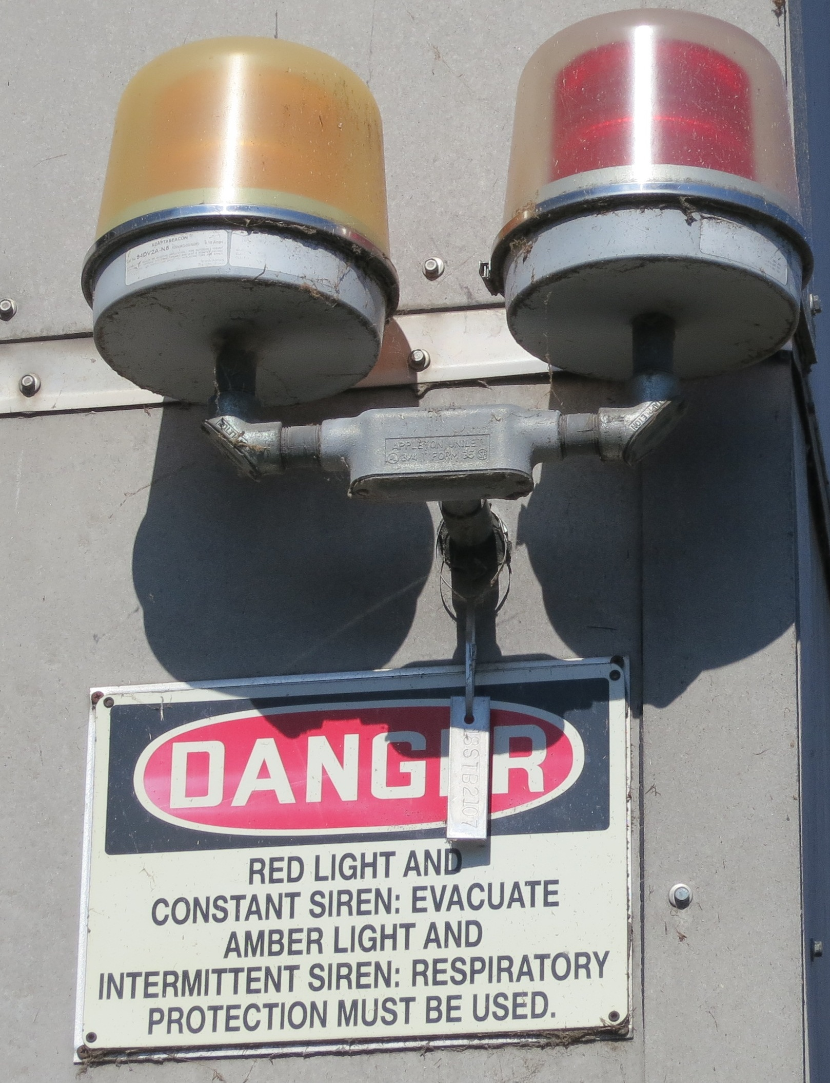
Mill Policy - Chemical Safety & Alarms
Chlorine Dioxide (ClO2)
To bleach our pulp, the Escanaba Mill uses Chlorine Dioxide; a chemical produced on site. Chlorine Dioxide is produced by the R8 Generator located in the Kraft Mill as a water solution and has a greenish yellow appearance.
The primary hazard from Chlorine Dioxide is inhalation of the vapors, acting primarily as an irritant to the respiratory system at high levels. While Chlorine Dioxide has a bleach-like smell, its odor is much less detectable. Chlorine Dioxide gas is approximately 2.5 times heavier than air, and will settle in low lying areas. It has a tendency to resist air movement and can form pockets. Alarm systems are provided to continuously monitor Chlorine Dioxide levels in suspect areas.
Chlorine Dioxide Alarms
The Chlorine Dioxide alarm consisting of sensors, red rotating beacons and sirens with a oscillating horn sound. Each alarm is accompanied by an instructional sign stationed below the beacons. If a beacon flashes and the alarm sounds, follow the instructions on the evacuation sign.
Suspect areas include:
Kraft Mill Chemical Prep/Generator, Bleach Plant, Kraft Mill Control Room,
Digesters (capping valve and blow heat floor)
Effluent Plant Mix Box, E1 Paper Machine Stock Prep, Acid Lift, Train Shed
Make sure to contact Loss Prevention (2911 or 906-233-2911) immediately if there is an alarm in your work area. Loss Prevention Officers will respond with SCBA and air monitors to see if chlorine dioxide is indeed present. Do not re-enter the area until advised to do so by Loss Prevention.

Slide 43
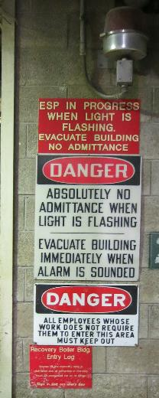
Mill Policy - Chemical Safety & Alarms
Emergency Shutdown Procedure (ESP)
The final emergency alarm is a specialty alarm located only around the area of the Recovery Boiler in the Recovery & Utilities Department. The Emergency Shutdown Procedure or ESP alarm is there to alert all personnel to evacuate immediately.
An ESP alarm indicates that water, known or suspected, is entering the boiler furnace and may make contact with the smelt, and that an emergency shutdown of the Recovery Boiler is in progress.
The ESP alarm consists of a red rotating light and continuous siren. The instructional sign located below the light, advises the nearest evacuation route. Upon activation, follow the instructional sign and evacuate the area immediately. Do not re-enter the area until cleared to do so by Recovery and Utilities (R&U) department management.

Slide 44
Mill Policy - Process Safety Management (PSM)
Required by OSHA regulation 29 CFR 1910.119, Process Safety Management of Highly Hazardous Chemicals is designed to prevent and control an accidental release of highly hazardous chemicals.
PSM Program Elements consist of the following:
Employee Participation
Process Information
Process Hazard Analysis
Operating Procedures
Employee Training
Contractor Safety
Pre-Startup Safety Review
Mechanical Integrity
Safe Work Practices
Management of Change
Incident Investigation
Emergency Planning
Compliance Audits
Trade Secrets

Slide 45
Mill Policy - Process Safety Management (PSM)
PSM processes at the Escanaba mill are:
Kraft Mill Chlorine Dioxide System (including Methanol)
Water Treatment Anhydrous Ammonia System
Water Treatment Chlorine Systems (Bay Station, Sanitary Plant and Water Plant)
Turpentine Recovery System

Slide 46
Mill Policy - Process Safety Management (PSM)
Chlorine Dioxide (ClO2)
“Boundaries” begin at the Chlorine Dioxide Generator, continue through the Chlorine Dioxide storage tanks and end at the addition of Chlorine Dioxide to the Bleach Plant mixers.
ClO2 chemicals include:
Sulfuric Acid, H₂SO₄
Sodium Chlorate, NaClO₃
Methanol, CH₃OH
In the liquid state, ClO2 is yellow and produces a strong chlorine odor.
In the gaseous state, ClO2 is yellow to green and produces a strong odor.
ClO2 is used in the R8 Plant and is produced by reaction of sodium chlorate, sulfuric acid and methanol, for use as the primary pulp-bleaching agent.
Hazards
Liquid: very toxic, burns to eyes and skin
Gas: severe respiratory irritant, dangerous at high concentrations
Reactive/Fire: highly explosive at high temperatures as a gas

Slide 47
Mill Policy - Process Safety Management (PSM)
Sulfuric Acid
“Boundaries” begin at the Chlorine Dioxide Generator, continue through the Chlorine Dioxide storage tanks and end at the addition of Chlorine Dioxide to the Bleach Plant mixers.
In the liquid state, oily, colorless, odorless.
Bulk storage for R-8 Plant, used with sodium chlorate, and methanol for production of chlorine dioxide the pulp-bleaching agent.
Hazards
Liquid: very corrosive to eyes and skin
Gas: respiratory irritant at concentrations in excess of 5 ppm
Reactive/Fire: Reacts with metals to produce explosive hydrogen gas and with water and organic materials to produce heat

Slide 48
Mill Policy - Process Safety Management (PSM)
Sodium Chlorate
“Boundaries” begin at the Chlorine Dioxide Generator, continue through the Chlorine Dioxide storage tanks and end at the addition of Chlorine Dioxide to the Bleach Plant mixers.
In the solid state, white to pale yellow crystals.
Sodium Chlorate is delivered dry and dissolved in water for the R8 Plant, used with Sulfuric Acid and Methanol in the production of Chlorine Dioxide.
Hazards
Solid: Contact irritant to eyes and skin
Liquid: Contact irritant to eyes and skin
Reactive/Fire: Reacts violently with strong acids/organic materials, dangerously combustible when liquid dries on/in clothing (use large quantities of water if sodium chlorate dries), strong oxidizing agent

Slide 49
Mill Policy - Process Safety Management (PSM)
Methanol
“Boundaries” begin at the Chlorine Dioxide Generator, continue through the Chlorine Dioxide storage tanks and end at the addition of Chlorine Dioxide to the Bleach Plant mixers.
In the liquid state, it is clear, colorless with alcohol odor.
Methanol is delivered to bulk storage as 100% liquid for the R8 Plant, used with Sulfuric Acid and Sodium Chlorate in the production of Chlorine Dioxide.
Hazards
Liquid: Contact irritant to eyes and skin, toxic if ingested
Vapor: Irritant to eyes at high concentrations (1,000ppm), toxic inhalation of repeated exposures or high concentrations
Reactive/Fire: Highly flammable vapors that burn with an invisible flame, no open flames or sparks, avoid contact with oxidizing agents

Slide 50
Mill Policy - Process Safety Management (PSM)
Anhydrous Ammonia
Used in Water Treatment Anhydrous Ammonia System
In the gas state, it is clear, colorless with a pungent odor.
Anhydrous Ammonia serves as a nutrient in the effluent area.
Hazards
Gas: Causes severe irritation and burns if absorbed into the skin, may cause frostbite, eye damage, blindness or conjunctivitis to the eyes. May be fatal if inhaled.
Reactive/Fire: Highly flammable vapors.

Slide 51
Mill Policy - Process Safety Management (PSM)
Chlorine
“Boundaries” start at the vacuum regulator, where Chlorine enters as a gas. From the vacuum regulator, Chlorine gas under a controlled vacuum, passes to the control module and then through a rotameter. A differential regulating valve is adjusted to control the Chlorine feed rate. From the control valve, the gas passes to the injector where it is mixed with water.
In the gaseous state, it is amber, greenish-yellow
Used to chlorinate waste water
Hazards
Gas: Causes severe irritation and burns if absorbed into the skin, corrosive to respiratory tract, could cause blindness, may be fatal if inhaled.

Slide 52
Mill Policy - Process Safety Management (PSM)
Management of Change (MOC) Process
MOC is the evaluation and approval of all changes specific to the PSM process.
Required for anything that is not a “replacement in kind.”
Requires evaluation and APPROVAL of temporary and permanent changes to covered processes BEFORE changes are made.
Ensures ongoing safety of the PSM covered processes.
Example of MOCs:
Change of material of construction (stainless vs. fiberglass, gasket material, etc.)
Piping modification
Pump size, pump style
Valve style (ball vs. gate valve)
Change in Fail Open/Fail Close
Change in department SOP
The MOC Form must be completed with input from Operations, Maintenance, Safety, Engineering, etc. and should include the description of change, review of impacts, approvals, documentation, and training.
The “Notification of Change” Form must be posted in the area and shared with the team.

Slide 53
Mill Policy - Process Safety Management (PSM)
Emergency Response
PSM requires the facility to have an Emergency Preparedness & Response Plan
Everyone must follow existing emergency procedures:
Call mill extension 2911 or 906-233-2911 from an outside line to report all emergencies
Describe the emergency in detail before hanging up
Loss Prevention, the Emergency Response Team (ERT), and the Medical First Responders (MFRs) handle all emergencies at the Escanaba Mill.
All emergencies must be reported immediately.

Slide 54
Test
It is the responsibility of the contractor to assure that its team members meet the training requirements of the Michigan Occupational Safety and Health Administration (MiOSHA) and ensure the proper safety training is current and documented. True or False
You do not have to stop at a railroad crossings unless you see flashing lights. True or False
The Mill Site Speed Limit is 15 MPH outside on mill roads unless otherwise posted. Inside the mill buildings the speed limit is 5 MPH (equivalent to a brisk walk). True or False
The following are part of the Escanaba Mill’s Smoke-Free Policy:
Burning of a lighted cigar, cigarette, pipe or any other tobacco product is prohibited.
Vaping and E-Cigarettes of any type and/or style are prohibited.
The policy applies to the entire facility.
The use of smokeless chewing tobacco is not permitted in the E1 or PS&D (Roll Shipping) areas.
All of the above.
All contractor/visitor locks must have the following information on them:
The person’s name
The company’s name
The person’s phone number
All of the above
A and D

Slide 55
Test
All hot work must be performed under a hot work permit. Permits must be filled in completely by the individuals performing the hot work and signed by the VDR. True or False
A confined space must meet all of the following criteria:
It is large enough to allow an employee to bodily enter and perform assigned work;
It has limited or restricted means of entry or exit; and
It isn't designed for continuous occupancy.
All of the above.
Elevated work is any work taking place ____ or more above the working surface for general industrial work. At this height a worker needs to be tied-off or otherwise protected from an unprotected fall hazard (use of barriers, scaffolding, etc.).
6 feet
4 feet
Any height
8 feet
When lines, pumps, vessels, tanks, or any other equipment are opened and/or disassembled and the potential exists for injury due to the possible contents of the line or equipment, the Line Breaking Policy shall apply. True or False
Contractors are responsible for disposing of batteries, light bulbs and aerosol cans as they see fit. True or False

Slide 56
Test
Contractor personal vehicles must be parked in the fenced in area next to the contractor offices. Contractor company vehicles are permitted on the millsite (with prior approval). Both require the appropriate parking pass issued at the Back Gate. True or False
When excavation work is left unattended for any period of time, lighting and the appropriate barricades are optional based on the hazards. True or False
The use of compressed air to clean you or co-workers is allowed as long as each person is wearing safety glasses. True or False
You may pass under a crane or suspended load, if given permission from the crane operator. True or False
Barrier Tape is intended for use when there is a hazard present. The tape and sign must be used to warn people of a potential danger. True or False
Which of the following statements are true:
Hard hats must be worn with the brim facing forward.
Safety glasses with rigid side-shields are required in all operating areas, from the Front Gate turnstile to the Back Gate.
Hearing protection is mandatory in all operating areas (inside and outdoors).
Open toe/heel shoes are not permitted on the millsite at anytime (including the parking lot).
Team members must carry a pair of gloves on them at all times and wear gloves for each task.
Rings shall not be worn while on the millsite. This includes silicone rings.
All of the above.

Slide 57
Test
Pants and shirts with holes are not acceptable. True or False
Which of the following statements are true:
Hard hats must be worn with the brim facing forward.
Safety glasses with rigid side-shields are required in all operating areas, from the Front Gate turnstile to the Back Gate.
Hearing protection is mandatory in all operating areas (inside and outdoors).
Open toe/heel shoes are not permitted on the millsite at anytime (including the parking lot).
Team members must carry a pair of gloves on them at all times and wear gloves for each task.
Rings shall not be worn while on the millsite. This includes silicone rings.
All of the above.
For emergencies, call 2911 (from a mill phone) or 906-233-2911 (from a cell phone) 24-hrs/day. True or False
If evacuated, each contractor is to report to the contractor parking area. True or False
A hard copy of each SDS is kept at the Loss Prevention Front Gate. True or False
Process Safety Management (PSM) is designed to prevent and control an accidental release of highly hazardous chemicals. True or False

Slide 58
Test
Name (print): |  | Phone:
Company: |  | Date:
1. | _____ | 12. | _____
2. | _____ | 13. | _____
3. | _____ | 14. | _____
4. | _____ | 15. | _____
5. | _____ | 16. | _____
6. | _____ | 17. | _____
7. | _____ | 18. | _____
8. | _____ | 19. | _____
9. | _____ | 20. | _____
10. | _____ | 21. | _____
11. | _____ | 22. | _____

